Slide 1
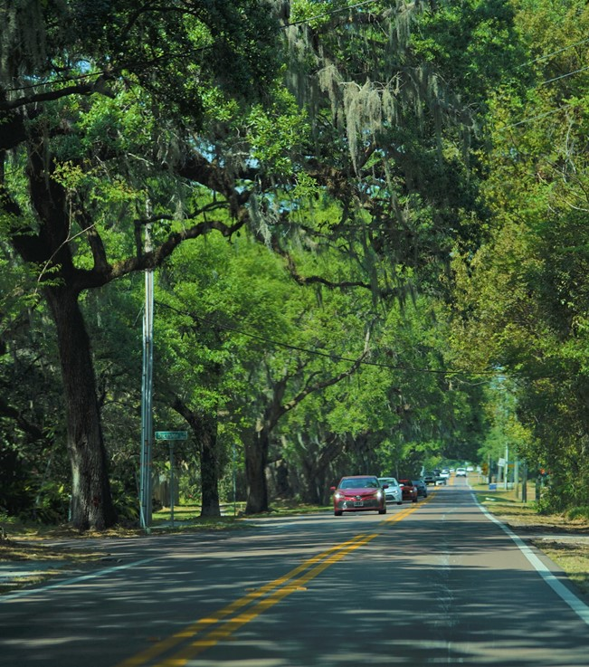
Valrico Community Plan
Open House
September 23 & 25, 2023
Mulrennan Middle School

Slide 2


Welcome!
The Valrico Community
Notes:
Add the year of the establishing legislature (1989)
Established by state legislature in the 1960’s, have been doing planning for the jurisdictions since that time.

Slide 3
Energy Industrial Park
SR 60
Plan Amendment process,
HC/CPA 23-15
Text Amendment
Timeline not established yet, applicant must provide additional information
Applicant will host community meeting, notice the community
Turkey Creek Road
Dover Road

Slide 4
Energy Industrial Park
SR 60
Questions?
Melissa Lienhard, AICP
lienhardm@plancom.org
(813) 547-4364
Jillian Massey
masseyj@plancom.org
(813) 565-9315
Turkey Creek Road
Dover Road

Slide 5
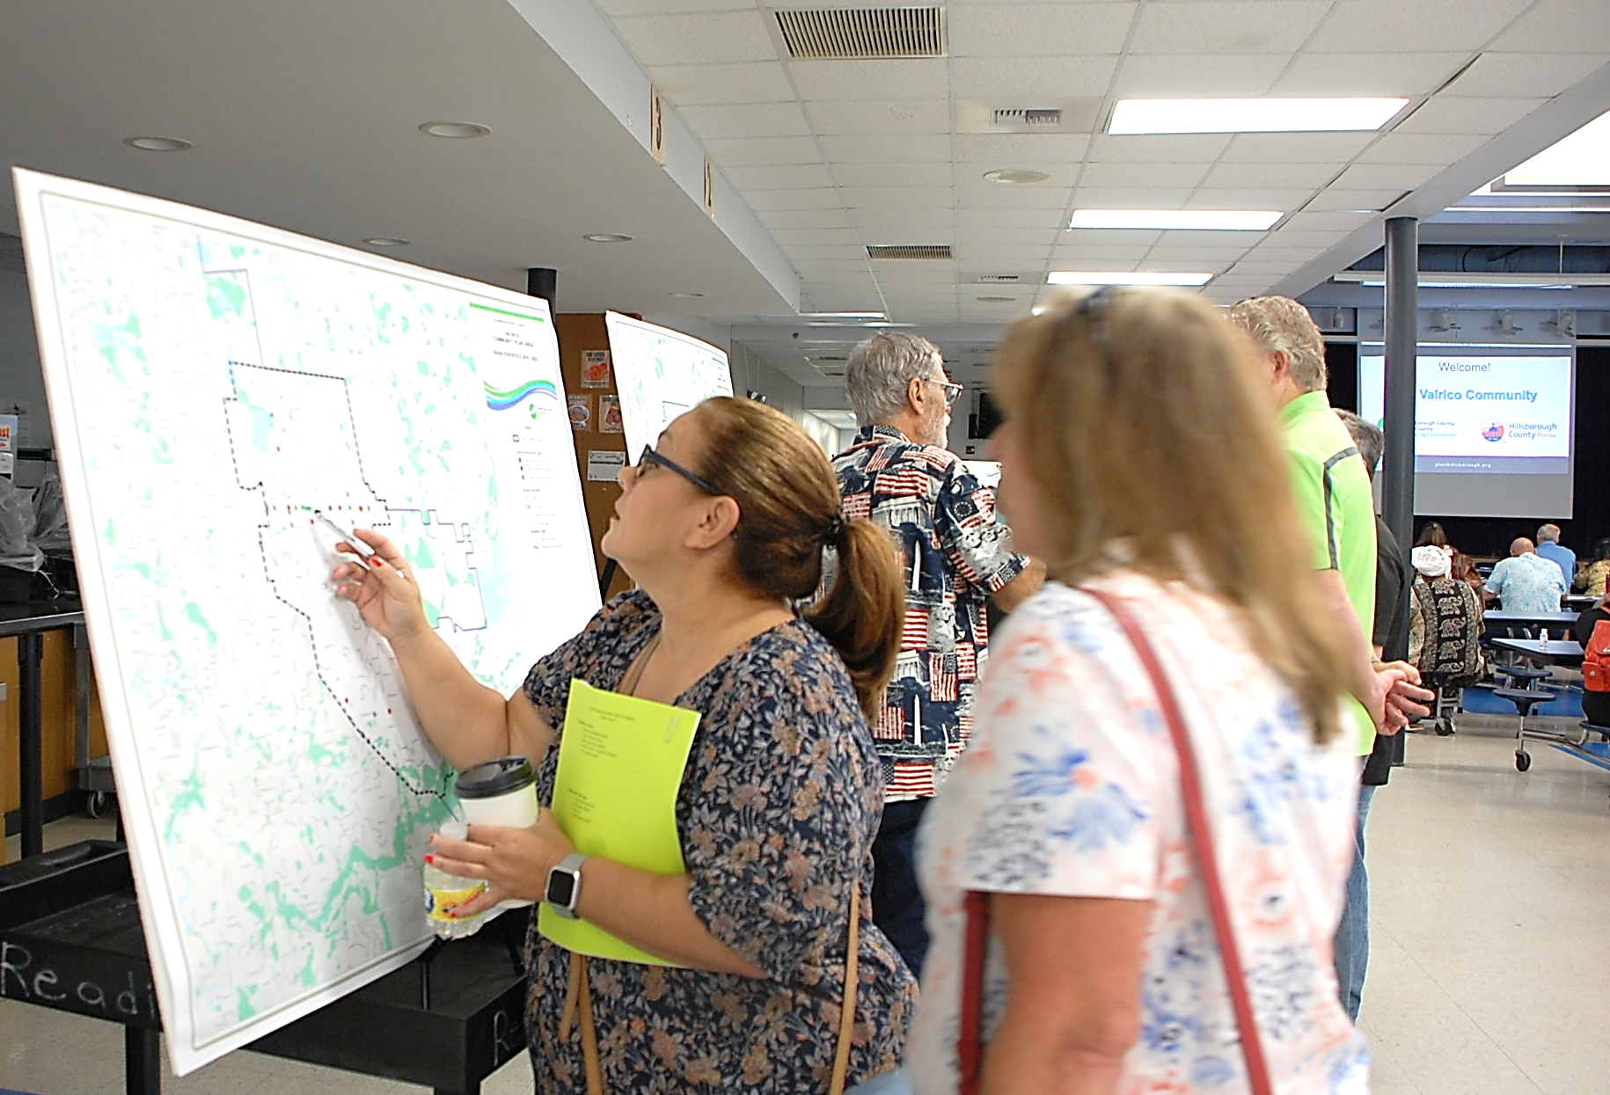
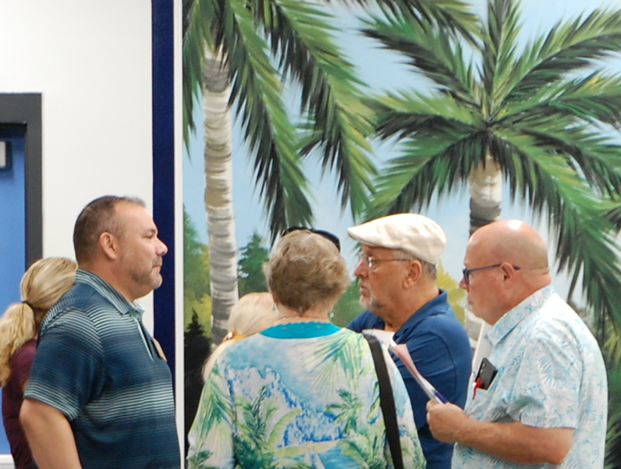
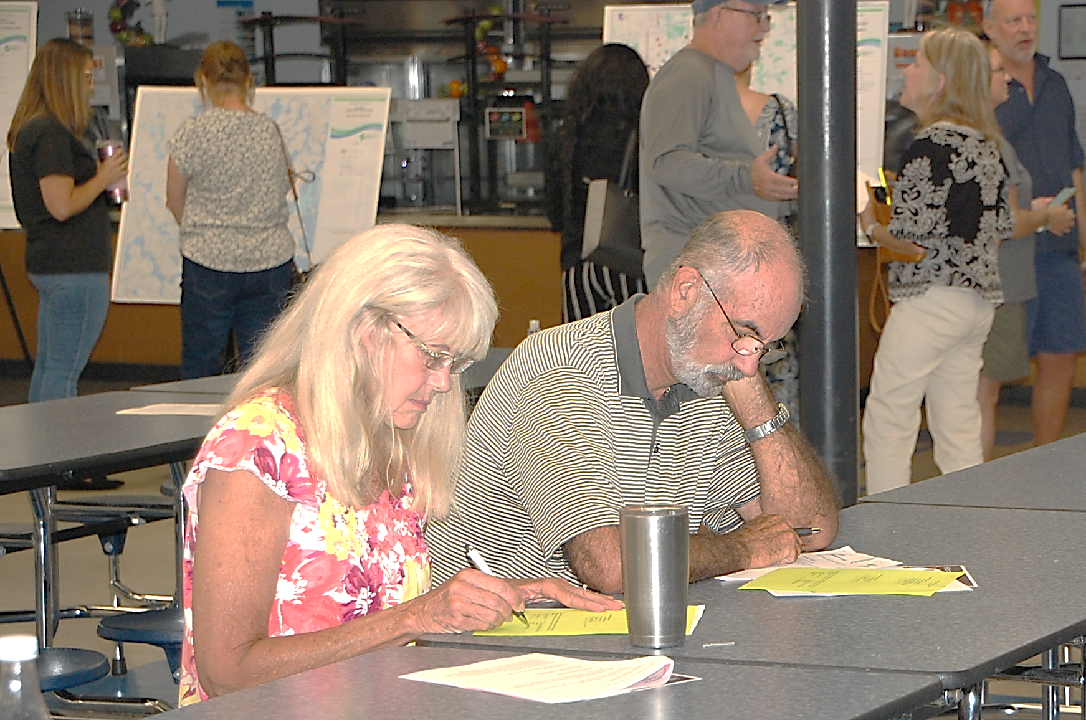
Recap from July
120+ participants in three community meetings
440+ survey responses
58 activity worksheets
14 comment cards

Slide 6
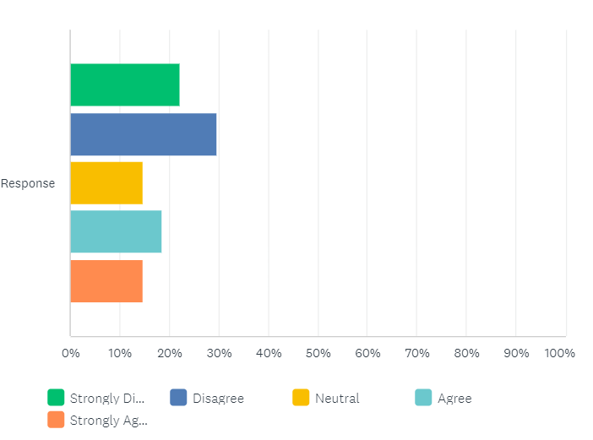
September Survey
70 survey responses
(as of 9/25)
Compiled feedback from July into statements for community reaction
Closing Oct. 8

Slide 7
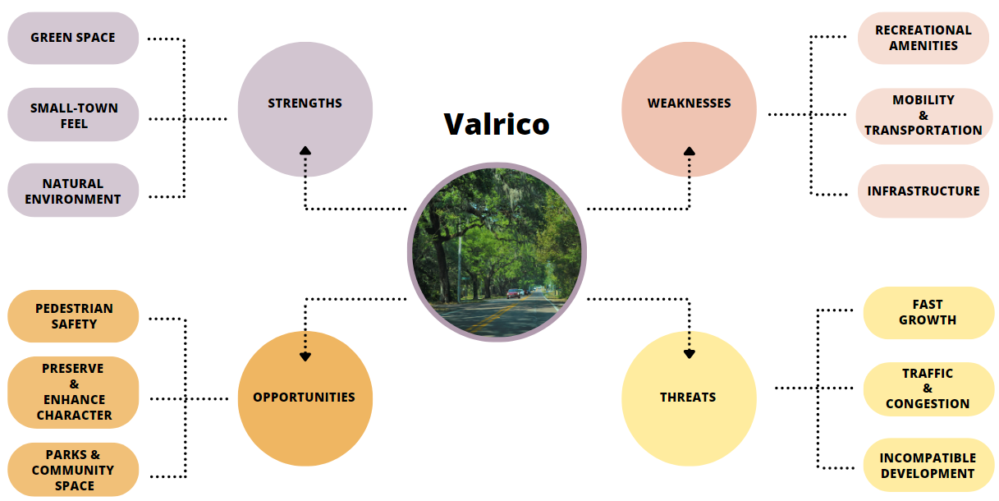
September Survey - SWOT

Slide 8
Your Feedback
Surveys
Meeting Discussions
Meeting Exercises
Maps
Parts of the Community Plan
Vision Statement
Community Concept Map
Plan Goals
Plan Strategies
Notes:
Use to visualize, advocate and memorialize their vision going forward
Use the CP to advocate for the Vision that the plan lays out.
Wimauma comp plan – community plan – code graphic
Used by Citizens in a variety of ways, some examples include, the community may find other ways of using it to create value.
Used by Citizens as a voice to continue the plan’s vision.

Slide 9
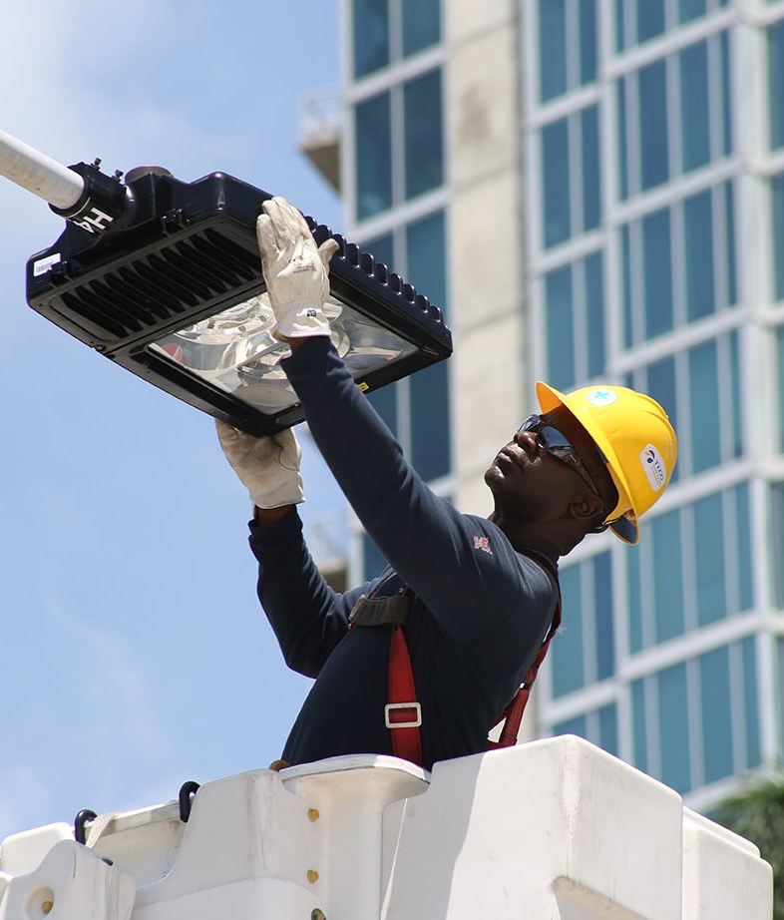
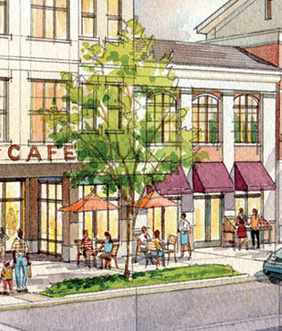
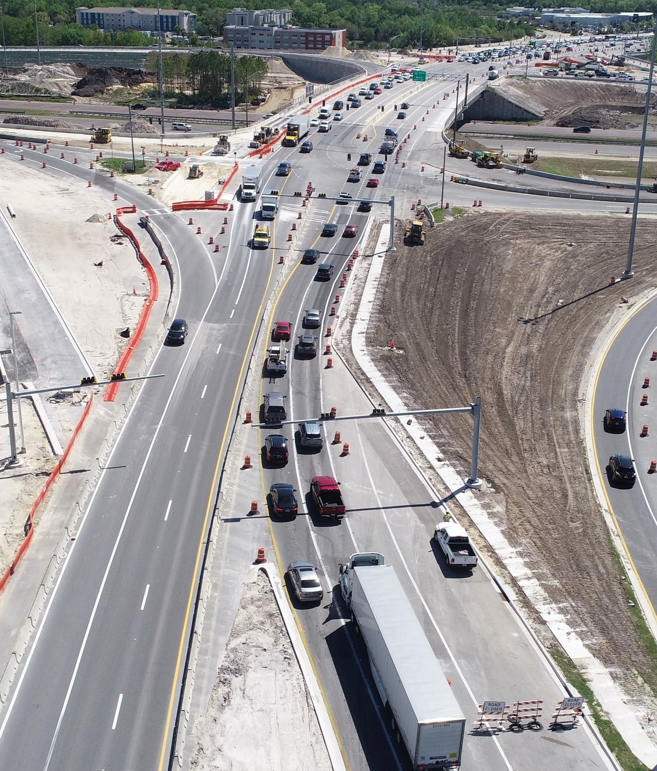
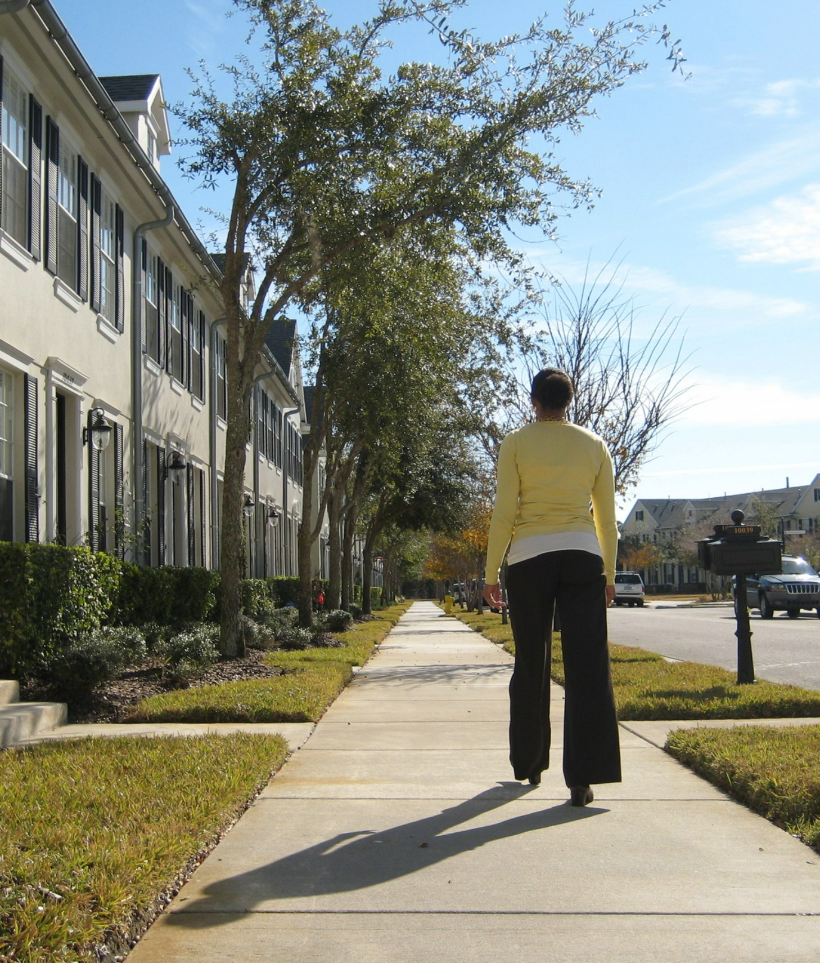
A Community Plan does not...
"Build" structures or specific businesses
Affect your school district
Change your address
Change your zoning or the land development code
Notes:
This is not a tool that is designed for a specific project to get done. It is to create a vision (does not widen roads, does not construct sidewalks)
If you own a piece of property and you want to change the zoning on it, this is not the process for that.
A community plan is not a catch-all, there will be issues that are raised that cannot be addressed in a community plan.
If you have comments and concerns about the community that cannot be covered by the community plan, that’s what these yellow cards are for.

Slide 10
A Community Plan...
Is a collaborative exercise
Provides a communication channel for the community
Gives you an advocacy tool
Informs new development
Notes:
This is not a tool that is designed for a specific project to get done. It is to create a vision (does not widen roads, does not construct sidewalks)
If you own a piece of property and you want to change the zoning on it, this is not the process for that.
A community plan is not a catch-all, there will be issues that are raised that cannot be addressed in a community plan.
If you have comments and concerns about the community that cannot be covered by the community plan, that’s what these yellow cards are for.

Slide 11
Comprehensive Planning in Unincorporated Hillsborough County
Comprehensive Plan
Livable Communities Element of the Comprehensive Plan
Valrico Community Plan
Vision, Goals & Strategies
Hillsborough County has created and maintained Community Plans for over 20 years
22 community plans, Valrico will be 23rd
Ensures development is consistent with the goals the Community expresses through this process
Notes:
Comprehensive Plan - An official document in ordinance form adopted by the local government setting forth its goals, objectives, and policies regarding the long-term development of the area within its jurisdiction.
Community Plan - A strategic plan that employs a public process to identify community assets, needs, and preferences, articulate a community vision for the future, and set goals and strategies aimed at resolving needs and achieving the vision. While it has required elements of Comp Plan, allows each community to choose its own path and establish goals. These 22 plans are housed within the Livable Communities Element. An extension of the comp plan, it deals with the same topics – Housing, Transportation, Land Use but how these topics can be more specifically looked at for Valrico.
*There is a transportation strategy for Hillsborough County – let’s talk about a transportation strategy for Valrico

Slide 12
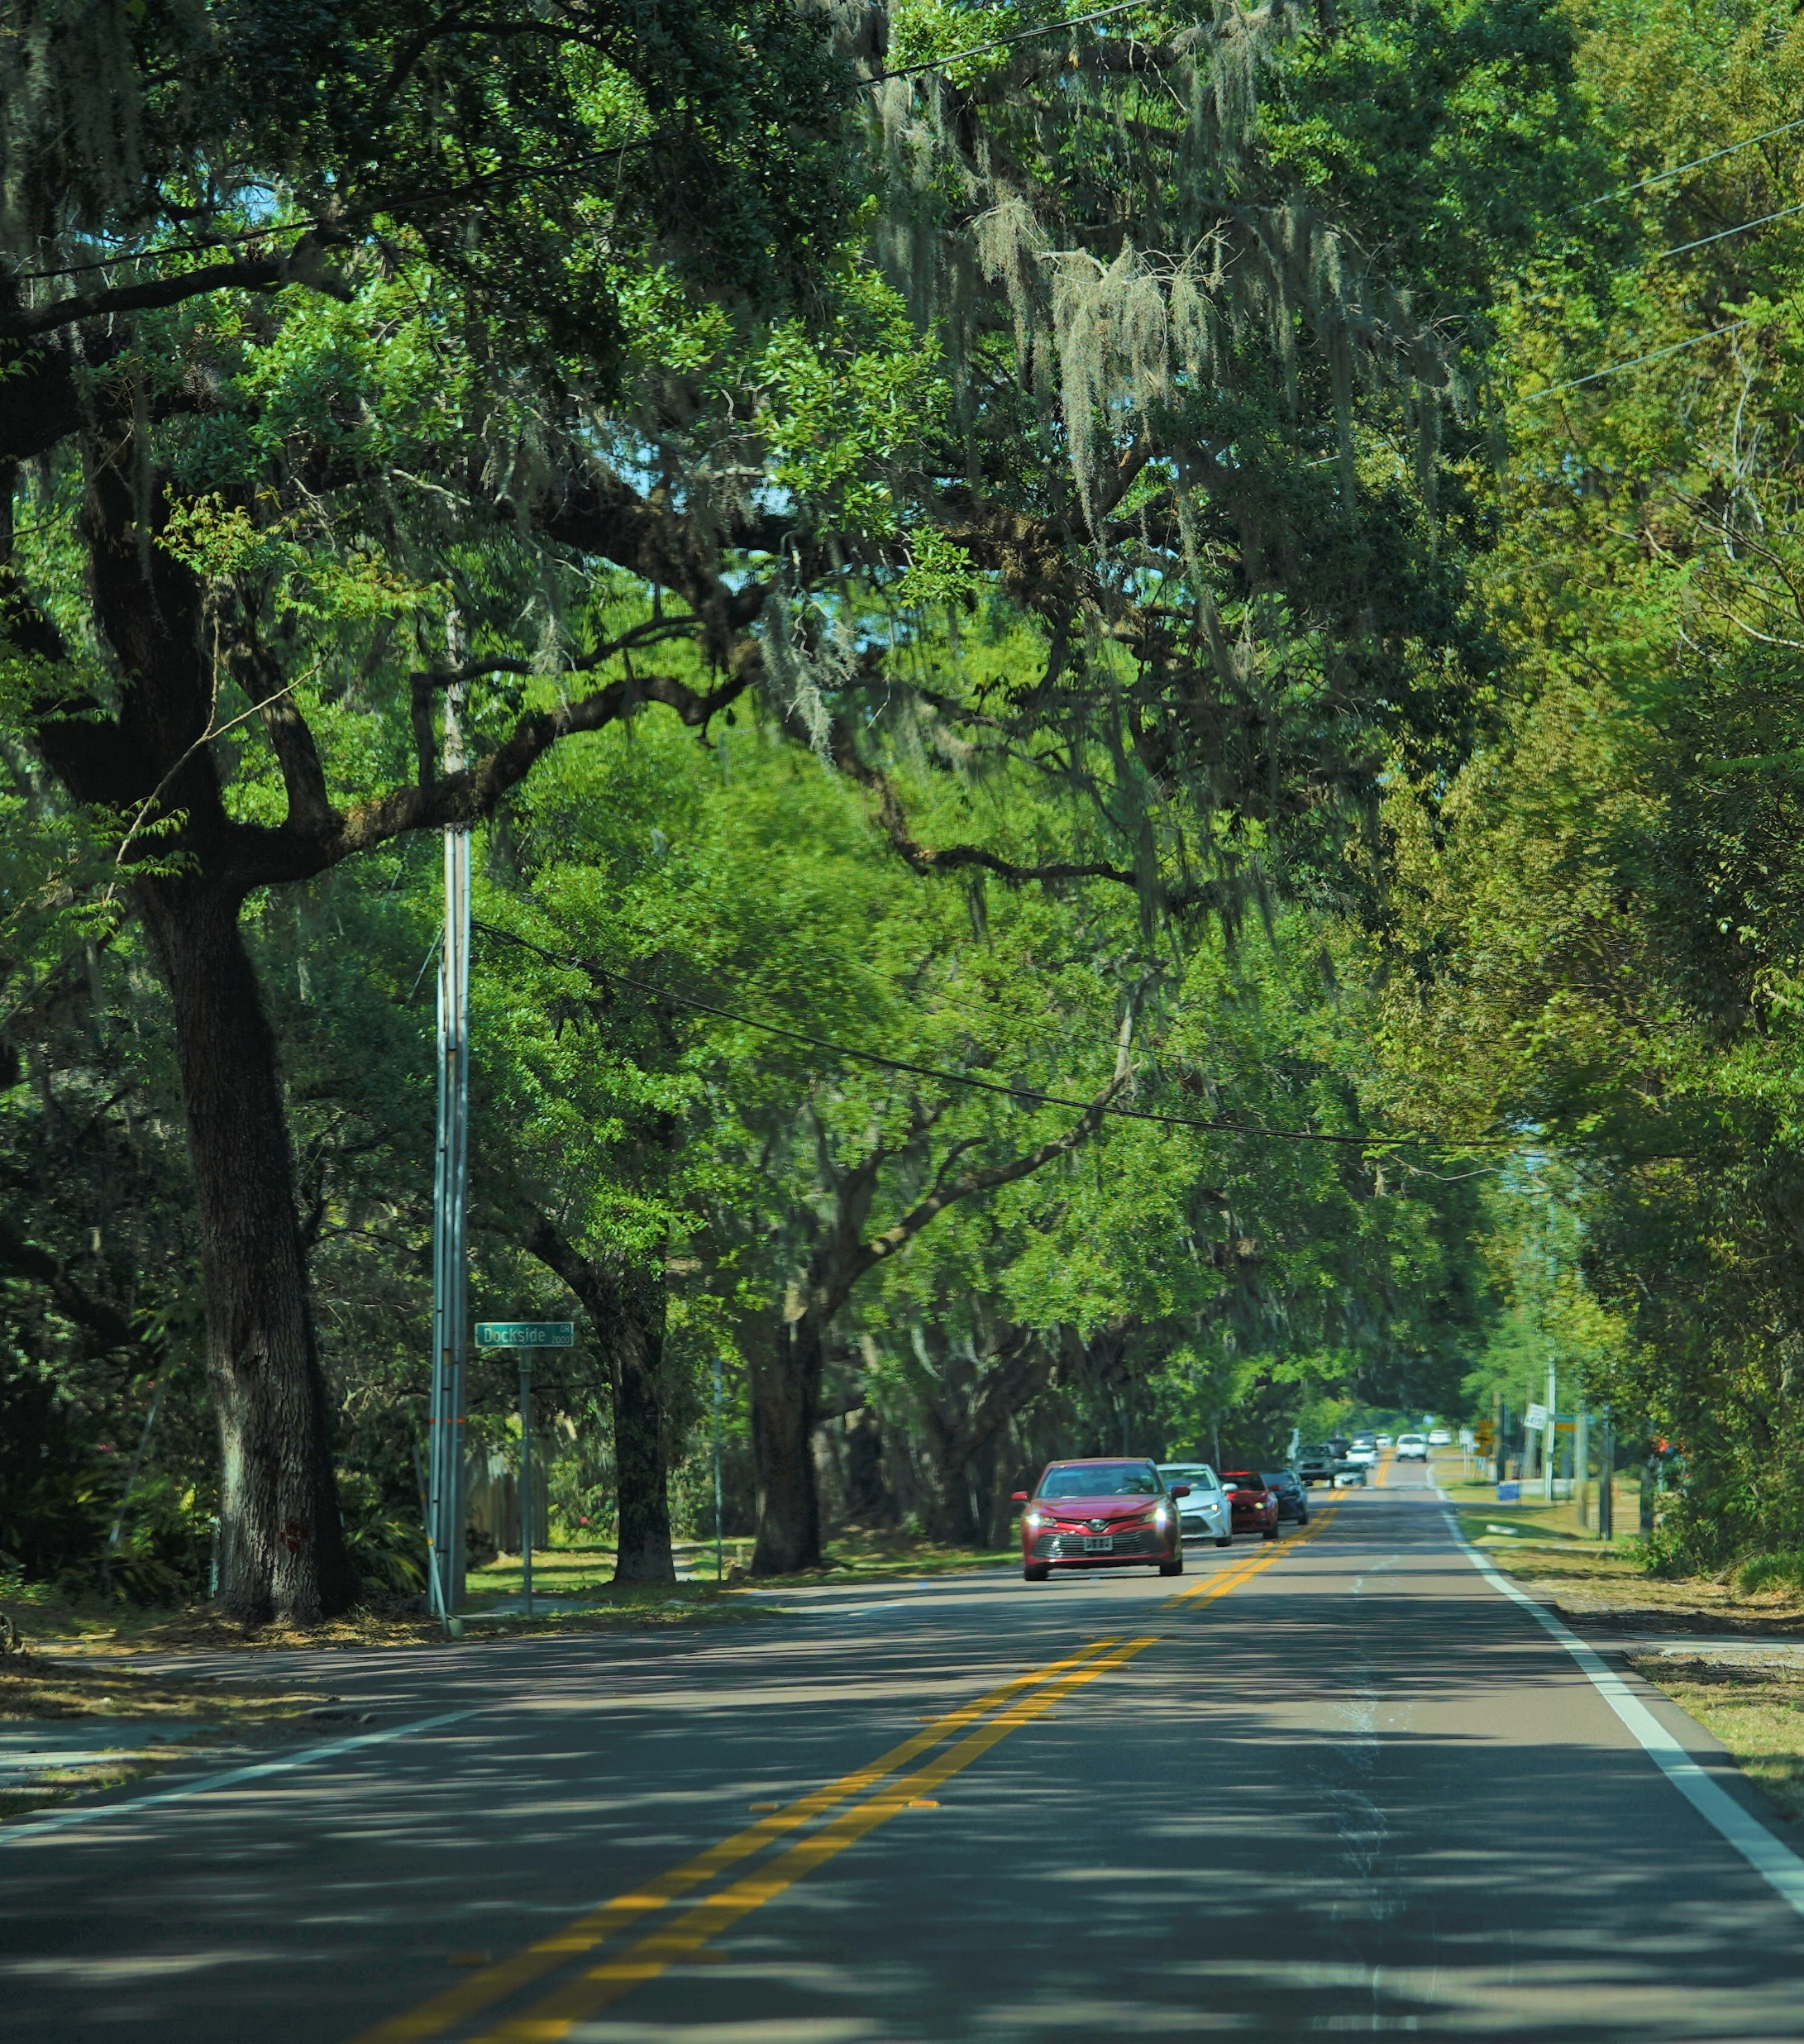
The Plan’s Vision is a community’s “view of the future.”
How does Valrico see itself in 5 years? 10 years?

Slide 13
September Exercises
Vision Exercise
1. Ad-Libs
2. Community Concept Map
Community Plan Boundaries Map

Slide 14
Vision Ad-Libs
How does Valrico see itself in 5 years? 10 years?

Slide 15
In 2033, Valrico’s community character will be reflected by walkable, connected spaces people can enjoy because the community plan has prioritized pedestrian safety and open space.

Slide 16
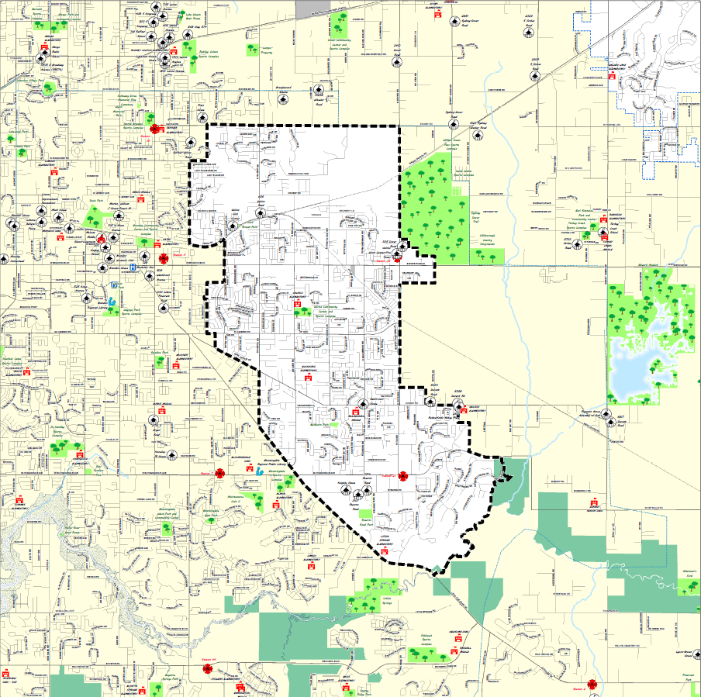
Concept
Map
Example
Historic
Downtown
Shopping area
Bike Trail
connecting
parks
Shopping area
Notes:
Circle – Great Park!
Lines – bike path / sidewalk from park to school, etc.

Slide 17
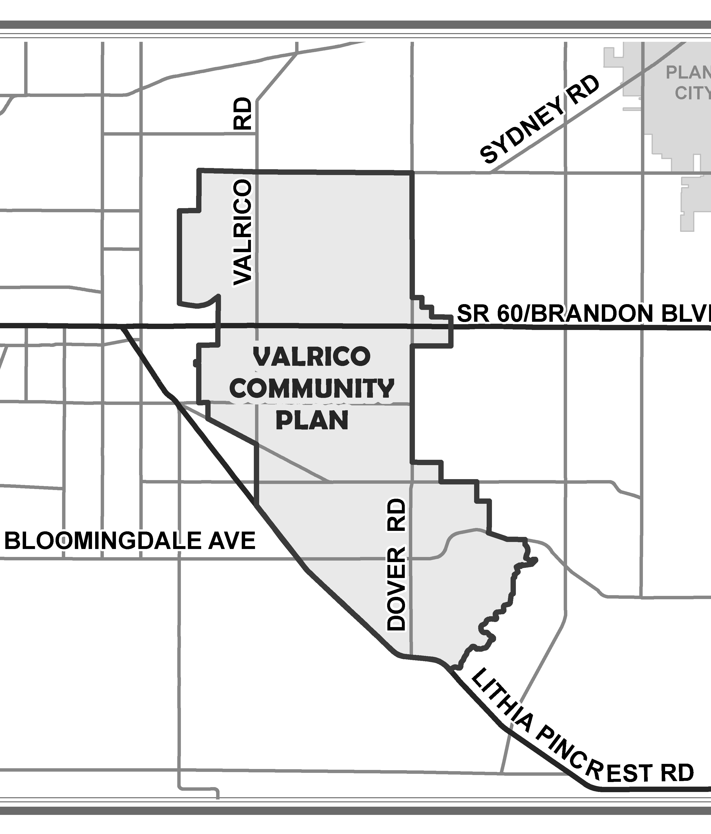
Next Steps
Office Hours, Survey, and Jan./ Feb. 2024
Draft Vision, Concept Map, Goals for Jan./Feb. 2024
Next in-person meeting workshop in Jan./ Feb. 2024
Office Hours
(Oct. – Dec. 2023)
Next Survey
(Nov. 2023 – Jan. 2024)
Notes:
Office hours, oct./ nov. – time TBD

Slide 18
Alvaro Gabaldon
(813) 582-7349
gabaldona@plancom.org
Jay Collins
(813) 582-7335
collinsj@plancom.org
bit.ly/planvalrico
Sofia Garantiva
(813) 582-7320
garantivas@plancom.org

