Slide 1
Fowler Avenue Vision Plan
Community Ambassador Stakeholder Meeting
October 5, 2023

Slide 2
Agenda
Purpose of Today:
Provide an overview of the Fowler Avenue Vision Plan
Answer questions and receive feedback on the Plan
Explain the role of a Community Ambassador and empower participants to bring the work back to the community to carry it forward
Agenda:
Introductions
Project Overview and Intent
Corridor Vision
Q&A
Talking to Your Community
How You Can Help

Slide 3
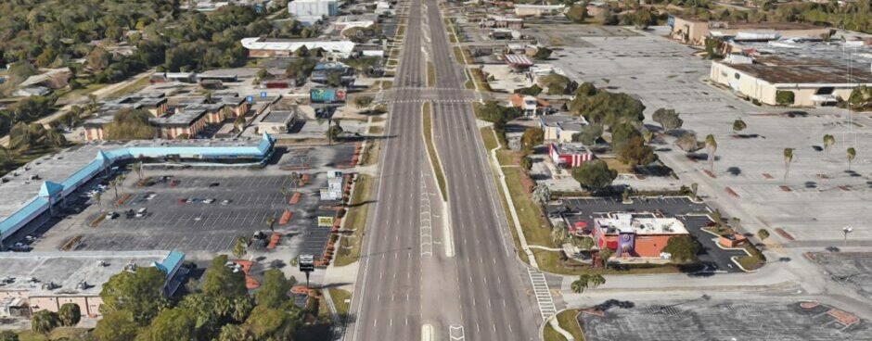
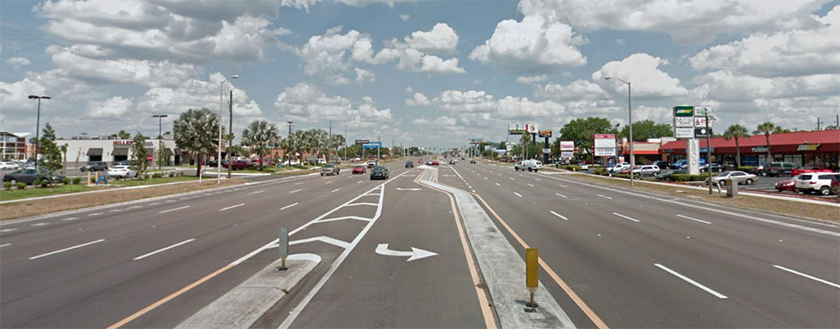
Background
Fowler Ave is at the intersection of Hillsborough County and City of Tampa boundaries, with unique planning challenges
A Vision Plan for the Fowler Avenue corridor:
Conveys clear and consistent strategies shared across jurisdictional boundaries
Enables equitable redevelopment
Integrates land use and transportation

Slide 4
Outcomes of the Study
A comprehensive Vision Plan for Fowler Avenue
Coordination between jursidictions and with HART and FDOT studies
Community education, engagement, and feedback
Comprehensive Plan policies and strategies for implementation

Slide 5
Fowler Avenue Vision Plan Outline
Fowler Avenue Vision Plan Contents:
Chapter 1: Introduction
Study Purpose, Goals, Objectives, and relationship to past planning efforts
Chapter 2: Community Context
Existing Conditions (Feb 2023)
Chapter 3: Community Voices
Key takeaways and themes from community engagement activities
Chapter 4: Vision Plan
Study Area Opportunities and Constraints, Overall Corridor Vision, Character Area Vision
Chapter 5: Action Plan
Recommendations/strategies to achieve the Vision and action steps for project partners

Slide 6
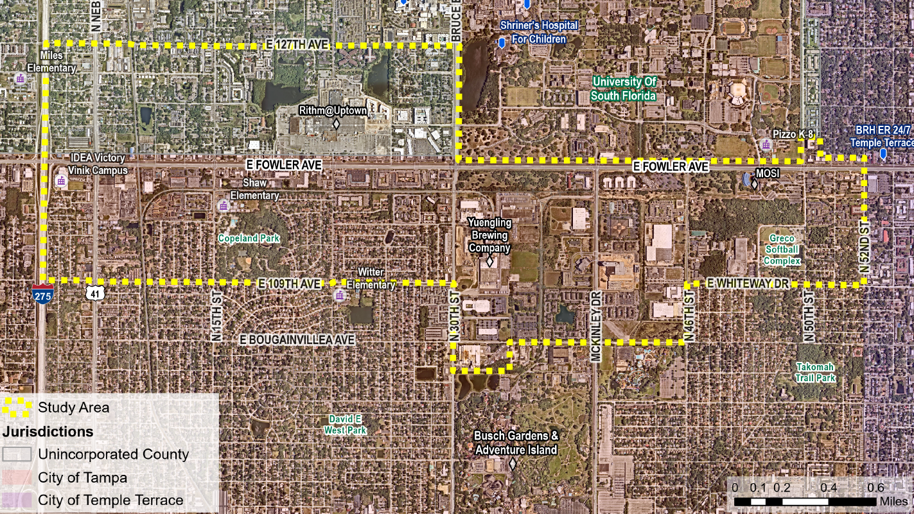
Study Area

Slide 7
Framing the Fowler Ave Vision Plan
Existing Conditions Report
Describes the study area as it is today through:
Study Area Profile
Existing Plan Review
Equity Analysis
Land Use Characteristics
Regulatory Assessment
Transportation Assessment
Opportunities and Constraints

Slide 8
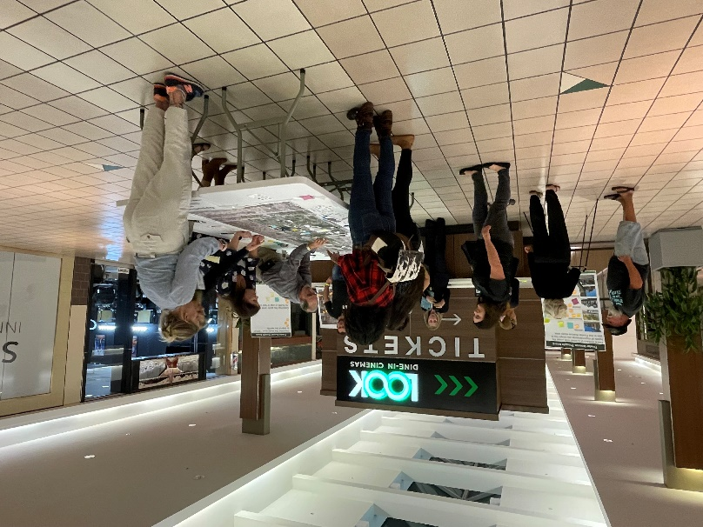
Fowler Avenue Engagement Timeline
Engagement Activities December 2022 - Present
Community Workshop #1: December 2022
Virtual Listening Session: December 2022
Mobile Engagement: February - May 2023
Walk and Talks: March 2023
Stakeholder Focus Group Meetings: March - April 2023
Community Ambassador Meeting: Today (10/5/2023)
Community Workshop #2: October 21, 2023

Slide 9
Fowler Avenue Engagement Insights
Community
Diversity of culture - businesses, restaurants, retail are special
New development is harbinger of displacement
Lack of identity or collective character
Physically and socially divided by Fowler Ave and railroad
USF, MOSI, health care facilities don’t “face the community”
Housing in the area is affordable
Development
Inconsistencies between City of Tampa and Hillsborough County permitting processes
Difficult to do business in the County along corridor
Buildings and Connectivity
Vacant properties are not maintained and attract litter and cut-through traffic
Signage creates visual clutter along Fowler Avenue and is not designed for non-motorists
Buildings are spread out and “far away” – want to see buildings closer to the sidewalk

Slide 10
Fowler Avenue Engagement Insights
Safety
Speeding is an issue along most roads
Lack of lighting
Lack of mid-block crossings
Transit
Most bus stops do not have shelters
Would like to see trash cans, lighting, and more seating capacity at bus stops
Lack of stops in Terrace Park
Walking / Biking Conditions
Moderate amount of bike / ped activity
Rush hour has a major impact on the pedestrian experience
Lack of shade
Sidewalk is narrow and disconnected in some areas
Infrastructure
Stormwater/ flooding issues
Septic Systems
Want to see more lighting and beautification
Want to see more community services and amenities in proximity to neighborhoods

Slide 11
Fowler Avenue Opportunities and Constraints
Constraints
Heavily-trafficked roadways and railroad create physical barriers
Safety concerns and several high-crash intersections
Lack of street connectivity
Opportunities
Vacant and underutilized sites
Catalytic sites, redevelopment and economic development drivers
Connecting neighborhoods to key destinations and future transit stations

Slide 12
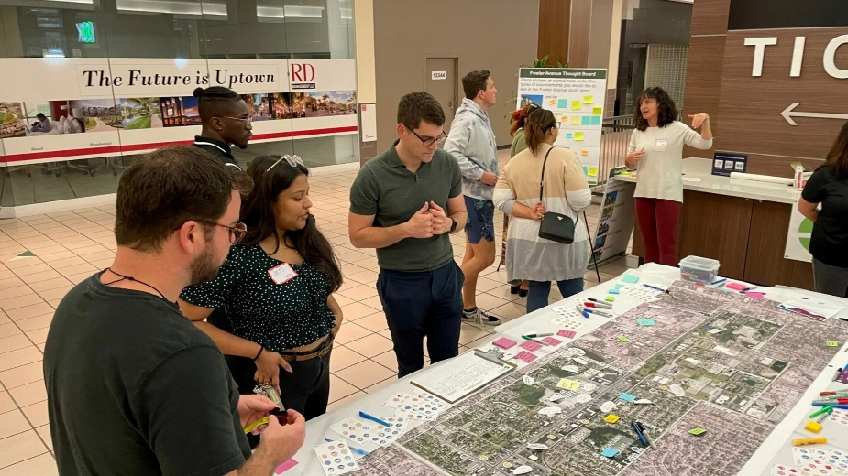
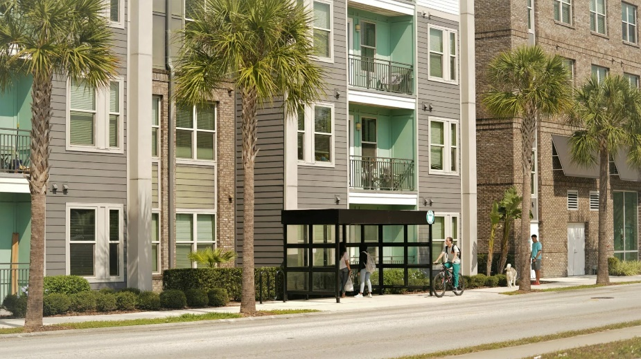
Redevelopment Vision Objectives
Create a cohesive community identity
Improve mobility and connectivity
Improve safety
Encourage redevelopment that revitalizes the area
Mitigate displacement of current residents and small businesses

Slide 13
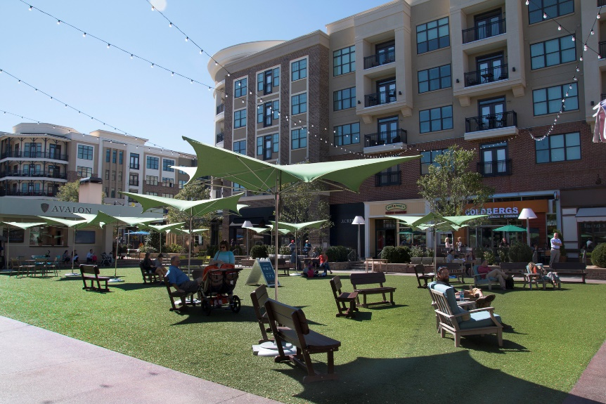
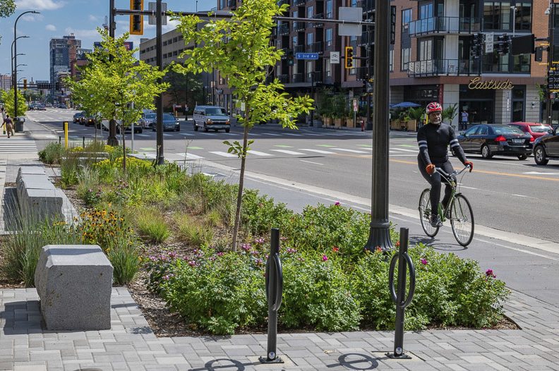
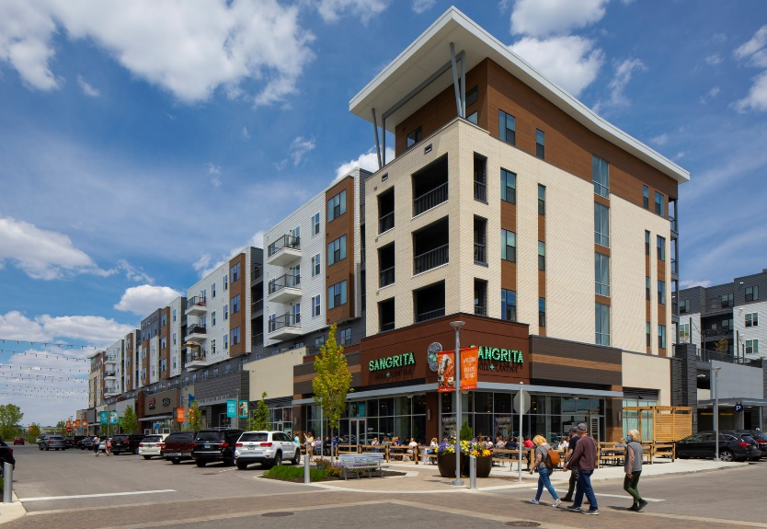
Fowler Avenue Redevelopment Vision
Overall Corridor Vision:
The Fowler Avenue Corridor will be an inclusive and vibrant community that welcomes a diversity of people and businesses by providing those who live, work, and play in the area with safe, convenient, and accessible options for housing, employment, transportation, and recreation.

Slide 14
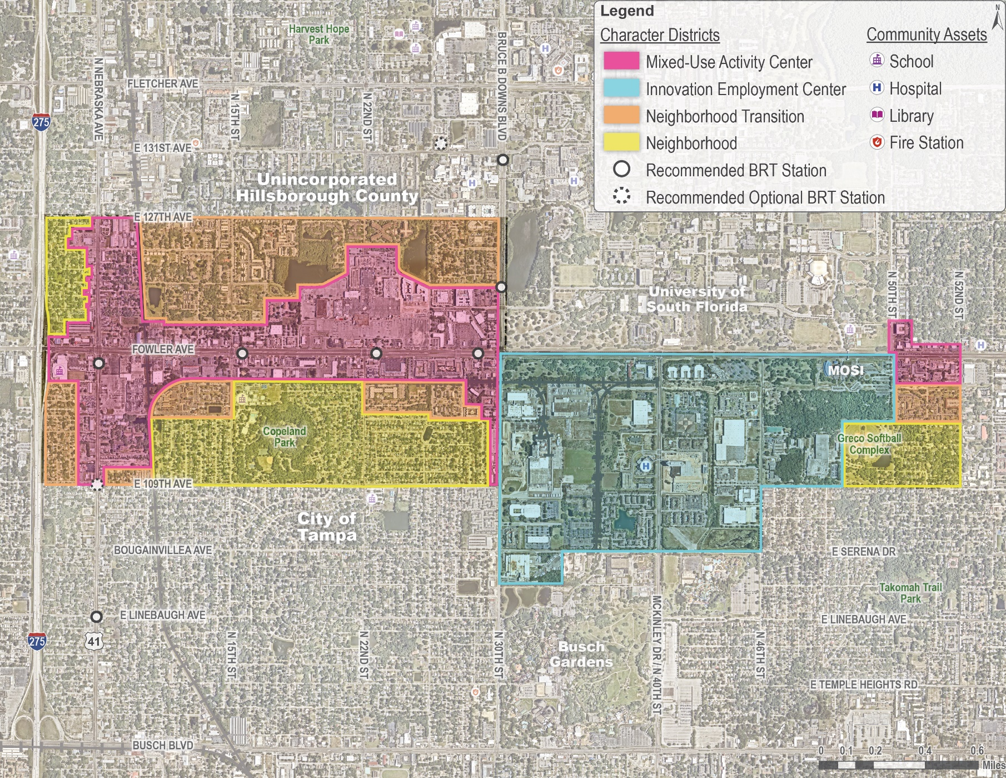
Fowler Avenue Redevelopment Vision
Character District Map - DRAFT
District 1: Mixed-Use Activity Center
District 2: Innovation Employment Center
District 3: Neighborhood Transition
District 4: Neighborhood

Slide 19
Fowler Avenue Policy Recommendations
Increase density and intensity in appropriate locations to support mixed-use development, affordable housing, and a more walkable design
Allow a varied land use mix so that a diversity of housing types, businesses, and services can locate throughout the area
Manage building form and placement to create a more comfortable and enjoyable experience that is inclusive of all people who use the corridor
Celebrate the area’s unique assets and enhance sense of place through urban design standards
Enhance community infrastructure through a community bonus system
Improve mobility options, connectivity, and safety for all
Explore options for implementation so that the City and County can take a unified approach to achieving the vision

Slide 20
Vision Plan vs. Comp Plan vs. Zoning Code
Vision Plan Recommendations
Comprehensive Plan Policies
Land Development Zoning Regulations
Brings together diverse interests to create an overall vision for a specific area
Recommends strategies and actions to accomplish the community’s vision
Recommendations are suggestions for future action by the City and County
Not a legally-binding document
Provides principles and strategies to manage future growth and development
Goals, Objectives, and Policies provide direction for future land use, the provision of public services, and conservation of natural resources
Legally-binding document:
A local government’s decisions must be consistent with the Goals, Policies, and Objectives of their Comp Plan
Provides specific standards for:
The types of development that can occur in different zones
How buildings must be built to protect public health, safety, and wellness
How and when utilities must be provided to support development
Legally-binding document:
Development must follow regulations or ask for an exception, which is only granted after extensive review

Slide 21
Question and Answer Session

Slide 22
Community Workshop Agenda
When: Saturday, October 21st from 12 - 4PM
Purpose: Provide an overview the Fowler Avenue Vision Plan and receive community feedback on the vision for the area.
Where: BX2 Theater at University Mall
Draft Discussion Questions for the Workshop:
What would you add or take away from the Character Area vision?
What would you want to see near your neighborhood to feel that new development is providing a benefit? (for example: community amenities, specific destinations, building design, etc.)
How likely are you to use Bus Rapid Transit (BRT) when it starts operating? What changes, if any, would make you more likely to use the BRT?
What challenges do you see for development in the area?
Ambassadors:
What do you think of these questions? Is there anything you would change, add, or take away?
What opportunities do you see?

Slide 23
How You Can Help
Pass out flyers to help us advertise the Community Workshop
Share your understanding of the project with your friends and neighbors and encourage them to share their perspective
Attend the 10/21 Workshop and help facilitate activities and discussions with fellow community members

Slide 24
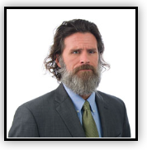
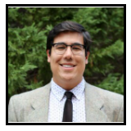
Contact the Project Team
Visit the Project Website:
Jay Collins, AICP
Special Area Studies Manager
(813) 582-7335
CollinsJ@plancom.org
Alvaro Gabaldon
Planner II
(813) 582-7349
GabaldonA@plancom.org

