Slide 1
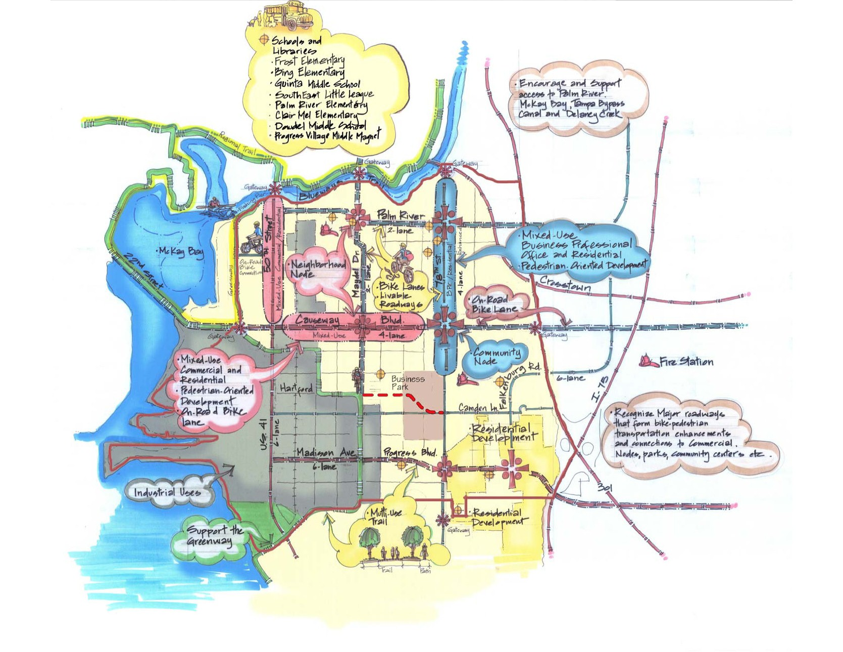
Greater Palm River Area Community Plan Update
August 17, 2023
Virtual Zoom Meeting
Notes:
Good evening and thank you for joining us. My name is Sofia Garantiva with the Planning Commission. Online we also have Jay Collins and Priya Nagaraj. Jay will be monitoring the questions in the chat and Priya is our technical support.

Slide 2
Welcome!
Please keep yourself muted during the presentation.
Type questions in the chat box.
Questions from the audience will be read and answered after the presentation.​
Notes:
A few housekeeping items since this is a virtual meeting – we ask that you keep yourself muted during the presentation and type any questions into the chat. We will read and answer any questions after the presentation. Thanks in advance.

Slide 3
Agenda
Community Planning in Hillsborough County
Adopted Community Plan
Community Plan Update
Q&A
Notes:
Tonight's presentation will be split into a few topics.
We will review how community planning is done in Hillsborough County
Review key components of the existing community plan and
Then we will dive into the current community plan update efforts
And as mentioned , at the end we will answer and questions.

Slide 4
What is a Community Plan?
Community Planning in Hillsborough County
Extension and refinement of the County’s Comprehensive Plan
Identifies community assets, needs, and preferences in a particular area of the county
Articulates a community vision for the future, and set goals and strategies aimed at resolving needs and achieving the vision
Developed through an extensive citizen participation
Hillsborough County has 22 adopted plans established during the last twenty years
Notes:
So what is a community plan again?
Read Slide - A Comprehensive Plan is an official document adopted by Hillsborough County, setting forth its goals, objectives, and policies regarding the long-term (20+ year horizon) development of the county.
Read through slide…
How does this look like in the wider sense of land development in the county?

Slide 5
Community Planning in Hillsborough County
Comprehensive Plan
Livable Communities Element
Greater Palm River Area Community Plan
Vision, Goals & Strategies
Land Development Code (Zoning)
Notes:
The comprehensive plan is organized into several sections based on topic - mobility, land use
The 22 plans, including your community’s, are housed within the Livable Communities Element.
- As an extension of the comp plan, the community plan deals with the same topics – Mobility, Land Use but focuses on how topics can be more specifically looked at for the Greater Palm River Area.
And the again the community plan includes a vision, goal and strategies.
The land development code – which regulates zoning, specific uses, and site design, is a separate document, not being changed at this time.

Slide 6
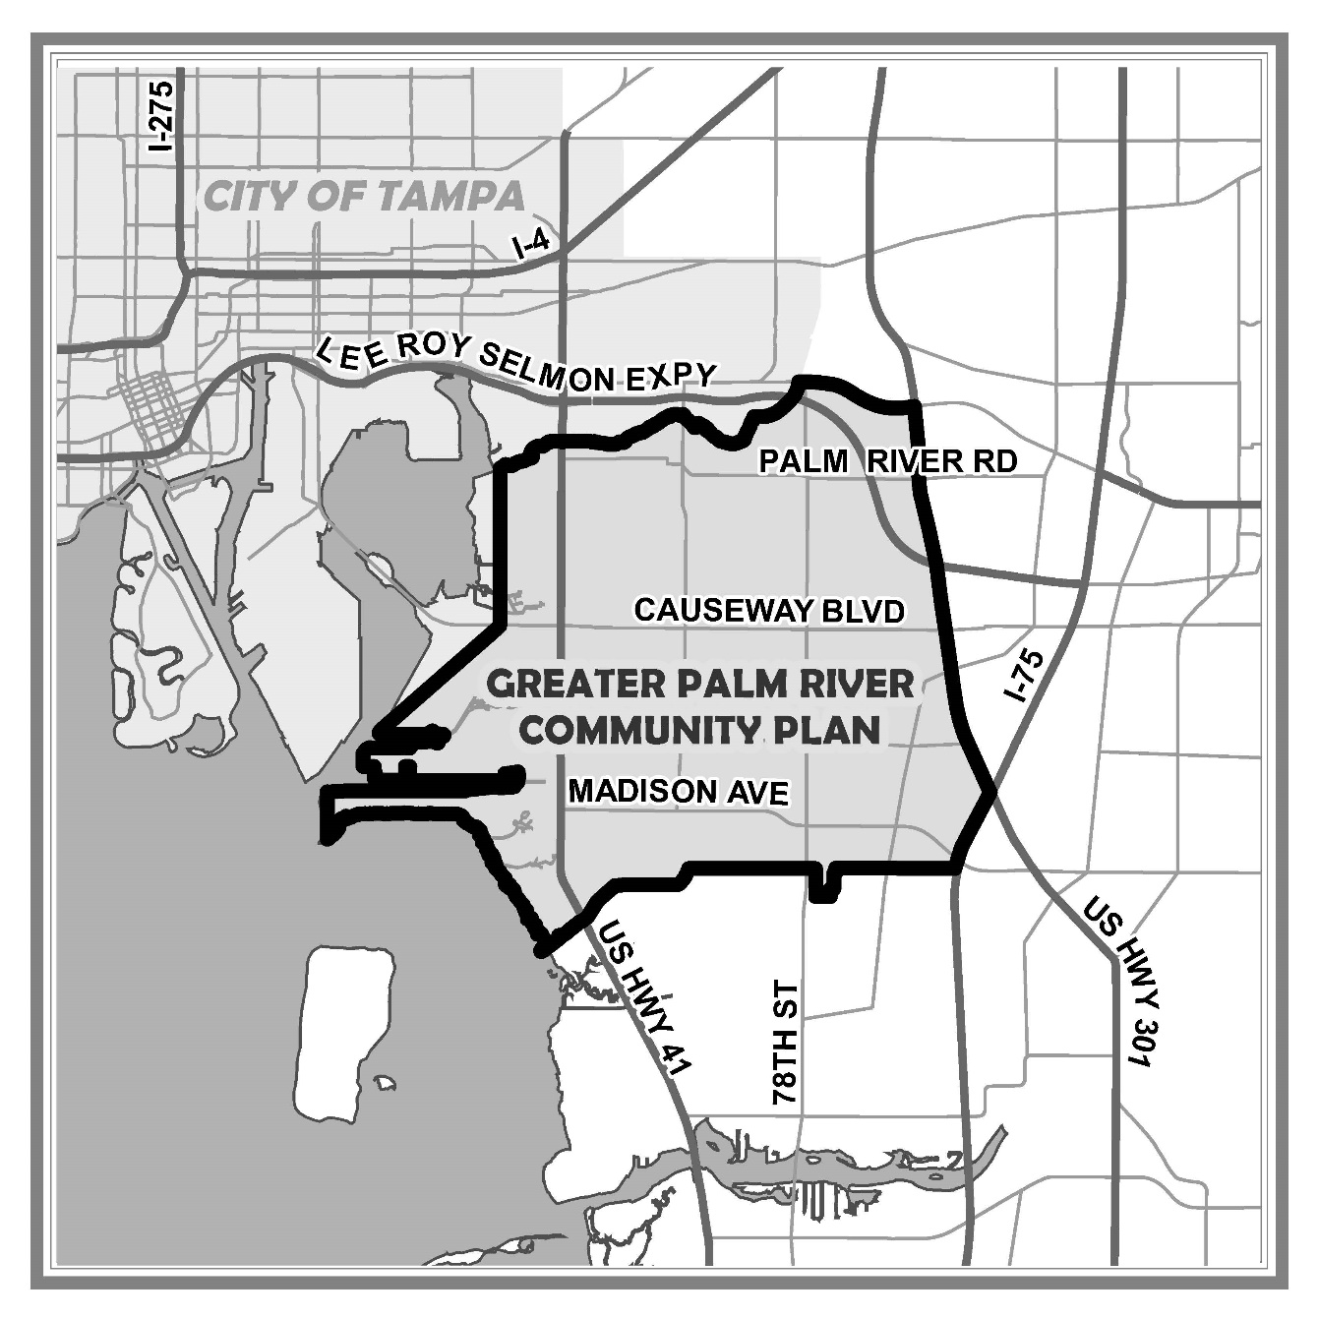
Adopted Community Plan:
Greater Palm River Area Community Plan
Adopted in 2008
Multiple neighborhoods – Palm River, Clair-Mel City, Progress Village
Established a Vision, Goals, and Strategies
Includes a “Concept Vision Map” – a visual representation
Notes:
To provide more detail on the existing community plan -
It was adopted in 2008 and established the boundaries shaded in blue on the Map.
includes multiple neighborhoods within the boundaries – Palm River, Clair-Mel City, Progress Village to name a few
It established shared community Vision, identified and prioritized Goals, and listed Strategies to achieve those goals
The plan also Includes a “Concept Map” – which is a visual representation of the vision and select goals and strategies.

Slide 7
Adopted Community Plan:
Vision Statement
“In 2007-2008 the Greater Palm River Area Community is located in Hillsborough County, adjacent to the City of Tampa, south of the State Road 60/Adamo Drive; west of US 301 to the McKay Bay, and north of the border of the Riverview Community Plan Boundary (south of Madison Avenue/Progress Boulevard). We recognize that Palm River is a unique Community that includes the Palm River/Tampa Bypass Canal and Delaney Creek, and McKay Bay waterways. We desire to retain our mixture of open spaces, large lots, and developed parcels; maintain our high-home ownership ratio, our diverse multi-cultural Community assets and neighborhoods, and our historic landmarks; we value our multi-generational residential makeup; we seek to minimize thru traffic on local roadways, focusing thru trips to arterials; and we desire to preserve and protect our waterfronts, and our recreational and environmentally-sensitive lands. This Vision is graphically represented on the Greater Palm River Area Concept Map.
In 2020, we will have recognized and fostered an economically diverse community that includes additional residential, commercial, office and industrial development accomplished through planned growth. We have supported a mixture of old and new residential, both large lot with individual homes and higher density developments in appropriate areas as well as commercial, industrial development and viable agricultural uses. New development and redevelopment will have been encouraged that fits the characteristics of the existing and historic Community. Community centers, sports complexes, parks, greenways, water-way accesses have been established that provide a wealth of services and recreational opportunities to the Community.”
Notes:
One of the main components of your community plan is the Vision statement - it is the first couple of pages of the community plan – and comes with a vision concept map as depicted to the right. As you can see the vision statement is a bit wordy, but I did want to highlight, what I understood as the essential points-

Slide 8
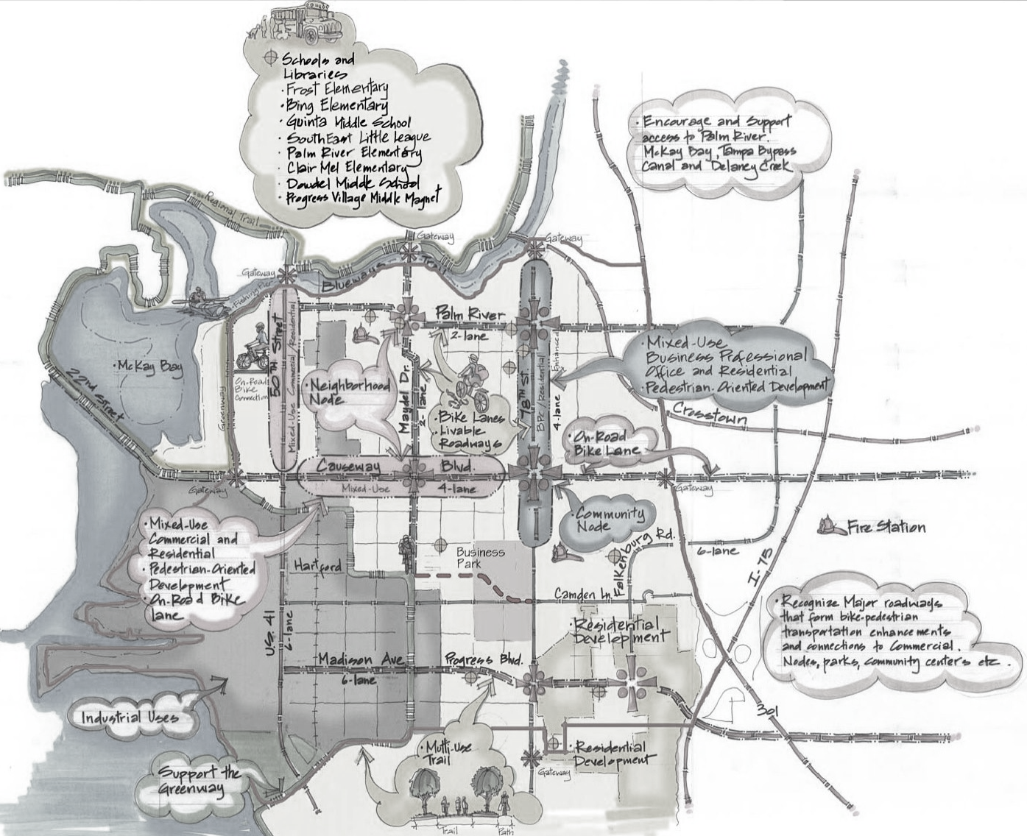
Adopted Community Plan:
Vision Statement
“In 2007-2008 the Greater Palm River Area Community is located in Hillsborough County, adjacent to the City of Tampa, south of the State Road 60/Adamo Drive; west of US 301 to the McKay Bay, and north of the border of the Riverview Community Plan Boundary (south of Madison Avenue/Progress Boulevard). We recognize that Palm River is a unique Community that includes the Palm River/Tampa Bypass Canal and Delaney Creek, and McKay Bay waterways. We desire to retain our mixture of open spaces, large lots, and developed parcels; maintain our high-home ownership ratio, our diverse multi-cultural Community assets and neighborhoods, and our historic landmarks; we value our multi-generational residential makeup; we seek to minimize thru traffic on local roadways, focusing thru trips to arterials; and we desire to preserve and protect our waterfronts, and our recreational and environmentally-sensitive lands. This Vision is graphically represented on the Greater Palm River Area Concept Map.
In 2020, we will have recognized and fostered an economically diverse community that includes additional residential, commercial, office and industrial development accomplished through planned growth. We have supported a mixture of old and new residential, both large lot with individual homes and higher density developments in appropriate areas as well as commercial, industrial development and viable agricultural uses. New development and redevelopment will have been encouraged that fits the characteristics of the existing and historic Community. Community centers, sports complexes, parks, greenways, water-way accesses have been established that provide a wealth of services and recreational opportunities to the Community.”
“…We desire to retain our mixture of open spaces, large lots, and developed parcels; maintain our high-home ownership ratio, our diverse multi-cultural Community assets and neighborhoods, and our historic landmarks; we value our multi-generational residential makeup; we seek to minimize thru traffic on local roadways, focusing thru trips to arterials; and we desire to preserve and protect our waterfronts, and our recreational and environmentally-sensitive lands. This Vision is graphically represented on the Greater Palm River Area Concept Map.”
Notes:
The first paragraph describes the strengths and characteristics the community wanted to keep -

Slide 9
Adopted Community Plan:
Vision Statement
“In 2007-2008 the Greater Palm River Area Community is located in Hillsborough County, adjacent to the City of Tampa, south of the State Road 60/Adamo Drive; west of US 301 to the McKay Bay, and north of the border of the Riverview Community Plan Boundary (south of Madison Avenue/Progress Boulevard). We recognize that Palm River is a unique Community that includes the Palm River/Tampa Bypass Canal and Delaney Creek, and McKay Bay waterways. We desire to retain our mixture of open spaces, large lots, and developed parcels; maintain our high-home ownership ratio, our diverse multi-cultural Community assets and neighborhoods, and our historic landmarks; we value our multi-generational residential makeup; we seek to minimize thru traffic on local roadways, focusing thru trips to arterials; and we desire to preserve and protect our waterfronts, and our recreational and environmentally-sensitive lands. This Vision is graphically represented on the Greater Palm River Area Concept Map.
In 2020, we will have recognized and fostered an economically diverse community that includes additional residential, commercial, office and industrial development accomplished through planned growth. We have supported a mixture of old and new residential, both large lot with individual homes and higher density developments in appropriate areas as well as commercial, industrial development and viable agricultural uses. New development and redevelopment will have been encouraged that fits the characteristics of the existing and historic Community. Community centers, sports complexes, parks, greenways, water-way accesses have been established that provide a wealth of services and recreational opportunities to the Community.”
“…recognized and fostered an economically diverse community …accomplished through planned growth...New development and redevelopment will have been encouraged that fits the characteristics of the existing and historic Community. Community centers, sports complexes, parks, greenways, water-way accesses have been established that provide a wealth of services and recreational opportunities to the Community.”
Notes:
In the second paragraph - talks about what the community wants to see in the future…the community would have.
So this and the concept map serve as the vision for your community plan.

Slide 10









Adopted Community Plan: Goals
Infrastructure and Utilities
Crime and Public Safety
Traffic/
Transportation
Parks and Recreation
Planning and Growth
Economic Development
Senior, Social, Health-Medical Services and Schools
Environment and Natural Resources
Historic Preservation
Notes:
The next portion of the plan is the Goals and strategies – These are the roughly 9 goals of your community plan in order of prioritization.
Each goal has multiple strategies – some are general in nature and others are more specific.
The first and #1 ranked goal is…read slide

Slide 11
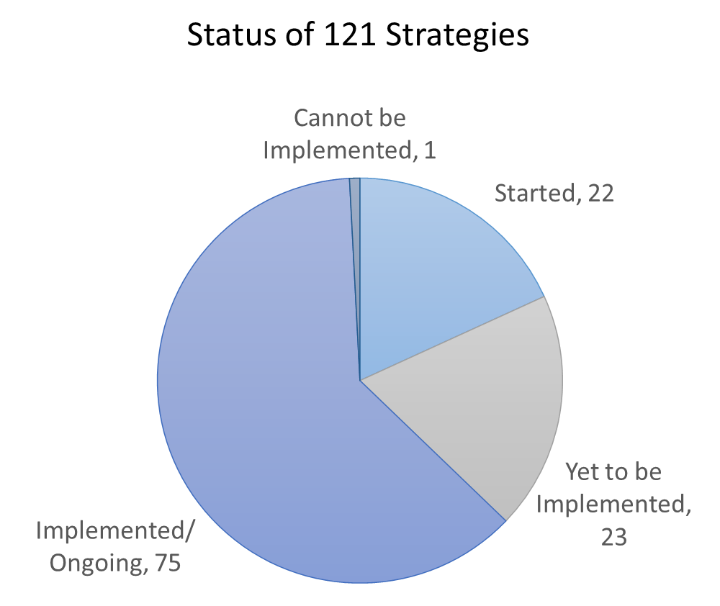
Adopted Community Plan: Implementation
Greater Palm River Community Plan Implementation Status Report
Notes:
There are a total of 121 Strategies in the community plan –
Community and Infrastructure Planning prepared a Community Plan Implementation Status Report (which is available online on our project website) and based on it
A majority have been implemented or are ongoing.
Am example of implemented strategies is collocating facilities on county lands – the Boys and Girls Club at Winston Park was built. And example of an ongoing strategy could mean “promote education on the history of the area” - the strategy is continuous in nature and not tied to a specific action.
There is a portion that has yet to be implemented and only one that can no longer be implemented.

Slide 12
The Community Plan Update
County Staff was requested to review implementation status of adopted community plan
Based on findings Planning Commission and County staff were requested by the BOCC to initiate an update to the plan
Re-evaluating and amending the community plan to respond to the needs and preferences of the community
Notes:
The community plan update – so how did it start?

Slide 13
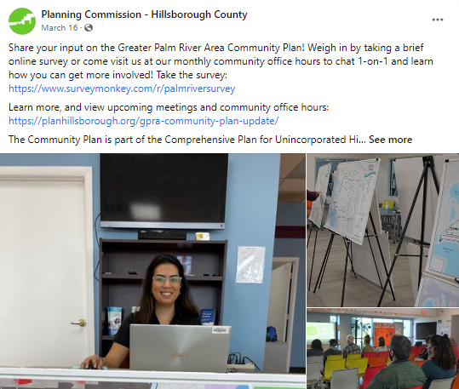
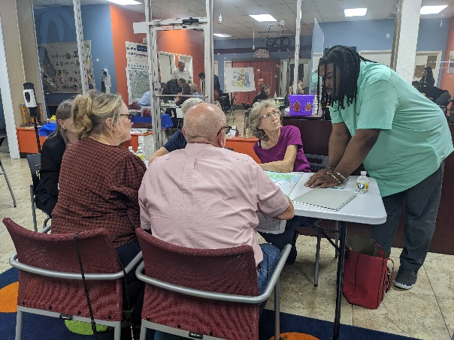
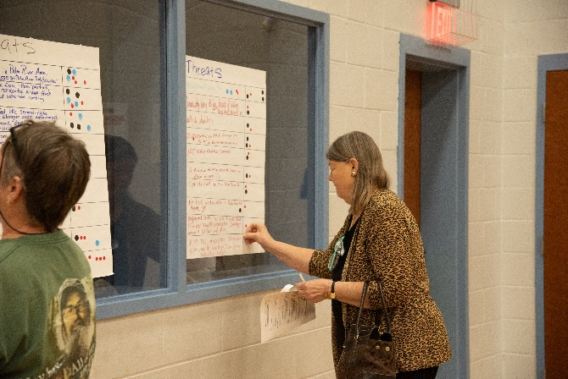
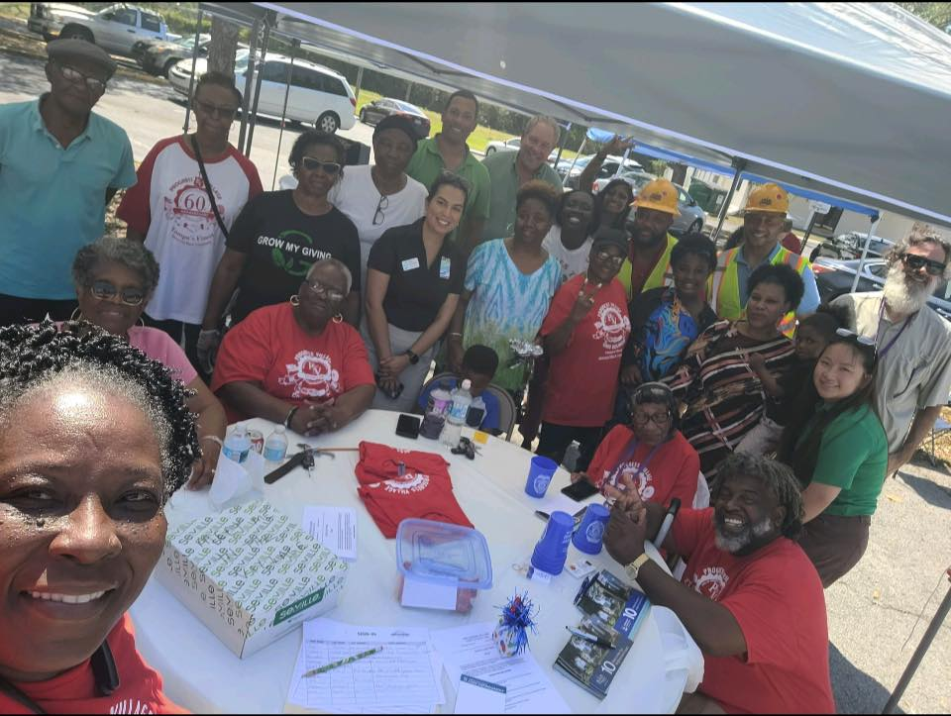
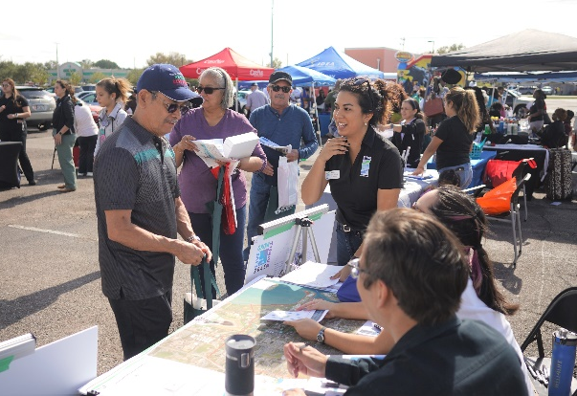
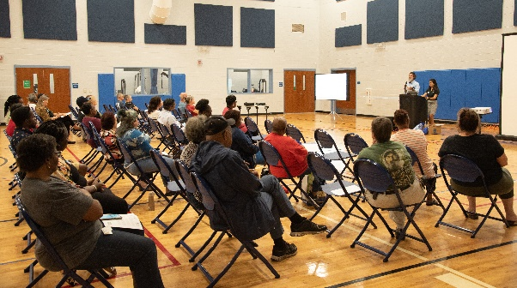
The Community Plan Update: Engagement to Date
Community-Wide Meetings
Open Houses in November 2022
Online
Online Survey (January – March 2023)
Project Webpage
Office Hours
Once a Month from January – May 2023
Community Plan Advisory Committee (CPAC)
Monthly January – July 2023
Community Events
Progress Village Civic Council Meet and Greet
Commissioner Myer’s Town Halls
Palm River CDC Events
Notes:
We’ve had numerous community engagement opportunities that were open to the public.

Slide 14
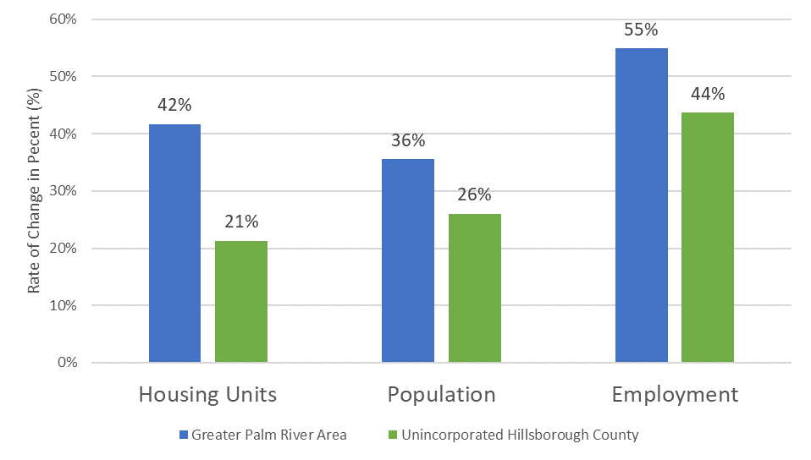
The Community Plan Update
2010-2022 Demographic and Economic Growth
Notes:
Going into some of the data we collected during this process –
Many folks we chatted with can attest to this, but the community has changed and grown a bit since the time when the community plan was adopted. The chart here shows the rate of change from 2010 (a couple years after the community plan adoption) to 2022. Greater Palm River is in blue and the county’s rates are in green.
You can see that the area is growing at a faster rate than the county in terms of housing being built, population and employment.
Projected that the population of Greater Palm River Area will grow 40% (from roughly 47 K to just over 60 k people) by 2050, a bit more than the county which is projected to grow by 34% by 2050.
So, growth is expected to continue, and that this growth is expected throughout the county and due to location growth outside of the community and will affect the community.

Slide 15
The Community Plan Update
SWOT Analysis
Strength
Weakness
Opportunity
Threat
Individuality of neighborhoods
Long term community members
Location
Affordable homes/lots for middle income families
Diversity
Small Businesses
Crime/Violence
Funding
Communication
Roads/Traffic
New business development
Water/Sewer
Attracting new business & services
Improved infrastructure
Engagement of youth
More recreational venues
Funding
Crime
Lack of cohesiveness within neighborhoods
Rapid development
Loss of Identity/Original Residents leaving area
Open Houses and Survey
Notes:
During the Open Houses and throughout the first half of the year, through an online survey, we asked for participation in a SWOT analysis. This tools helped us get a snapshot of what the community sees are the big issues and gets folks thinking about possible solutions.
These are some of the most common responses for each category – read through
We can see that there are a few overlapping ideas – many current strengths can be built upon to create new opportunities for the future and certain weaknesses need to be addressed so that they don't become threats.

Slide 16
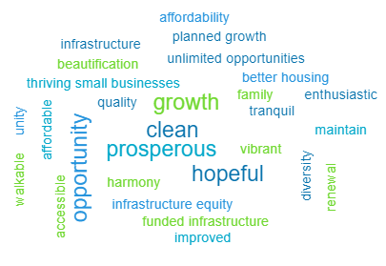
The Community Plan Update
What word best describes your desired future for Greater Palm River?
Survey says:
Notes:
Another question asked at the Open Houses and in the survey. There is a lot of positive language here (read some)

Slide 17









The Community Plan Update
There are nine (9) established goals within the adopted community plan. Out of these goals, which do feel are the highest priority? Please select three (3)
Survey says:
Infrastructure and Utilities
Crime and Public Safety
Traffic/
Transportation
Parks and Recreation
Planning and Growth
Economic Development
Senior, Social, Health-Medical Services and Schools
Environment and Natural Resources
Historic Preservation
Notes:
We also asked folks to pick their top three goals in the survey.
Results show that the first three goals still rank highly. And we see that economic development and environment and natural resources seem to have increased in importance.
This helps us determine if/how priorities have shifted

Slide 18
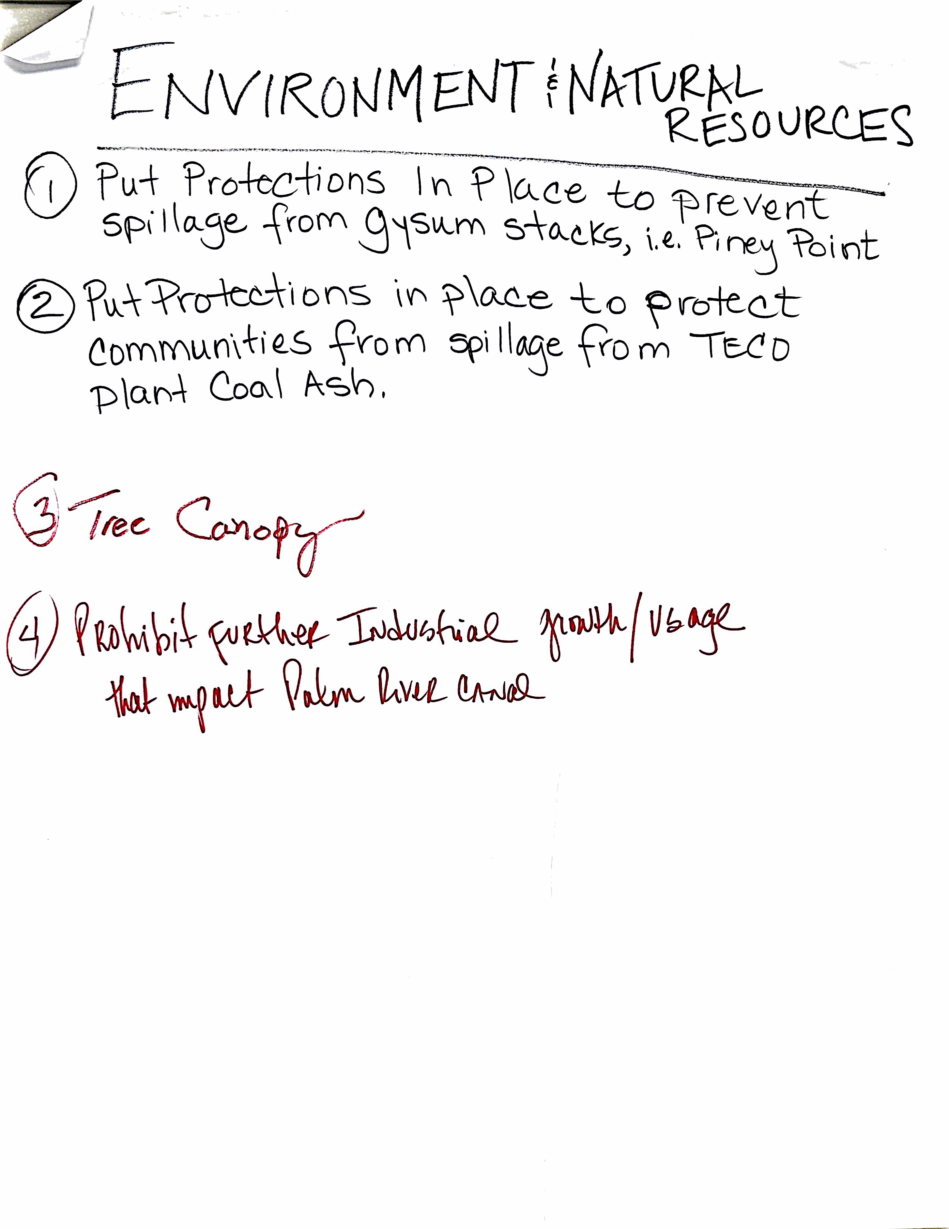
The Community Plan Update: Engagement Insights
Adopted community plan not implemented adequately
Area’s history and sense of community/identity being lost to new development and changing demographics
Desire for balance between development and infrastructure demands
Desire for better communication within the community and with the county
Notes:
So based on the data collected so far, we have some insights -
There is a perceived opinion by the community that numerous adopted goals and strategies have not been implemented adequately (i.e., code enforcement, transportation improvements, water/sewer improvements, unbuilt community centers/parks).
This is probably a combination of the way the goals and strategies were originally written
Changes to overall county policies/directives since the time of adoption
and just generally not being aware of what has been implemented goals/strategies.
There is a fear of the area’s history and sense of community being lost to new development and changing demographics (this is also expressed throughout the adopted community plan). It was also expressed that the name of the community plan is a point of tension as it singles out one neighborhood (Palm River). We understand that some residents of the other neighborhoods do not feel the community plan applies to them, even though they are within the boundary.
There does not appear to be outright opposition to development but the desire for there to be balance between new development and infrastructure demands.
There is a desire for better communications within the community and with the county.
As with many community planning efforts, there are members of the community that are well versed in county government functions/process/projects and those who are not as familiar. Staff directed residents to tools they can use, as citizens, to advocate for their community and receive county communications (i.e., the community plan, registering organizations with the county’s Neighborhood Relations Department).

Slide 19
The Community Plan Update
Draft Community Plan Recommendations
Updating Vision Statement and Concept Map
Clarifying strategies
Relocating action items to a separate document
Combining related goals to focus efforts
Palm River-Progress Village Community Plan
Renaming of Community Plan
Identifying neighborhoods on Concept Map
Combining Planning, Infrastructure, and Transportation Goals to better address growth
Notes:
Based on the input received and the insights we have some draft recommended changes to the plan
We will be updating the vision statement and concept map – with help from the CPAC we identified the historic neighborhoods and will add those on the concept map.
We have also taken into consideration the renaming of the Community Plan – our initial proposal is Palm-River- Progress Village – from a geographic standpoint it captures the northern boundary to the southern boundary of the existing plan and everything in between.
We think these changes will help address some of the community identity concerns.
We are recommending combining related goals to focus efforts – the county comprehensive plan has been updated in recent years to focus efforts and we would like to do the same for the greater palm river area community plan.
- We noticed there was a lot of overlap in strategies and goals and think that reworking the goals will help make the plan more implementable.
- For example, combining the Planning, Infrastructure and Transportation Goals to better address growth concerns. These topics are intertwined and when one is implemented it affects the other.
We are also proposing to clarify strategies – as we were working through the goals/strategies with the CPAC and with county staff we noticed that some strategies would be better suited in an action plan, so we are proposing moving them to, what we consider the basis for action plan. We want to make sure that those specific strategies are still captured so that when the county is looking for ways to implement the plan, in addition to the community plan, there is a specific starting list they can reference.

Slide 20
Next Steps
Drafting Recommendations
Fall 2023
Open to meet with Community Organizations/Individuals
Winter 2023-2024
Summer 2023
Community-Wide Meetings
Finalizing Recommendations
Finalized Draft of Updated Community Plan
Online Survey
Planning Commission and BOCC Briefings
Planning Commission and BOCC Public Hearings
Final Community-Wide Meeting
Notes:
The next steps in the process – finishing out the summer…Read Slides
In the fall…We will be easing out of the general public engagement…Read Slide
By wintertime…I wanted to highlight this step because this is when we anticipated starting the official comprehensive plan amendment process which has its own mandated noticing requirement and meeting schedule.
Between when public officials give their input and the public hearings (when voting occurs) we will hold one more meeting to let you know what changes public officials made.

Slide 21
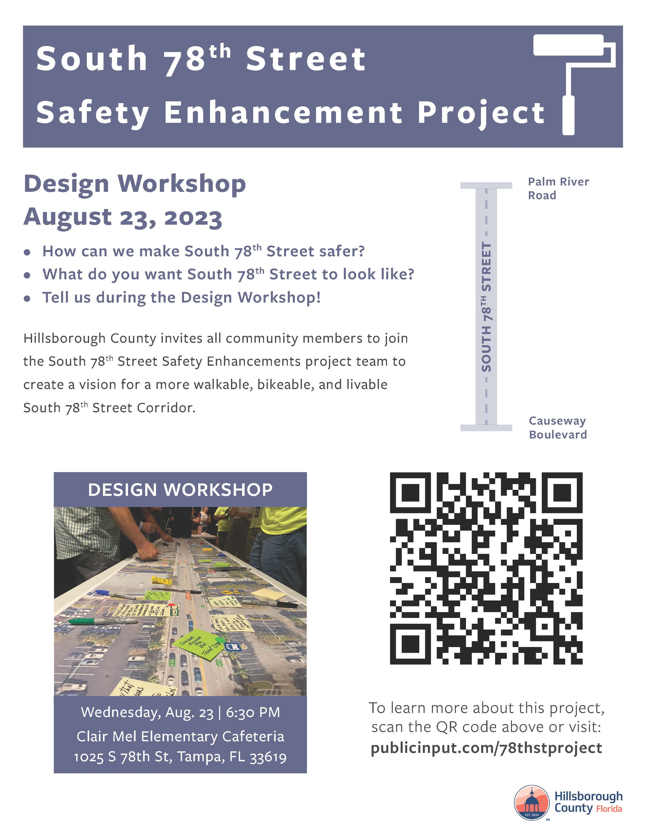
78th Street Safety Enhancement Project
Notes:
Before we wrap up – there is an engagement opportunity for a community plan implementation project. Again, since there is an adopted plan, it is still being implemented.
Hillsborough County Community and Infrastructure Planning Department invites all community members to join the South 78th Street Safety Enhancements project team Next Wednesday Aug 23 at 6:30 pm at the Clair Mel Elementary School Cafeteria for a Design Workshop.
Staff wants to know how they can make South 78th Street safer? And what do you want South 78th Street to look like? The project boundaries are 78ths Street from Palm River Road to Causeway Boulevard.

Slide 22
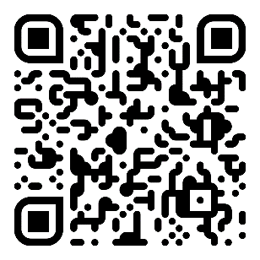
Sofia Garantiva
garantivas@plancom.org
Jay Collins
collinsj@plancom.org
bit.ly/planpalmriver
(813) 582-7320
(813) 582-7335
Q&A

Slide 23
Greater Palm River Area Community Plan: Goals
Infrastructure and Utilities
Crime and Public Safety
Traffic/
Transportation
Parks and Recreation
Planning and Growth
Economic Development
Senior, Social, Health-Medical Services and Schools
Environment and Natural Resources
Historic Preservation

Slide 24
Combination of Related Goals
Taking the adotped nine (9) goals and combining them into five (5) goals
Infrastructure/Utilities
Crime & Safety Goal
Transportation/Traffic
Parks and Recreation
Planning & Growth
Economic Development
Senior, Social, Health-Medical Services and Schools
Environmental Resources
Historic Preservation
Balanced Growth of the Built Environment
Safe and Secure Community
Foster Community Character and Identity
Diverse Economic Growth
Protection and Maintenance of Natural & Open Spaces

Slide 25
Connecting Goals back to Comp Plan
Connecting proposed goals to related sections in the new Hillsborough County Comprehensive Plan structure.
Balanced Growth of the Built Environment
Safe and Secure Community
Foster Community Character and Identity
Diverse Economic Growth
Protection and Maintenance of Natural & Open Spaces
Built Environment/One Water/Governance Sections
Built Environment/Governance Sections
Built Environment/Governance Sections
Built Environment/Governance Sections
Natural and Open Space Section

Slide 26
Proposed Goals Breakdown
Organization of adopted and modified/new strategies under proposed goals.
Balanced Growth of the Built Environment
Safe and Secure Community
Foster Community Character and Identity
Diverse Economic Growth
Protection and Maintenance of Natural & Open Spaces
Strategies from current Infrastructure/Utilities Goal
Strategies from current Crime and Safety Goal
Strategies from current Crime & Safety Goal
Strategies from current Planning & Growth Goal
Strategies from current Parks and Recreation Goal
Strategies from current Planning & Growth Goal
Strategies from current Transportation/Traffic (Mobility) Goal
Strategies from current Senior, Social, Health-Medical Services and Schools Goal
Strategies from current Historic Preservation Goal
Strategies from current Economic Development Goal
Strategies from current Senior, Social, Health-Medical Services and Schools Goal
Strategies from current Environmental Resources Goal

