Slide 1
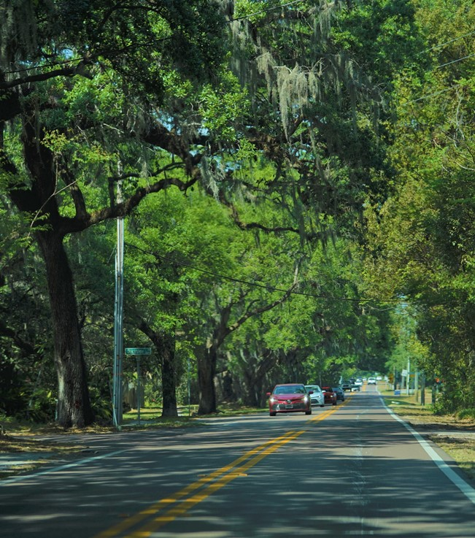
Valrico Community Plan
Open House
July 22, 2023 & July 24, 2023
Mulrennan Middle School

Slide 2
Welcome!
The Valrico Community
Notes:
Add the year of the establishing legislature (1989)
Established by state legislature in the 1960’s, have been doing planning for the jurisdictions since that time.
Questions:
How to protect Historical assets in the community?
Industrial and Energy park (specific policies,
Activites:
The map activities will lay the foundation for a concept map
Plan Ambassadors:
Bounce ideas and refine meeting agendas
Before next meeting, we’re going to ask for input on creating exercises

Slide 3
What is Plan Hillsborough?
Facilitates the involvement of all people in the long range planning and vision to improve economic development, quality of life, and provide value-added services.
Long-range transportation policy making board made up of local government and transportation agency representatives planning for state and federally funded multi-modal transportation investments.
Responsible for promoting collaborative planning, regulation and development along the river corridor while ensuring environmental health of the Hillsborough River
Notes:
Add the year of the establishing legislature (1989)
Established by state legislature in the 1960’s, have been doing planning for the jurisdictions since that time.

Slide 4
What is the Planning Commission?
Established by state legislature in 1960’s
Independent, Multi-jurisdictional comprehensive planning agency led by board of appointed citizens
Makes recommendations to the Board of County Commissioners
Updates and maintains the County’s Comprehensive Plan (which contains Community Plans)
Notes:
Established by state legislature in the 1960’s, have been doing planning for the jurisdictions of Hillsborough County for over 50 years.
The Planning Commission is an independent agency, our board is led by 10 citizens appointed by elected officials. These citizens serve four year terms and represent all four jurisdictions in Hillsborough County.
We make recommendations about land use, community planning, capital improvements, urban design, and other issues that the comprehensive plan covers. These topics are used to organize policies that the County uses when making decisions that affect growth management, transportation, and environmental protection. We do not create laws but provide decision makers with research, knowledge, and citizen feedback.
Aside from making recommendations at day to day government hearings and processes, we maintain and update the Comprehensive Plan. A comprehensive plan is a state mandated document that gets adopted by the County Government and reviewed by the state. We’ll go into more detail with a graphic on the next slide.

Slide 5
Comprehensive Planning in Unincorporated Hillsborough County
Comprehensive Plan
Livable Communities Element of Comprehensive Plan
Valrico Community Plan
Vision, Goals & Strategies
Land Development Code (Zoning)
Notes:
Comprehensive Plan - An official document in ordinance form adopted by the local government setting forth its goals, objectives, and policies regarding the long-term development of the area within its jurisdiction.
Community Plan - A strategic plan that employs a public process to identify community assets, needs, and preferences, articulate a community vision for the future, and set goals and strategies aimed at resolving needs and achieving the vision. While it has required elements of Comp Plan, allows each community to choose its own path and establish goals. These 22 plans are housed within the Livable Communities Element. An extension of the comp plan, it deals with the same topics – Housing, Transportation, Land Use but how these topics can be more specifically looked at for Valrico.
*There is a transportation strategy for Hillsborough County – let’s talk about a transportation strategy for Valrico

Slide 6
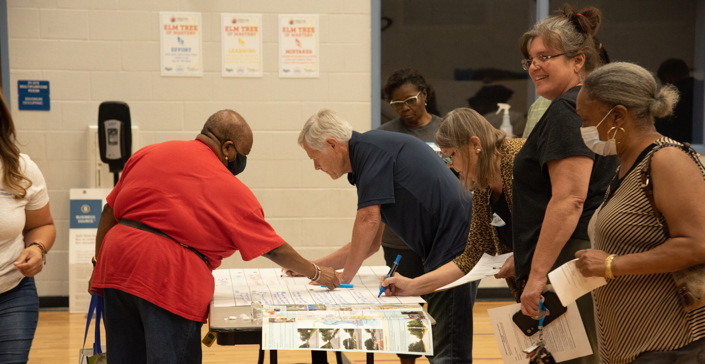
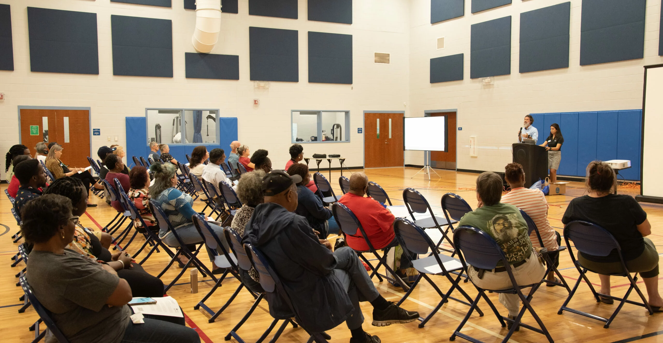
What is a Community Plan?
An extension or refinement of a Comprehensive Plan that provides specific policy to a defined area.
Hillsborough County has 22 adopted plans established during the last twenty years.

Slide 7
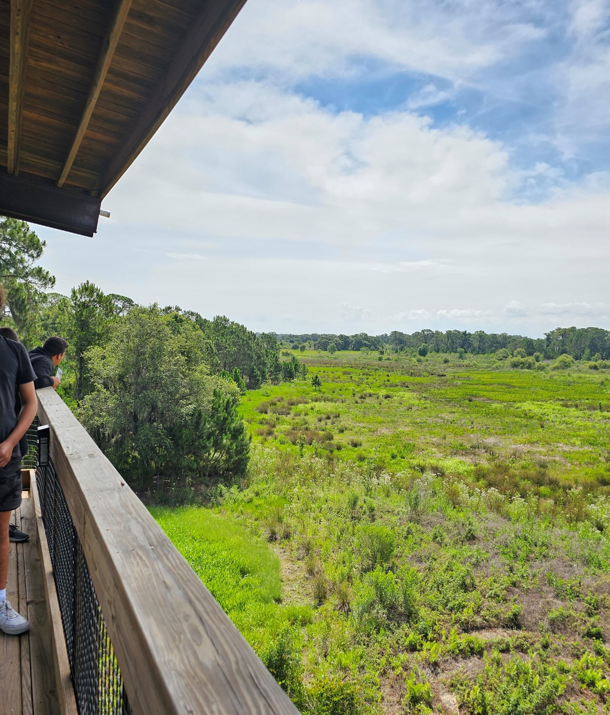
How is a Community Plan Used?
Used by staff to inform/prioritize infrastructure projects that may include improvements and maintenance through the Capital Improvements Program
Used by elected officials when considering development decisions
Used by staff when reviewing applications for new development
Used to inform other policies of the Comprehensive Plan
Notes:
Use to visualize, advocate and memorialize their vision going forward
Use the CP to advocate for the Vision that the plan lays out.
Wimauma comp plan – community plan – code graphic
Used by Citizens in a variety of ways, some examples include, the community may find other ways of using it to create value. Used by Citizens as a voice to continue the plan’s vision.

Slide 8
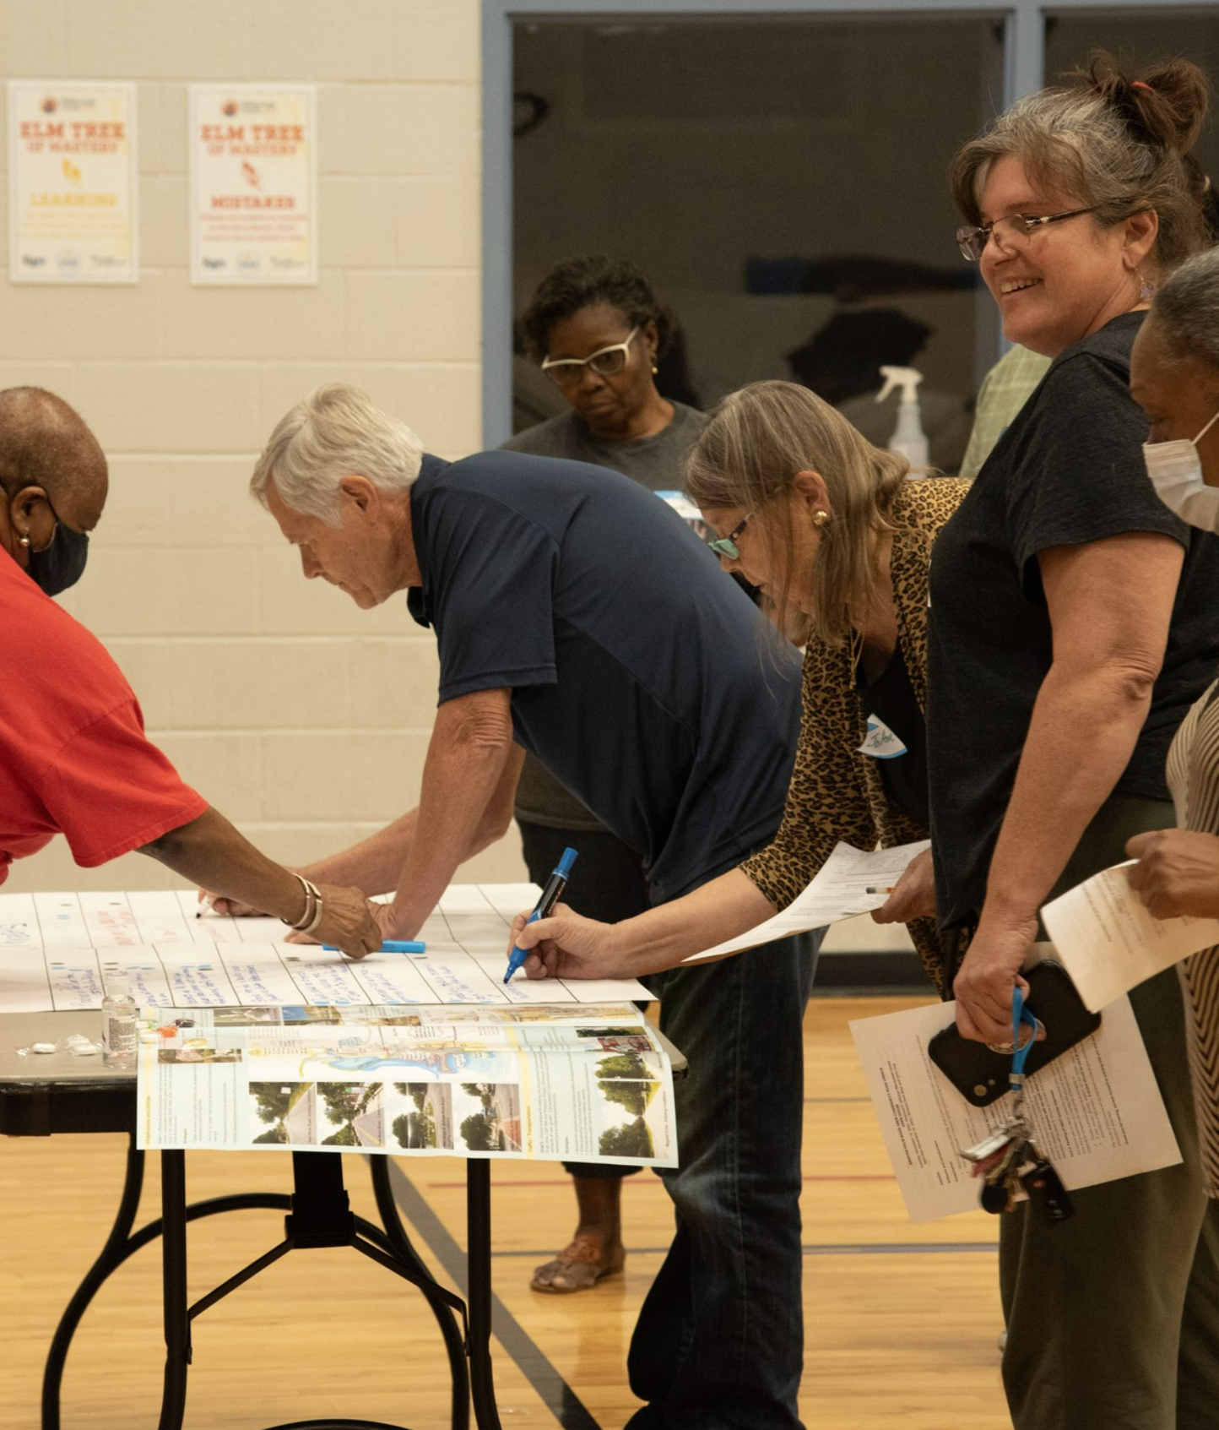
How is a Community Plan Used?
Used to memorialize the community’s priorities and vision in an adopted document
Used as a shared voice to address community concerns and solutions to these concerns
Used to inform public comments and feedback you can share about projects happening in your area
The Valrico Community
Notes:
Use to visualize, advocate and memorialize their vision going forward
Use the CP to advocate for the Vision that the plan lays out.
Wimauma comp plan – community plan – code graphic
Used by Citizens in a variety of ways, some examples include, the community may find other ways of using it to create value. Used by Citizens as a voice to continue the plan’s vision.

Slide 9
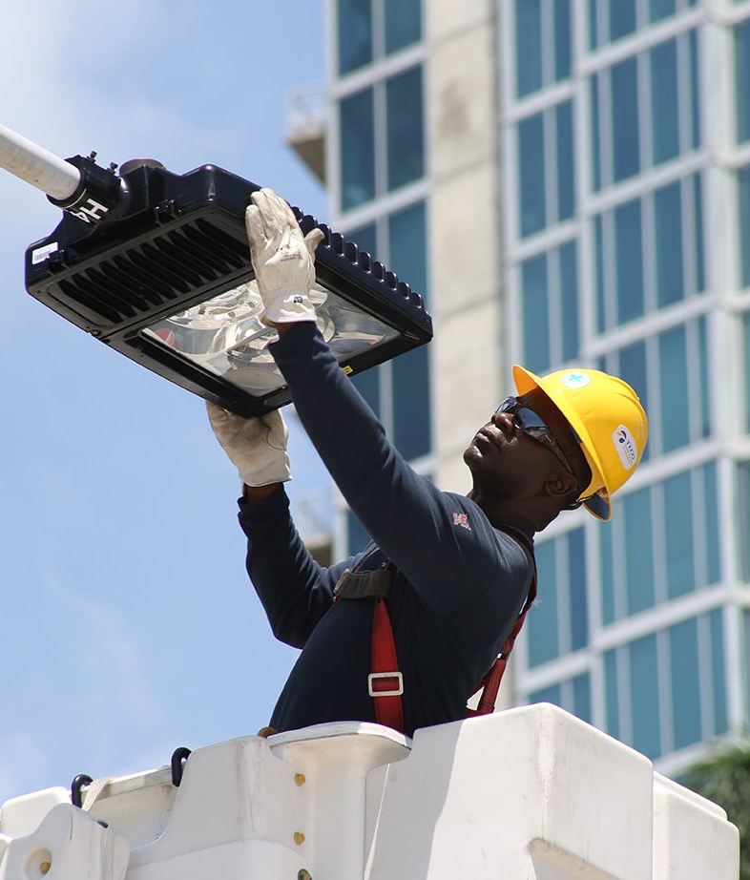
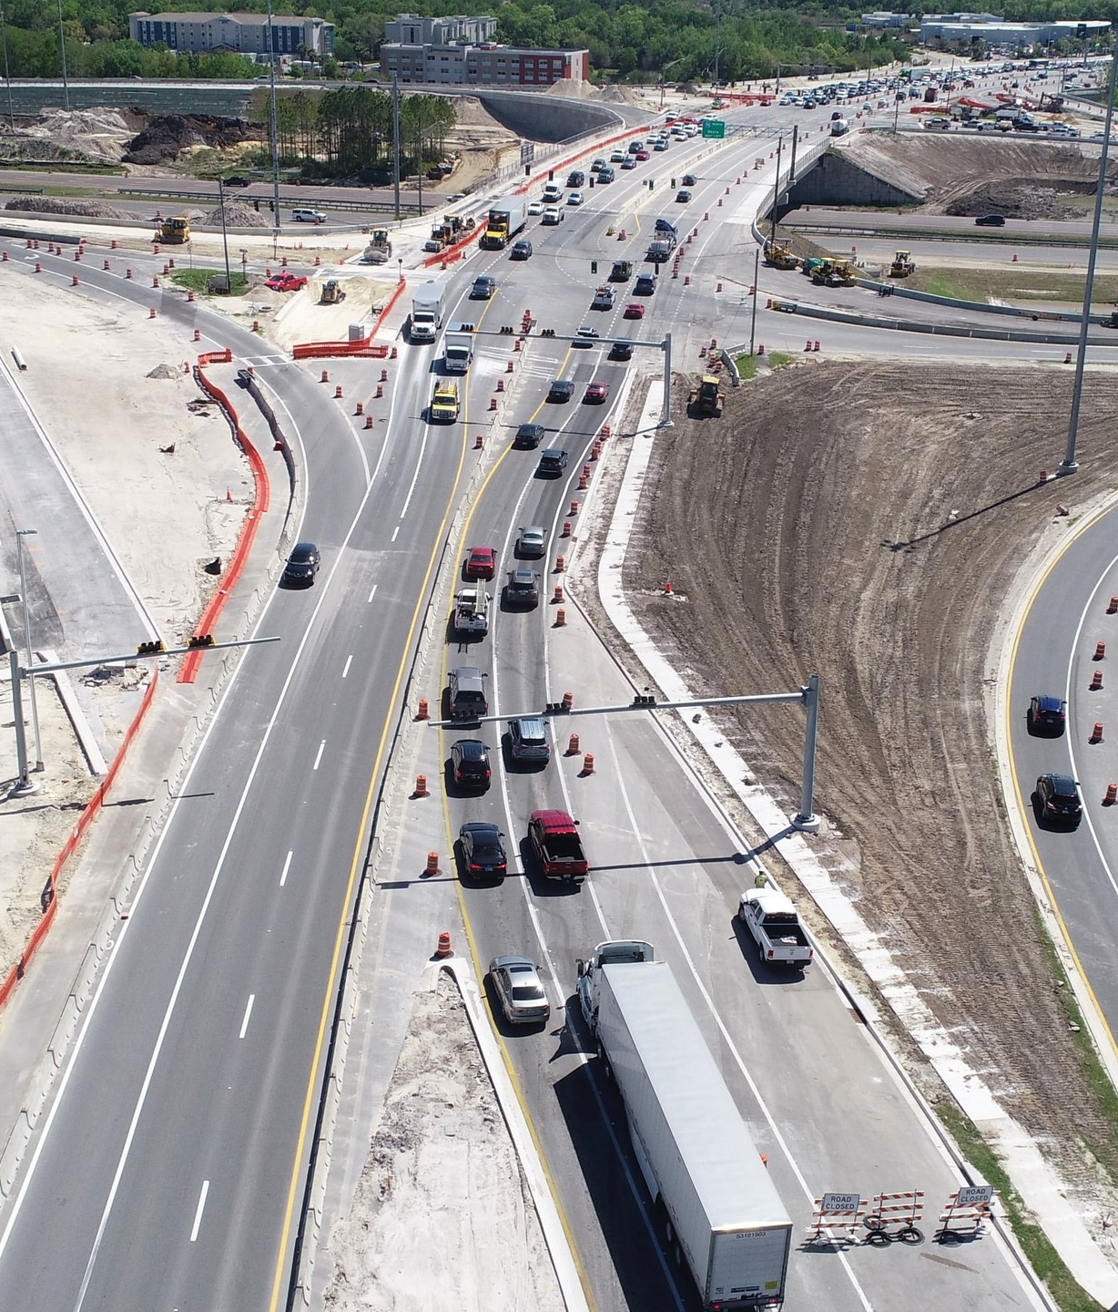
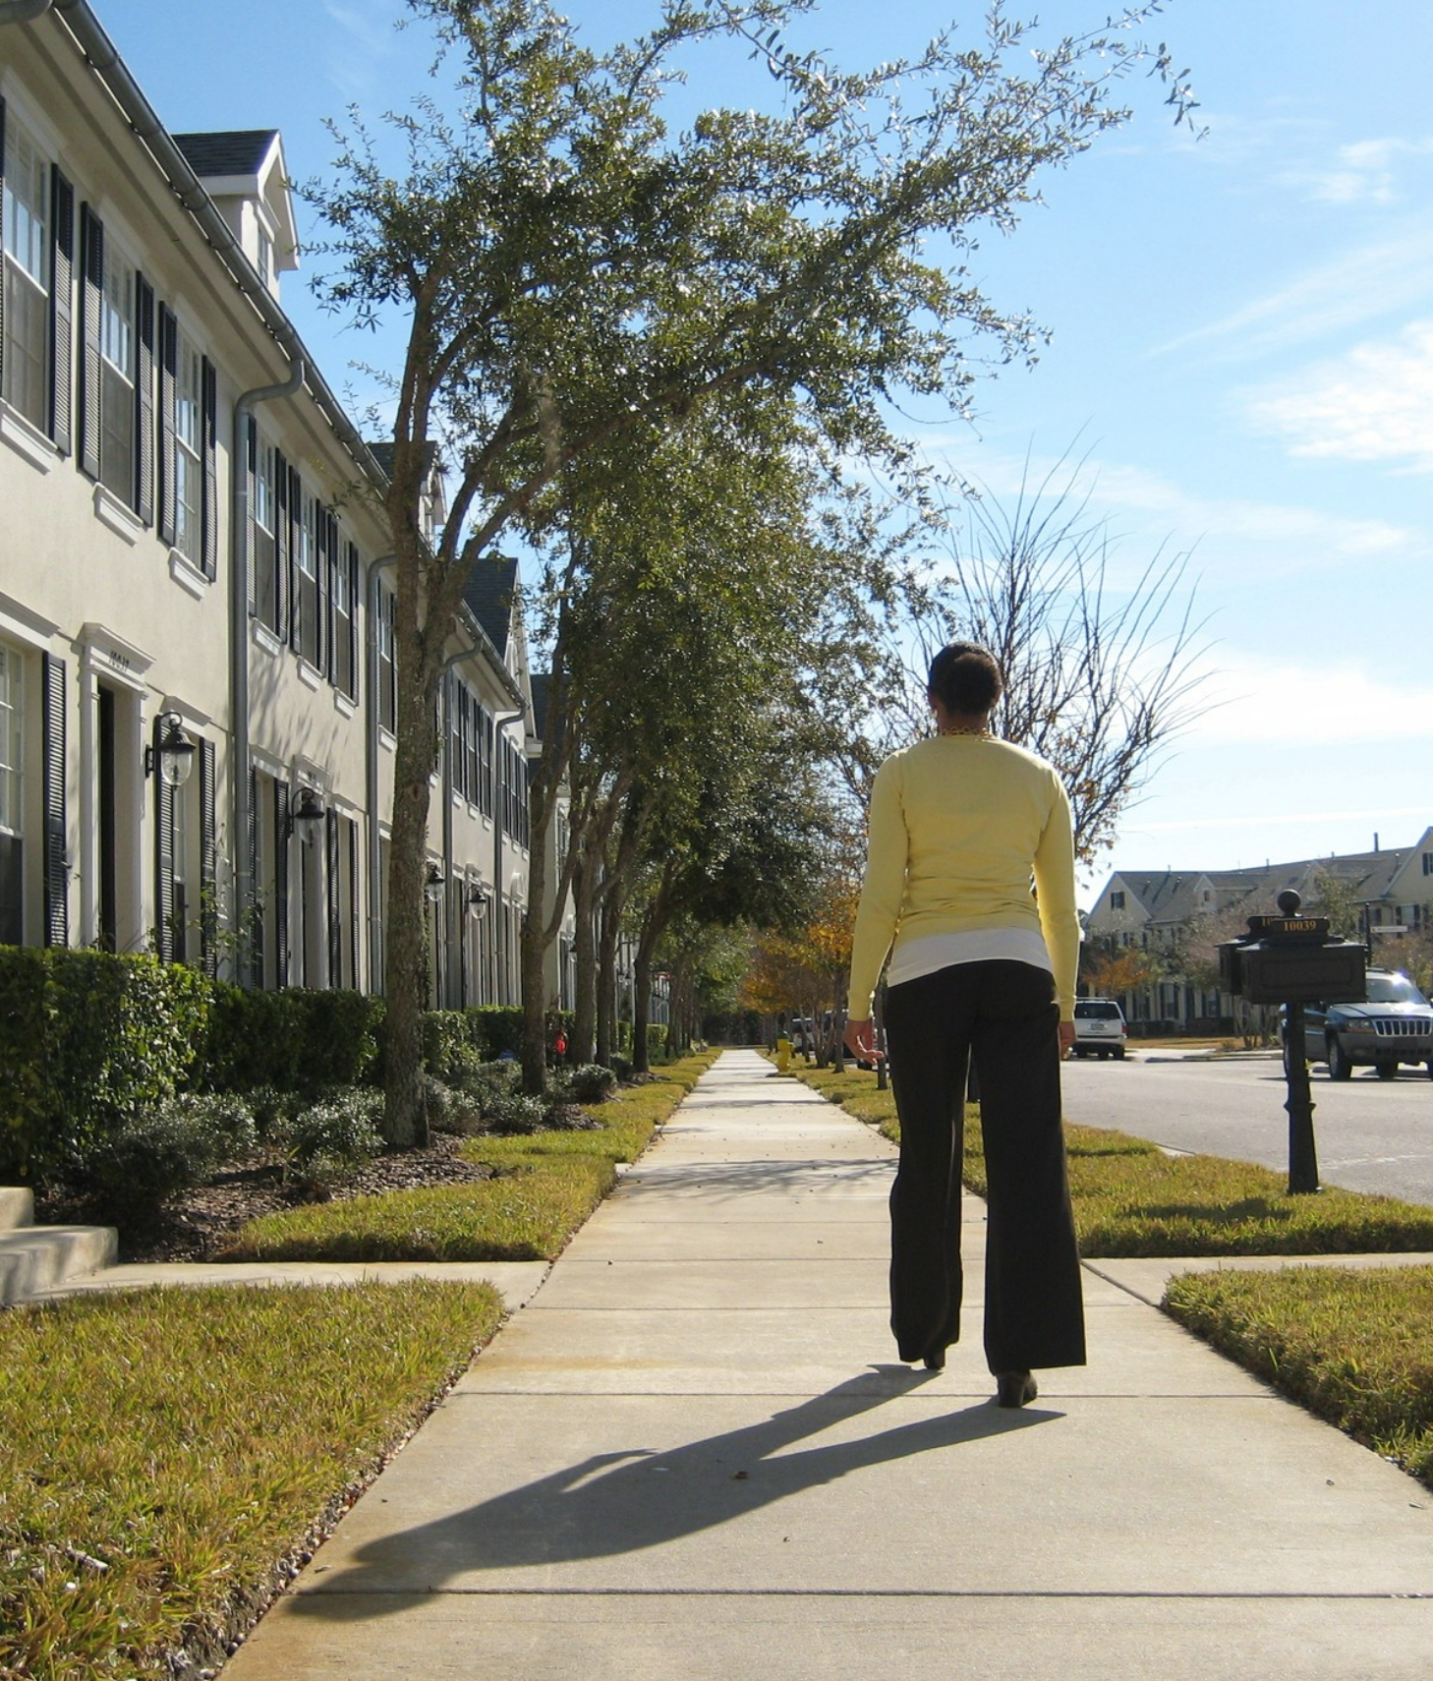
What a Community Plan does NOT do:
It does not allocate funds for infrastructure projects
By design, a plan does not generally change a property’s land use or zoning
Notes:
This is not a tool that is designed for a specific project to get done. It is to create a vision (does not widen roads, does not construct sidewalks)
If you own a piece of property and you want to change the zoning on it, this is not the process for that.
A community plan is not a catch-all, there will be issues that are raised that cannot be addressed in a community plan.
If you have comments and concerns about the community that cannot be covered by the community plan, that’s what these yellow cards are for.

Slide 10
Planning Commission and County staff were requested by the BOCC to create a new community plan for the Valrico area
The new Valrico Community Plan will be adopted into the Livable Communities Element of the Hillsborough County Plan
Valrico Community Plan
Planning Commission staff will work with the Valrico community to develop the plan’s Goals and Strategies

Slide 11
How to Get Involved
Online
Community-Wide Meetings
Volunteer as a Plan Ambassador
Office Hours
Check project website
Participate in virtual meetings
Held monthly in the community
Chat one-on-one with staff
Participate in a group activities
Held occasionally

Slide 12
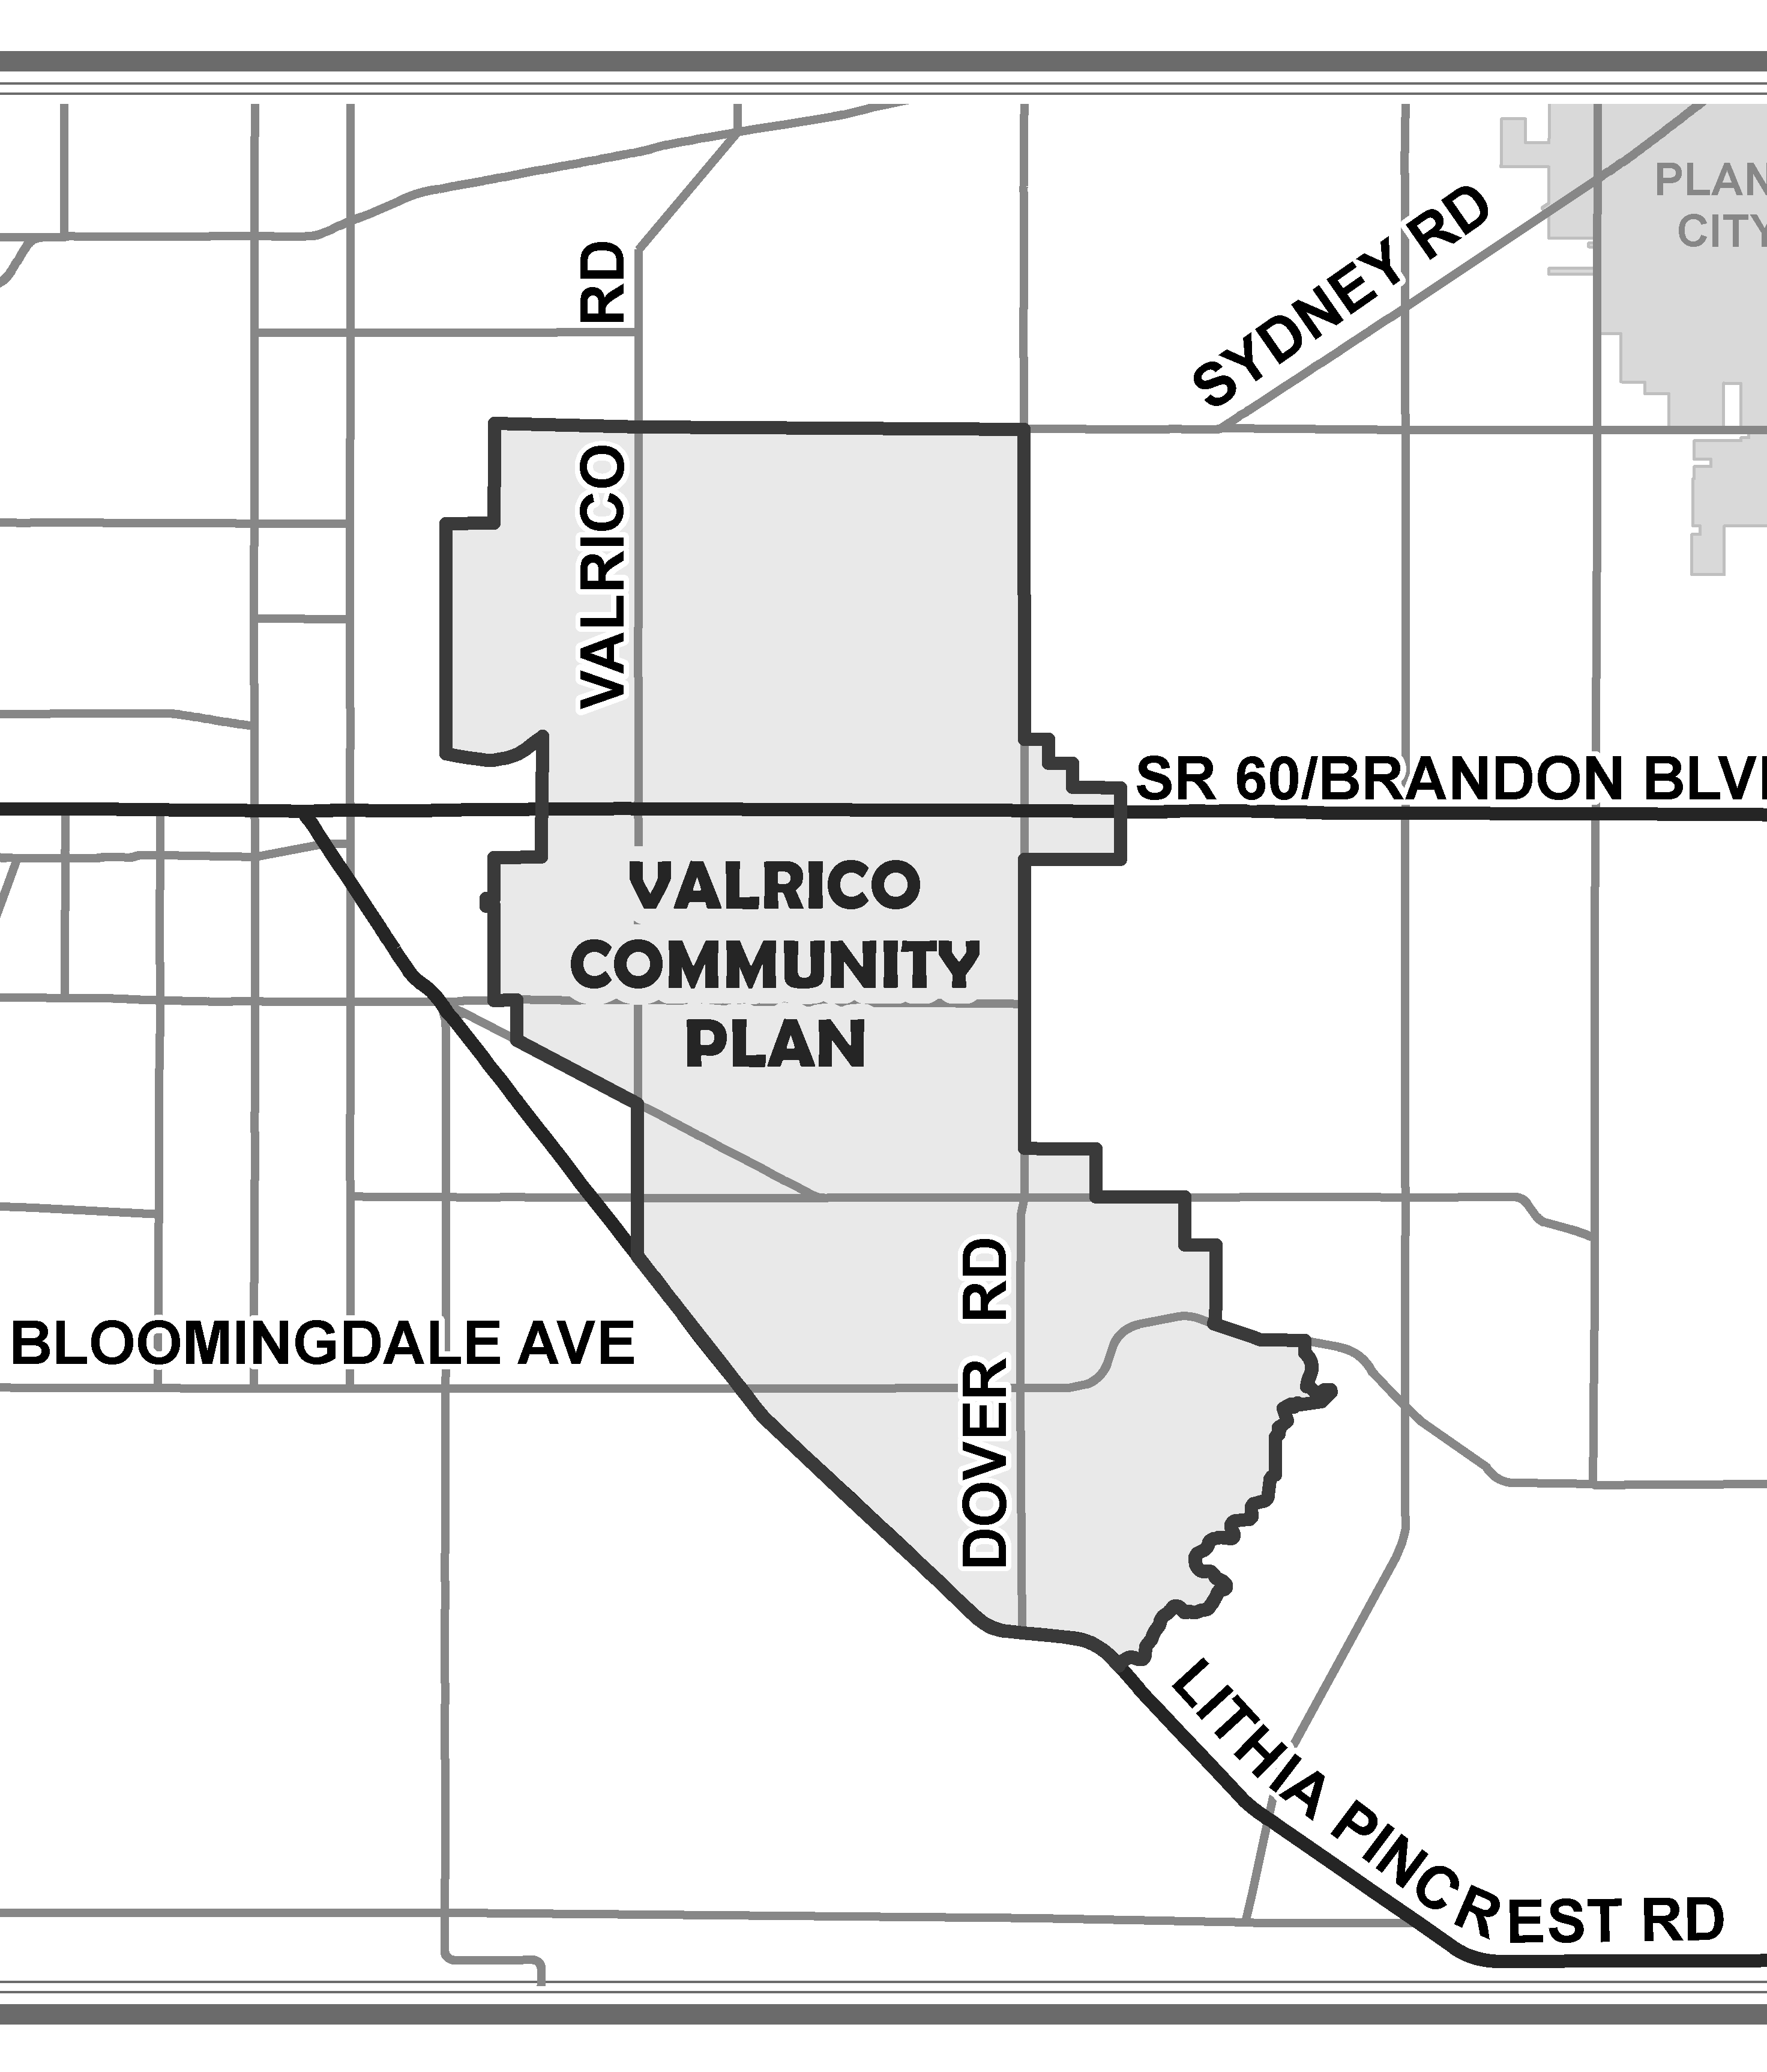
Tell Your Neighbors:
July Community Open Houses
Friday’s virtual meeting will just be a presentation
Monday’s meeting will follow the same format
July 24, 2023
5:00PM – 7:00PM
July 28, 2023 12:00PM – 1:00PM
Notes:
Second survey is building the community’s vision and establishing goals.

Slide 13
Next Steps
September Community Open Houses
Survey #2 – Vision Statement and Goals
Additional virtual meeting during weekday lunch hour
Summary of this meeting and results from activities
Sept. 23, 2023
9:00AM – 12:00PM
Sept. 25, 2023 5:00PM – 7:00PM
Notes:
Second survey is building the community’s vision and establishing goals.

Slide 14
Phase 1 - 2023
Phase 2 – Winter/ Spring 2024
Phase 3 – Summer 2024
Phase I -2023
Three community meetings in July – staff opportunities
Strengths, Weaknesses, Opportunities and Threats (SWOT)
Three community meetings in September – staff opportunities
Draft Goals, begin Strategy development
Office hours or other engagement opportunities throughout
Phase II - 2024
Report out Phase I
CPAC and community meetings
Office hours or other engagement opportunities throughout
Phase III - 2024
Report out Phase II and complete Plan Amendment process to adopt Plan
Community Meetings in July and September
Begin to draft plan Vision, Goals and Concept Map
Continue other community engagement opportunities throughout
Report out and refine Phase 1
Introduce strategies to meet Goals
Continue community engagement throughout
Report out on Phase 2
Present draft plan to community
Comprehensive Plan Amendment process
Notes:
Series of community meetings and surveys that reaffirm and reflect the conversation back to the community

Slide 15
Valrico Community Plan
Maps of Valrico
Valrico By the Numbers
Valrico Vision Survey

Slide 16
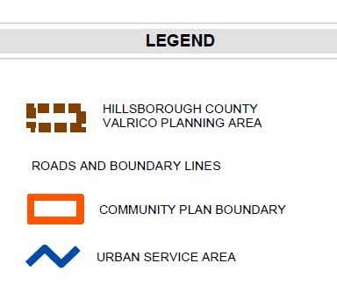
VALRICO RD.
SR 60/ BRANDON BLVD.
MULRENNAN MIDDLE SCHOOL
DOVER RD.
BLOOMINGDALE AVE.
LITHIA PINECREST.
Notes:
Describe the General Area/ Location of Valrico within the county
Describe the community plan boundaries
Describe the USA
Adopted in 1993
Ensures that growth gets directed where urban services like water, infrastructure, and roads are invested in
Min density of 4 units/ acre (the least intense land use within the USA)
The area to the right is the Energy/ Industrial area and is not currently in the plan
My address is “Valrico” but I am not within the boundary
- There are some people that

Slide 17
Valrico by the Numbers: Demographics
Average household size is almost 3 people
42% of households have yearly income of $100k or more
58% White, 22% Hispanic, 12% Black, 4% Asian, 4% Other
3% of households do not own a car

Slide 18
Valrico by the Numbers: Projection
In 2022, home to about 50,000 people, 18,000 residences, and 6,500 jobs
In 2045, Valrico is projected to be home to 56,000 people, 21,500 residences and 8,600 jobs
18,904
21,539
6,597
8,658
50,293
56,191
Notes:
31% of the population between the ages of 45 and 64 years old

Slide 19
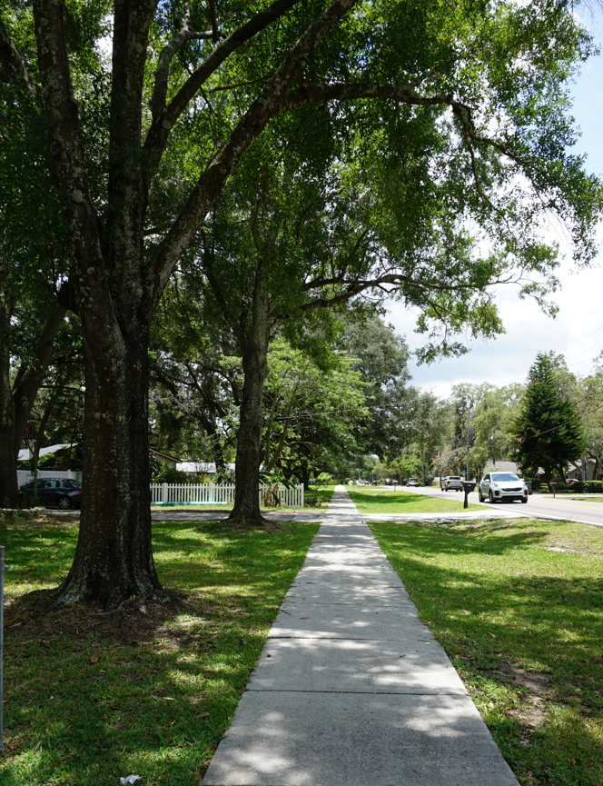
Valrico By the Numbers: Development
In 2022,
87% of the homes in Valrico are single-family (68% in Unincorporated Hillsborough County)
From 2011,
1,387 residential units were built in Valrico, 83% were single family (220 {15%} were multi-family)
Notes:
Overwhelmingly the construction and housing activity here has been single-family.

Slide 20
Valrico Vision Survey
Responses from April 13, 2023 to July 14, 2023

Slide 21
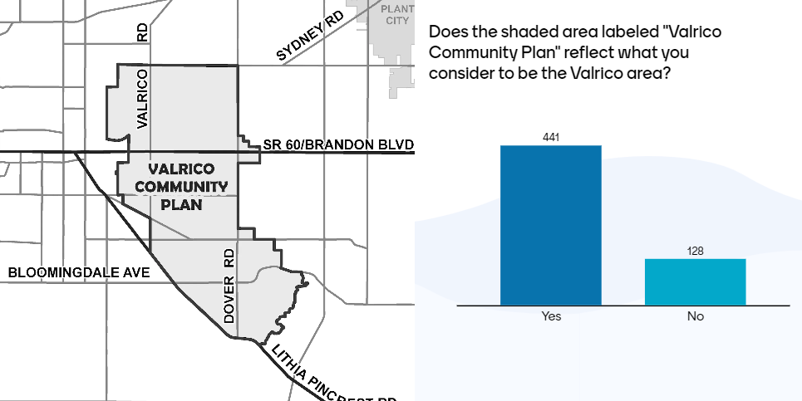

Slide 23
I like that it has lots of trees. I like that is being developed without getting rid of all the vegetation.
Trees
Far from downtown, all amenities are close by
Small community feel. Close and convenient commercial property (e.g. grocery, restaurants, gyms, medical facilities.

Slide 24
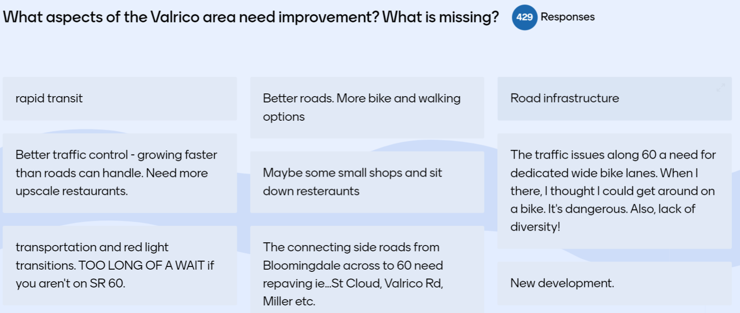
Better community parks and green spaces
Road design and construction
The roads are frequently congested and builders continue to build more homes on smaller lots, which brings more traffic.
More community centers, outdoor/indoor multi use facilities for recreation. Wider roads. Community events

Slide 25
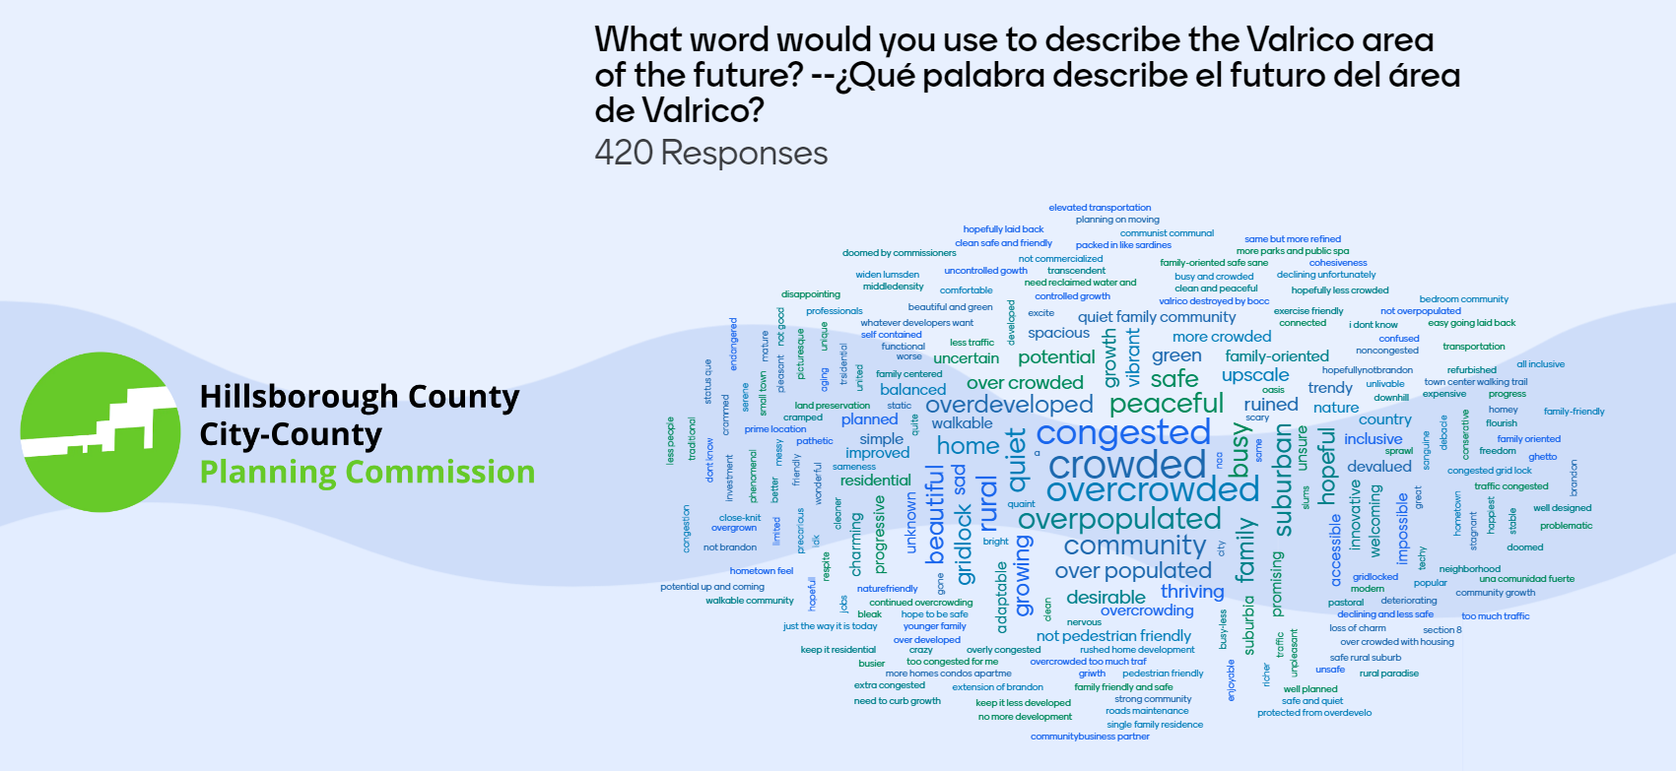
Notes:
Transition to Mentimeter

Slide 26
Near to most basic needs, but traffic congestion continues to get worse due to overdevelopment.
Trees, shade with big lots, local grocery and other shops, bicycle lanes for kids and pedestrians.
More mom and pop shops and restaurants, community events, public spaces, less traffic, less chains and franchises, native plants and trees.
Convenient to grocery stores, mall, fruit and vegetable stands. Lots in some areas are larger (1/3 acre). Tree shaded streets. Would like more community parks and community centers and better roads
Notes:
Transition to Mentimeter

Slide 27
None do. Changes that do not involve significant traffic/infrastructure improvement completely miss the issue most critical to Valrico’s future
Improved and added sidewalks, bike lanes, stopping some development, not every old farm property has to be turned into a subdivision.
More cohesion from schools to parks and shops.
Trees are kept and maintained. Curbs and sidewalks.
Notes:
Transition to Mentimeter

Slide 28
Valrico Community Plan
Meeting Activities:
SWOT Ranking
Valrico Community Plan Concept Map
In-Person Survey/ Free Response
Notes:
The exercise we’re doing today will:
Establish the boundaries of the CP
The foundation for the Concept Map which is the visualization of your plan
Begin to establish the goals for the plan

Slide 29
SWOT
Strengths
Weakness
Opportunity
Threat
Goal of the exercise is to prioritize:
Strengths & Weaknesses of the community today
Opportunities & Threats that can affect the future of the community
More instructions found in your meeting packet

Slide 30
SWOT Example - Trees
Strength:
Trees currently provide shade, aesthetics and character to the area
Weakness:
Trees today are removed to build homes, create businesses or widen roads
Opportunity:
Promoting trees in the future promotes the character of Valrico
Threat:
If future development removes trees that may mean less shade, aesthetics and change the character of Valrico

Slide 31
Next Steps
July Community Open Houses
Friday’s virtual meeting will just be a presentation
Monday’s meeting will follow the same format
July 24, 2023
5:00PM – 7:00PM
July 28, 2023 12:00PM – 1:00PM
Notes:
Second survey is building the community’s vision and establishing goals.

Slide 32
Next Steps
September Community Open Houses
Survey #2 – Vision Statement and Goals
Additional virtual meeting during weekday lunch hour
Summary of this meeting and results from activities
Sept. 23, 2023
9:00AM – 12:00PM
Sept. 25, 2023 5:00PM – 7:00PM
Notes:
Second survey is building the community’s vision and establishing goals.

Slide 33
Alvaro Gabaldon
(813) 582-7349
gabaldona@plancom.org
Jay Collins
(813) 582-7335
collinsj@plancom.org
bit.ly/planvalrico
Sofia Garantiva
(813) 582-7320
garantivas@plancom.org

