Slide 1
Open House Presentation

Slide 2
Presentation Agenda
Project Background and Purpose
Overview of Public Engagement Process
Overview of Existing Conditions
Workshop Activities
Next Steps

Slide 3
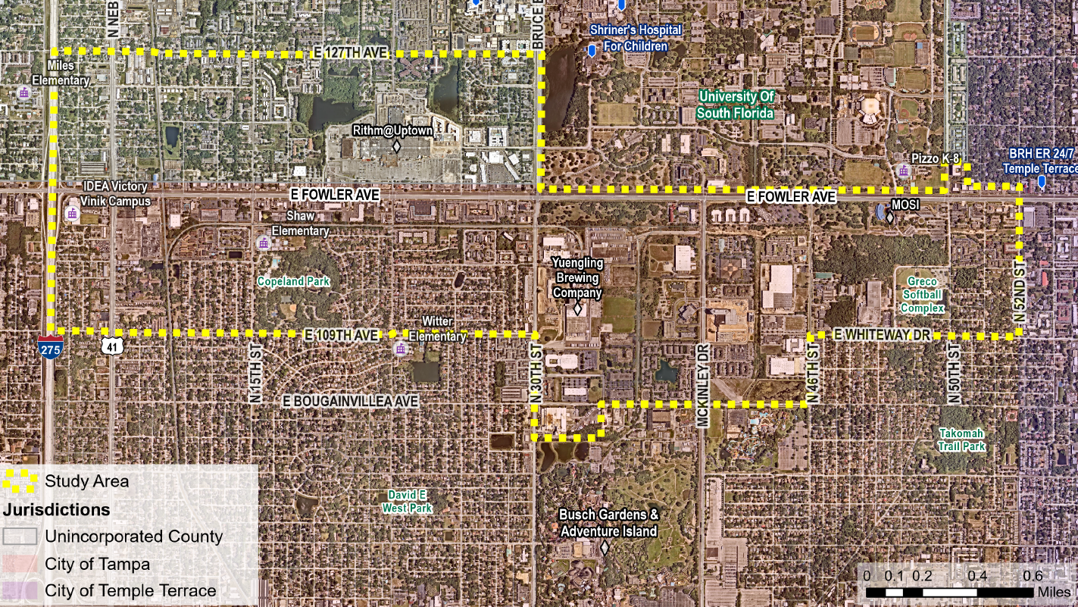
Study Area

Slide 4
Study Area Quick Facts
Approximately 1,900 acres
1,380 in City of Tampa
520 in Hillsborough County
Points of Interest include
Busch Gardens
USF
University Mall / RITHM at Uptown
Museum of Science and Industry (MOSI)
Churches and Religious Institutions
Parks
Schools

Slide 5
Purpose
Develop a vision plan for the Fowler Avenue Corridor that enables equitable redevelopment
Achieve an integrated land use and transportation vision for Fowler Avenue
Develop clear and consistent redevelopment strategies across jurisdictional boundaries along Fowler Avenue

Slide 6
Outcomes
A Comprehensive Vision Plan for Fowler Avenue
Coordination with HART and FDOT studies
Community education, engagement, and feedback
Comprehensive plan policy updates and recommendations for land use updates

Slide 7
Public Engagement
Different in-person and online engagement opportunities will be provided.
Community Workshops
Two workshops in the community.
Mobile Engagement
Mobile engagement opportunities include Community Walk and Talks and Community Ambassador Training.
Vision Toolkit
Materials available to bring to your community organizations and neighborhoods.
Focus Groups
Online Engagement
Stakeholder meetings and focus groups with business stakeholders, community groups and/or neighborhood groups.
An online survey on the project website.

Slide 8
Project Schedule: Engagement throughout
Fowler Avenue Vision Study - Project Schedule
Task | 2022 |  | 2023 | 2023/2024 |  |  | 2024
 | Q3 | Q4 | Q1 | Q2 | Q3 | Q4 | Q1
Project Phase | Community Values
 |  |  | Corridor Vision
 |  |  |  |  | Redevelopment Plan
Public Engagement and Outreach Activities
Community Workshop #1
Community Workshop #2
Online Survey
Project Website
Mobile Events
Stakeholder Focus Group Meetings
Presentations to Agencies and Boards

Slide 9
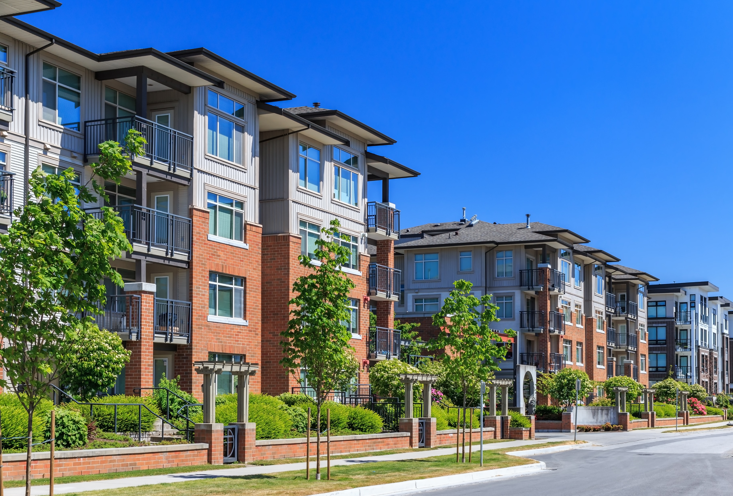
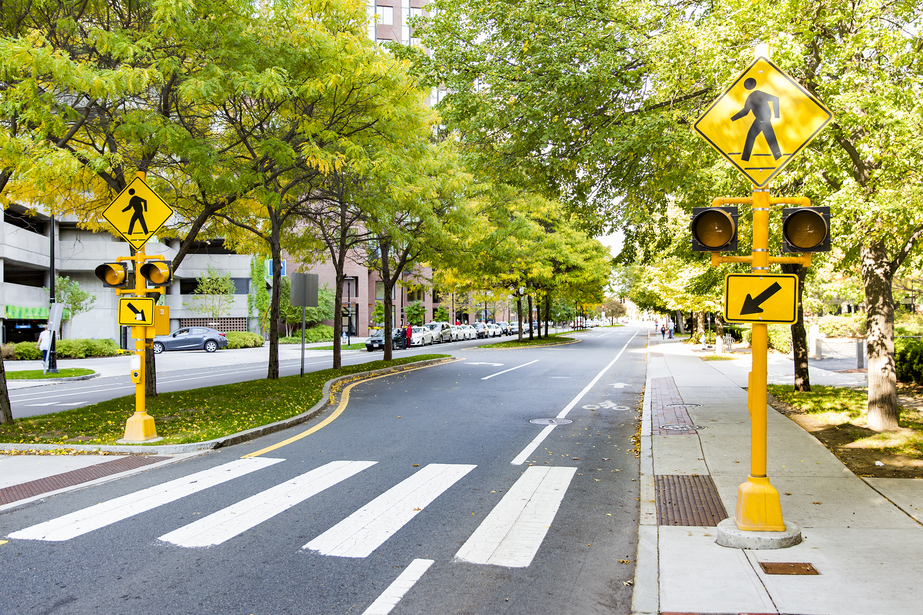
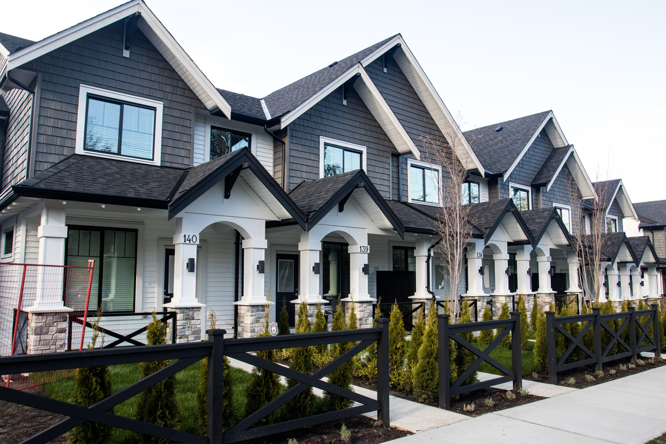
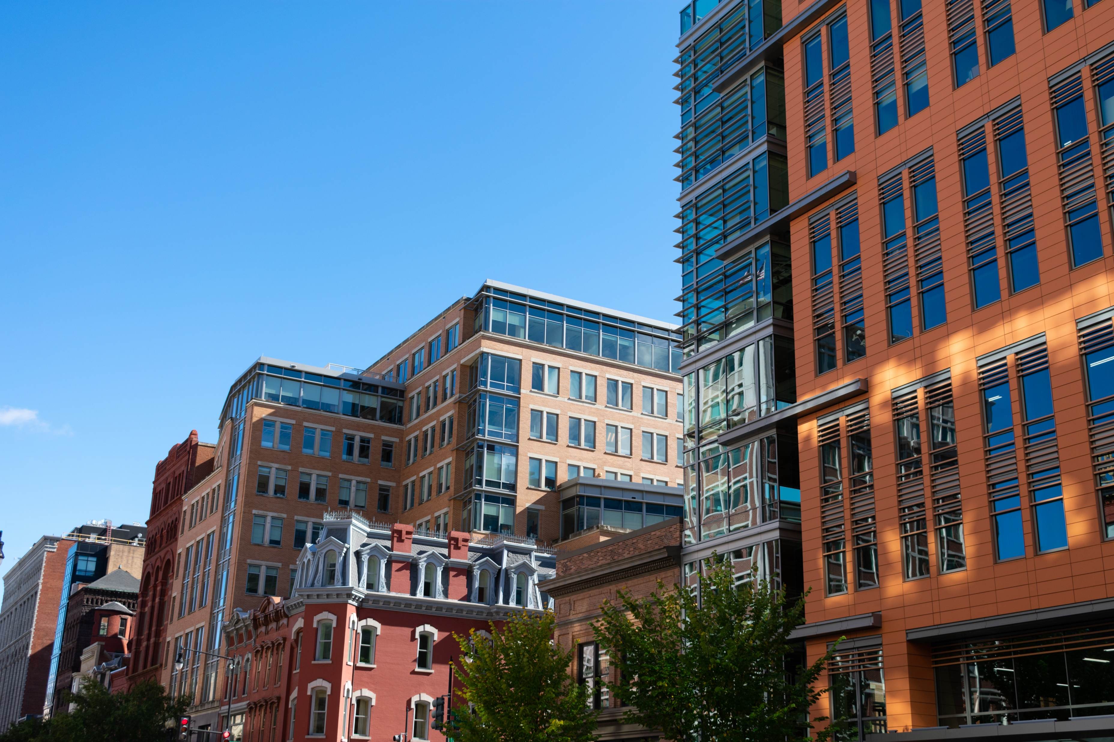
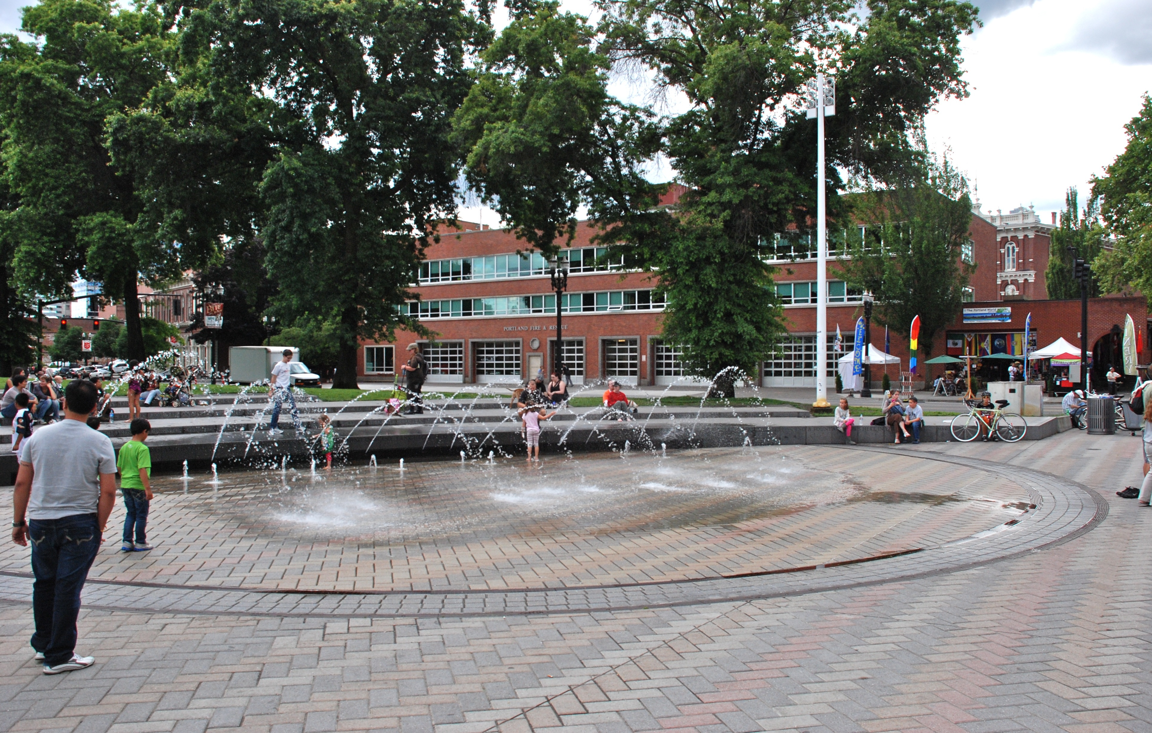
Potential Opportunities for Fowler Avenue
Land Use
Transportation
Housing
Economic Development
Public Spaces
Inspirational / Example Images

Slide 10
Today’s Workshop

Slide 11
Unincorporated County Future Land Use
Workshop Activities
Station 1 - Project Information
Station 2 – On-Going Study Area Projects
Station 3 – Opportunities and Challenges
Station 4 – Live, Work, Travel Map

Slide 12
Existing Conditions

Slide 13
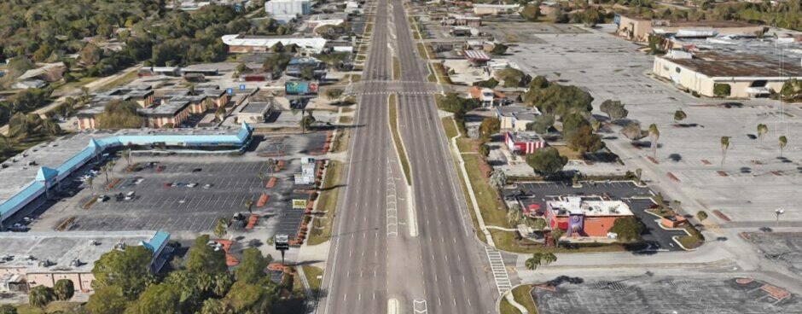
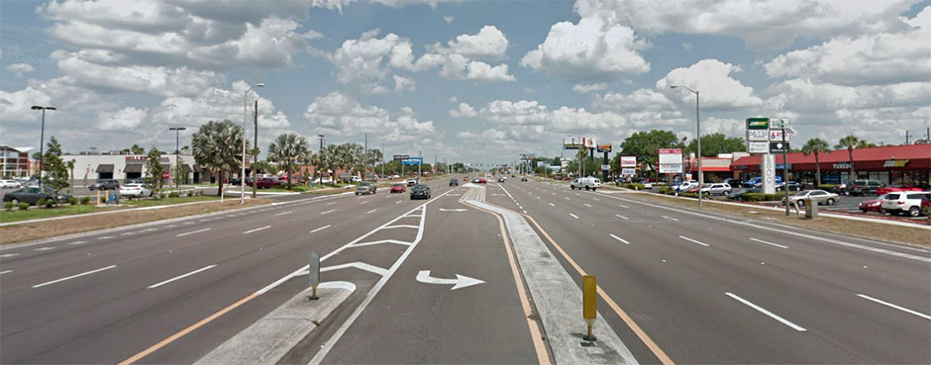
Background
Fowler Ave intersects Hillsborough County and City of Tampa boundaries
Provides unique land use challenges
Synergy with other studies and partners:
FDOT PD&E Study
HART Arterial BRT Study
USF
Soaring City !p / University Mall

Slide 14
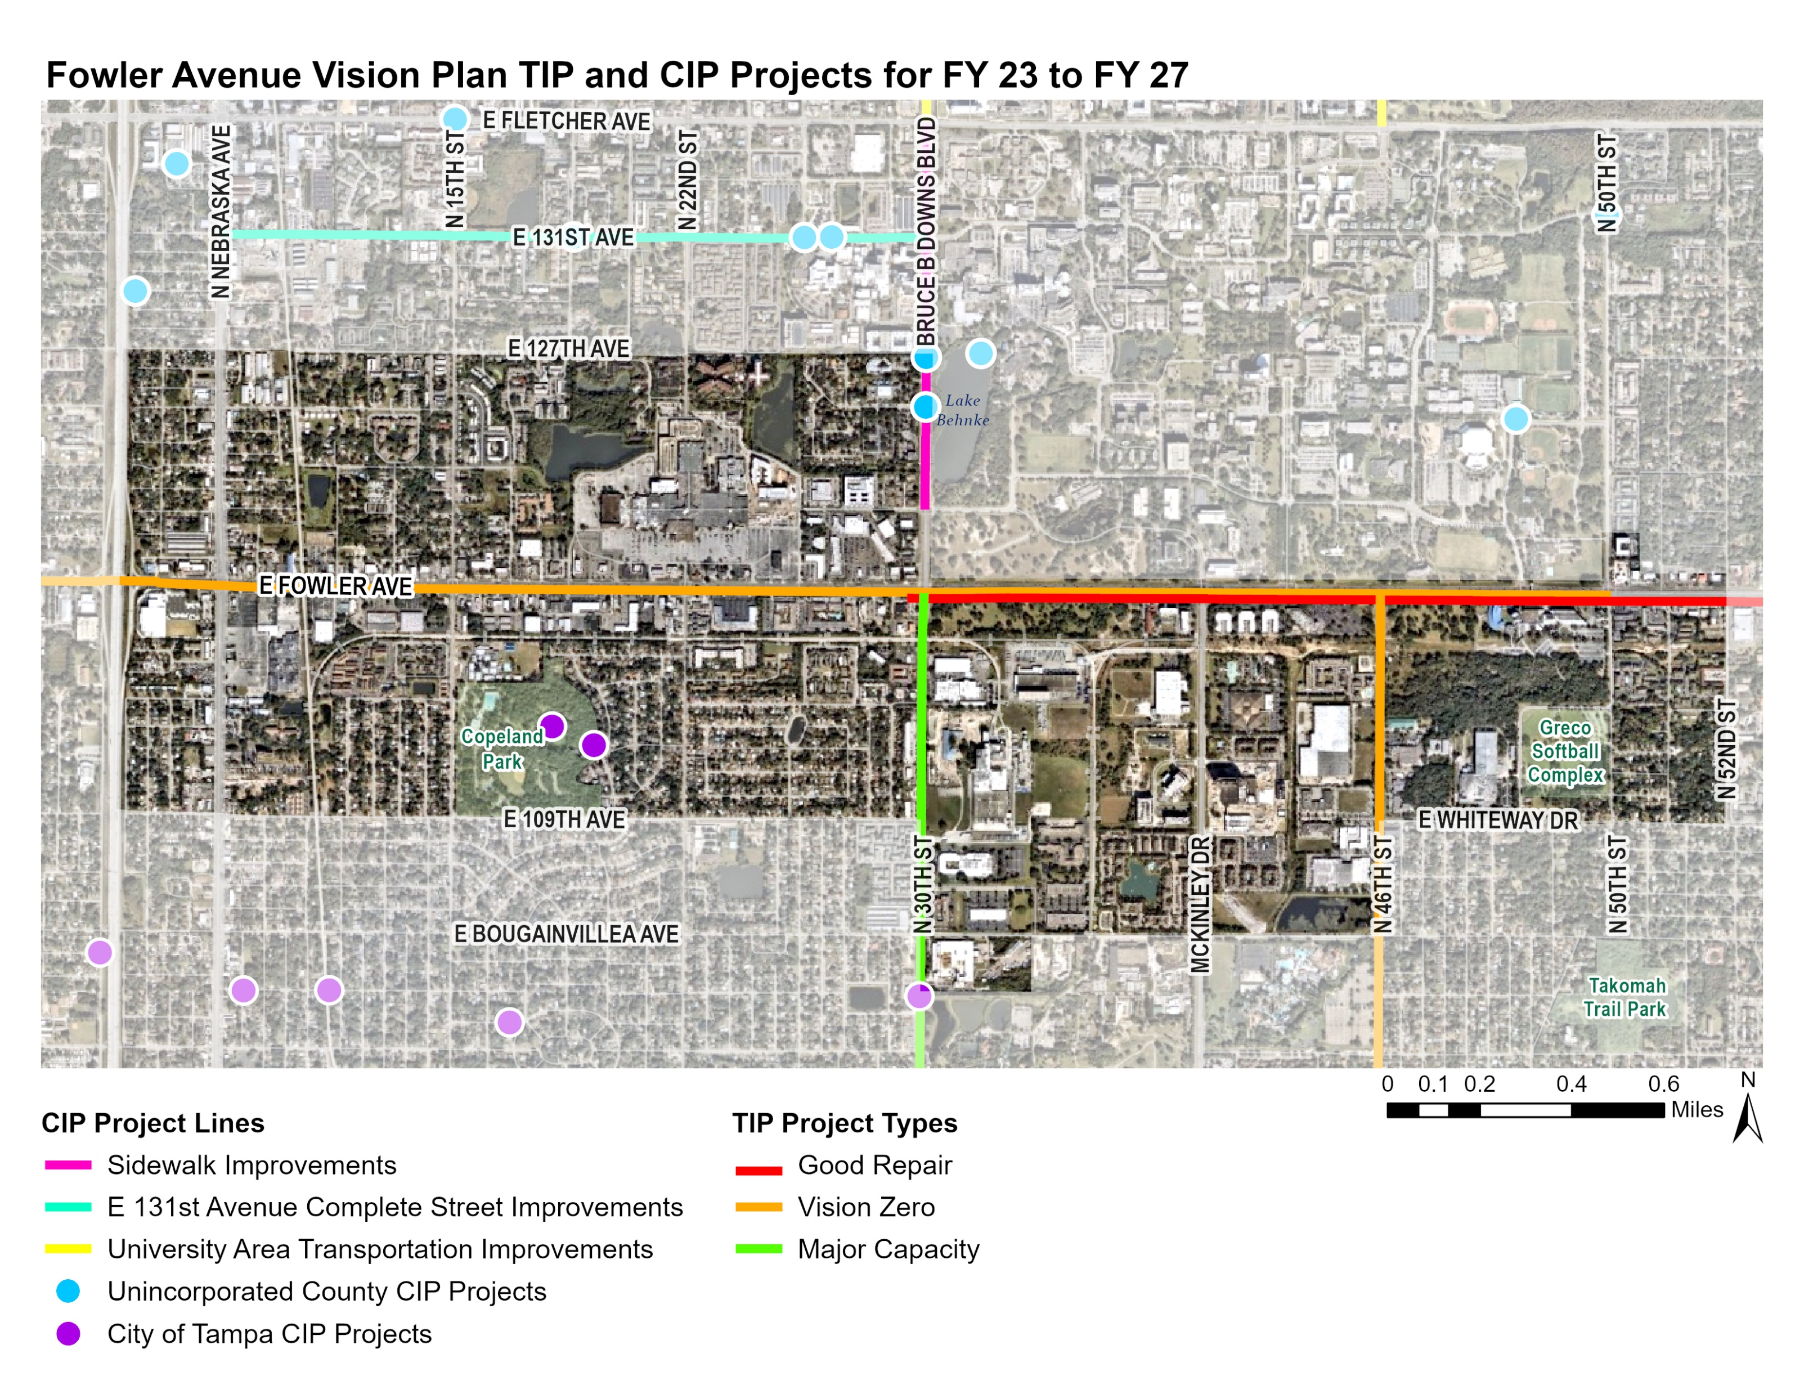
Planned Transportation Improvements
Unincorporated County CIP Project Point Descriptions
1
Bruce B Downs Blvd at Campus Hill Transportation Facilities Upgrade (ADA compliance)
2
1
2
2
Sidewalk Improvements along Bruce B Downs Boulevard from USF Pine Drive to Fletcher Avenue
1
2
City of Tampa CIP Project Point Descriptions
1
Copeland Park Pond Overlook and ecosystem restoration
2
Copeland Park Flooding Relief

Slide 15
On-Going Study Area Efforts
HART BRT Study
http://gohart.org/Pages/brt-arterial.aspx
FDOT Fowler Avenue PD&E
https://www.fdotd7studies.com/projects/fowler-florida-to-56th/

Slide 16
Demographics
Population: 15,120
Approx. 1% of County population
Number of Households: 6,080
Average Household Size: 2.44
25% of households do not have a vehicle
Total Employees: 9,950
About 1.5% of total County employees

Slide 17
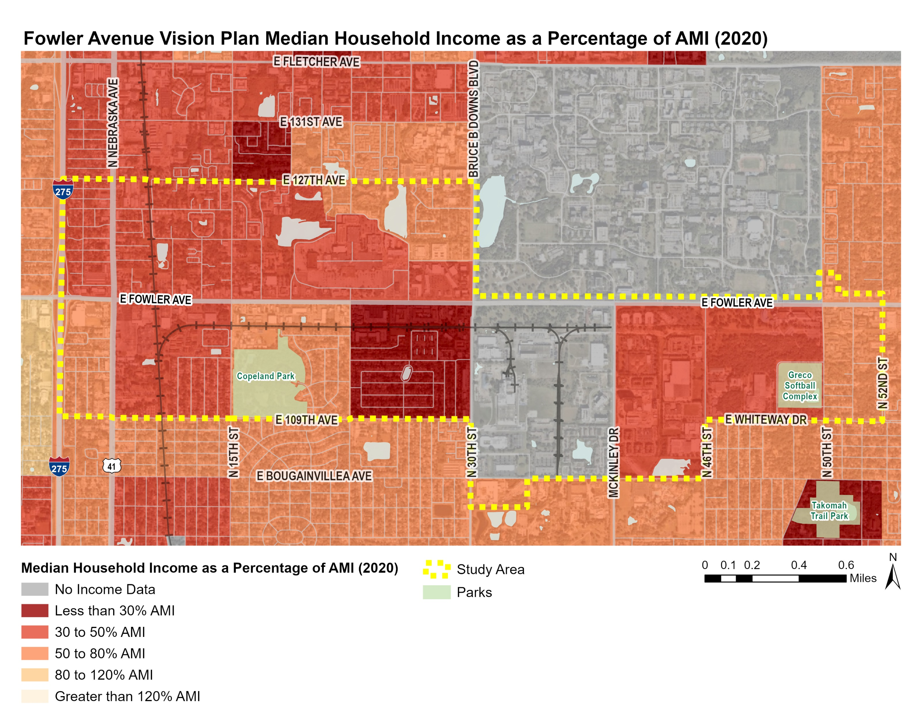
Household Income Expressed as a Percentage of AMI
The Study Area median household income is 64% lower than the Tampa-St. Pete-Clearwater MSA median household income
Income data sourced from 2020 ACS 5-Year Estimates, AMI determined using FHFC 2020 Income Limits for a Three Person Household

Slide 18
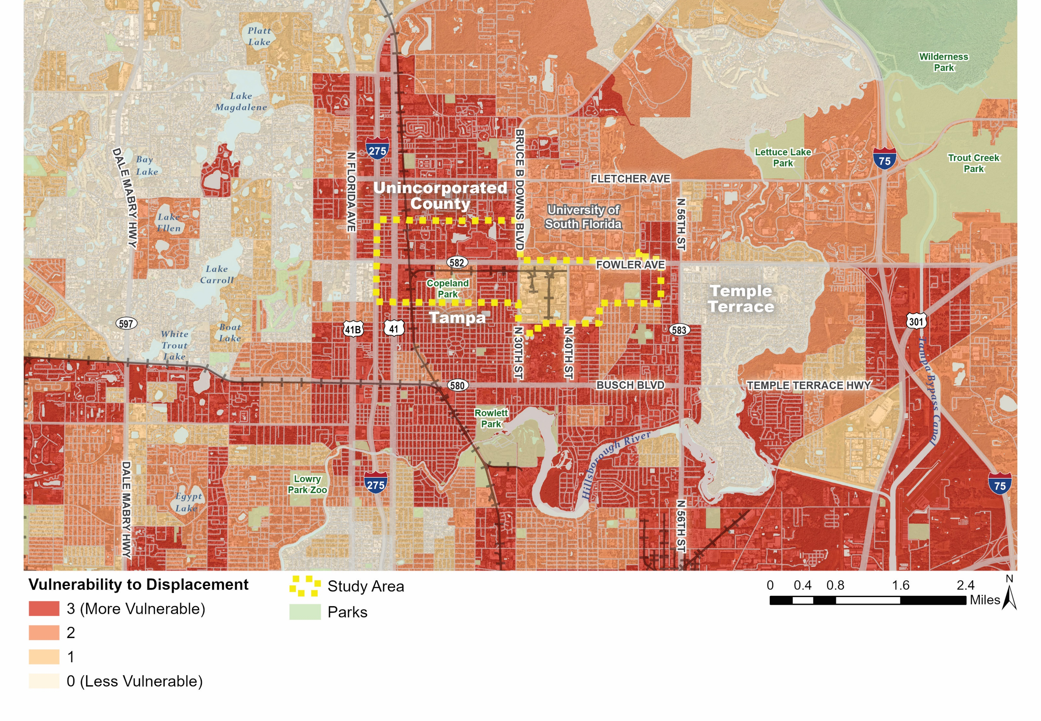
Vulnerability to Displacement
All Census Block Groups in Study Area are below the County Median Income
Average Percent of Renter-Occupied Households = 79.6%
County average = 40.7%
Average Population Over 25 with a Bachelor’s Degree or Higher = 17.3%
County average = 34.5%
Data sourced from 2020 ACS 5-Year Estimates
Median Household Income
+
Renter-Occupied Households
+
Population 25+ with a Bachelor’s Degree or Higher
=
Vulnerability to Displacement

Slide 19
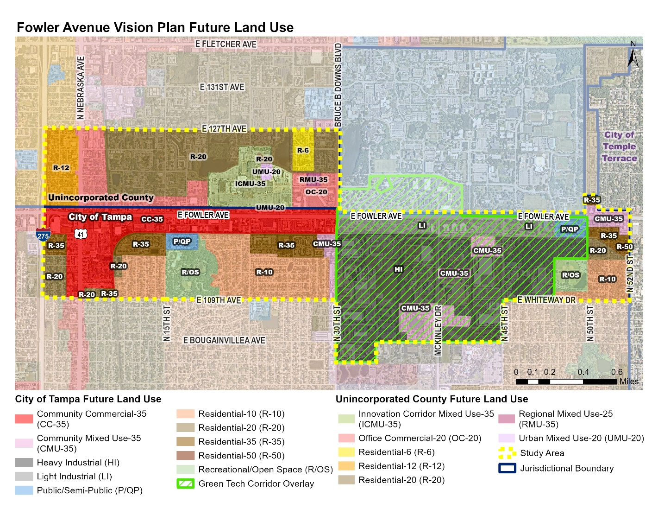
City Use
Future Land Use
The City of Tampa is predominantly Industrial (39.6%), followed by Residential (26.3%)
Unincorporated Hillsborough is predominantly Residential (59.8%)
Green Tech Corridor Overlay is meant to create economic development opportunities and promote energy-efficient development

Slide 20
Potential Opportunities for Fowler Avenue
Land Use
Transportation
Housing
Economic Development
Public Spaces
Inspirational / Example Images

Slide 21
Today’s Workshop

Slide 22
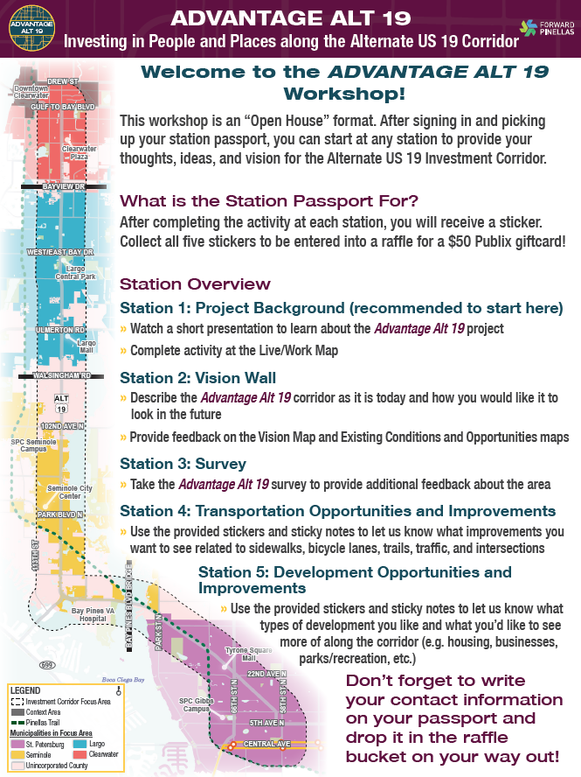
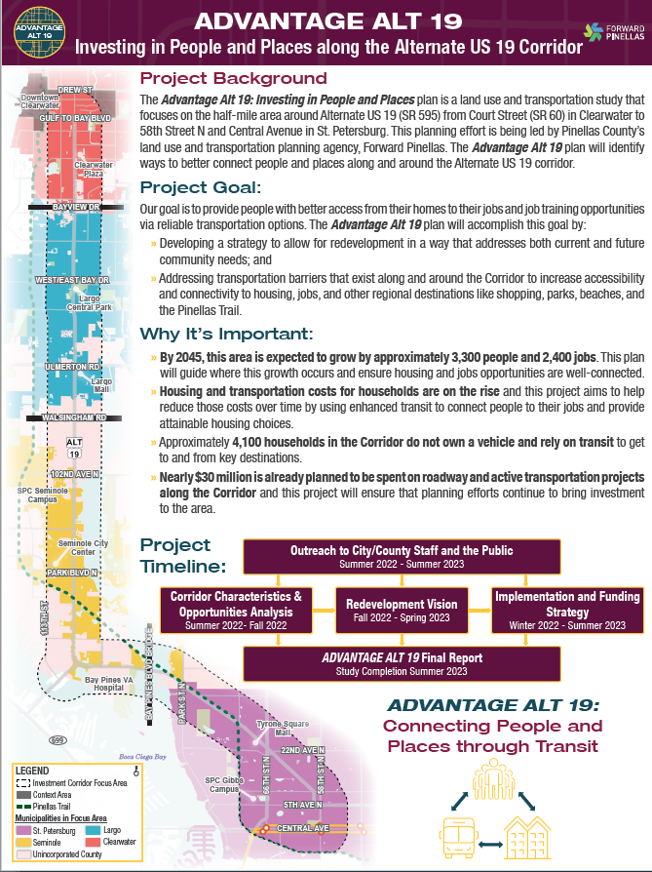
Unincorporated County Future Land Use
Workshop Activities
Station 1 - Project Information
Station 2 – On-Going Study Area Projects
Station 3 – Opportunities and Challenges
Station 4 – Live, Work, Travel Map

Slide 23
Next Steps
Existing Conditions Report
Mobile Engagement Activities
Stakeholder Meetings
Develop Vision to guide land use
Redevelopment Strategies

Slide 24
Alvaro Gabaldon
Planner II
(813) 582-7349
GabaldonA@plancom.org

Slide 25
Future Land Use – Hillsborough County
City of Tampa Future Land Use Classification | Acres | % of City Land within Study Area
Community Commercial (CC-35) | 237.5 | 17.2%
Community Mixed-Use (CMU-35) | 99.2 | 7.2%
Heavy Industrial (HI) | 448.5 | 32.5%
Light Industrial (LI) | 98.2 | 7.1%
Public/Semi-Public (P/QP) | 50.4 | 3.6%
Recreation/Open Space (R/OS) | 83.2 | 6.0%
Residential-10 (R-10) | 225.4 | 16.3%
Residential-20 (R-20) | 44.3 | 3.2%
Residential-35 (R-35) | 92.3 | 6.7%
Residential-50 (R-50) | 1.8 | 0.1%
Total | 1380.8 | 100%
County Future Land Use Classification | Acres | % of County Land within Study Area
Innovation Corridor Mixed-Use (ICMU-35) | 83.9 | 16.0%
Office Commercial (OC-20) | 117.2 | 22.4%
Regional Mixed-Use (RMU-35) | 4.3 | 0.8%
Residential-6 (R-6) | 59.9 | 11.4%
Residential-12 (R-12) | 232.8 | 44.6%
Residential-20 (R-20) | 19.1 | 3.8%
Urban Mixed-Use (UMU-20) | 4.8 | 0.9%
Total | 522.0 | 100%

Slide 26
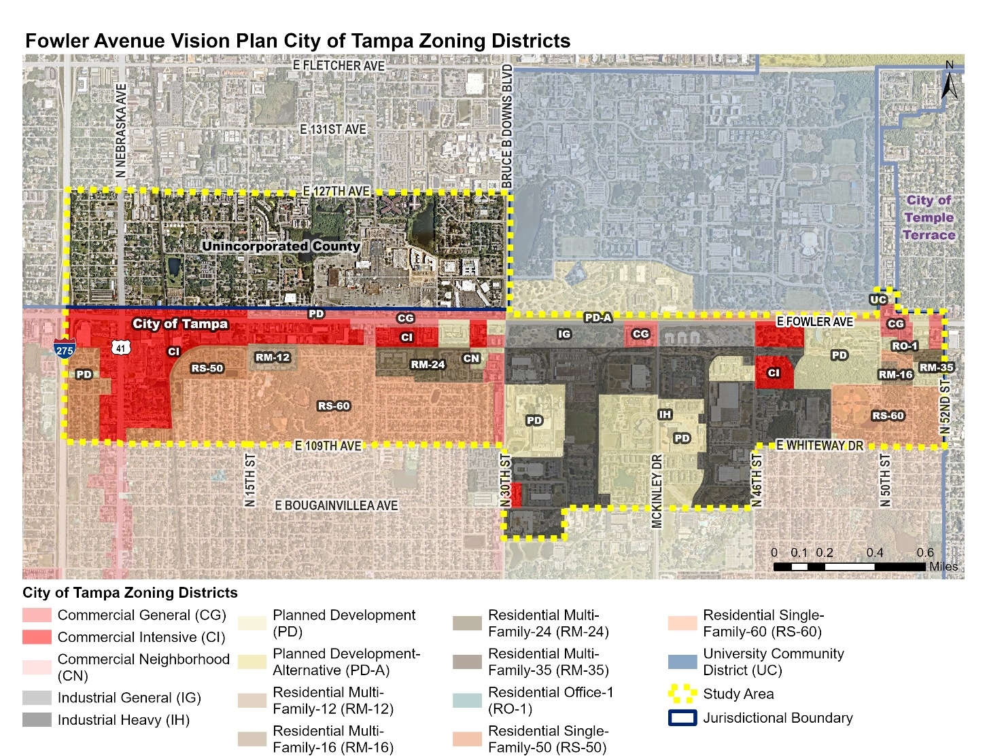
City of Tampa Zoning
Zoning – City of Tampa
City of Tampa Zoning District Group | Acres | % of City Land within Study Area
Commercial (CG, CI, CN) | 289.3 | 21.0%
Industrial (IG, IH) | 363.4 | 26.3%
Planned Development (PD, PD-A) | 270.9 | 19.6%
Residential Multi-Family (RM-12, RM-16, RM-24, RM-25) | 60.8 | 4.4%
Residential Single-Family (RS-50, RS-60) | 394.7 | 28.6%
Other (RO-1, UC) | 1.7 | 0.1%
Total | 1380.8 | 100%

Slide 27
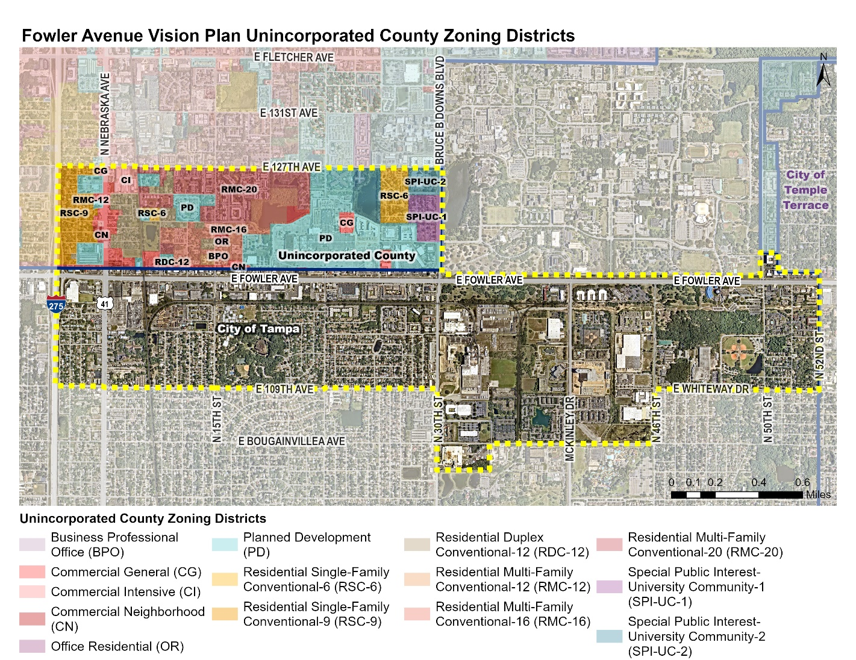
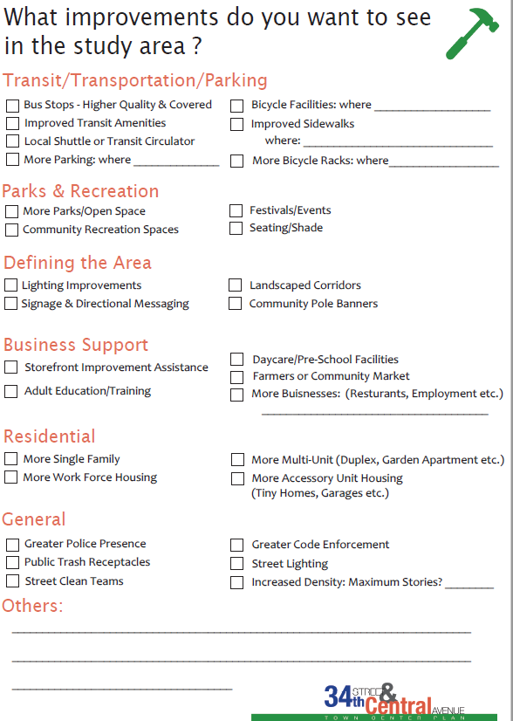
Unincorporated County Future Land Use
Zoning – Hillsborough County
County Zoning District Group | Acres | % of County Land within Study Area
Commercial (CG, CI, CN) | 55.4 | 10.6%
Office (BPO, OR) | 1.3 | 0.2%
Planned Development (PD) | 175.3 | 33.6%
Residential Multi-Family (RDC-12, RMC-12, RMC-16, RMC-20) | 178.1 | 34.1%
Residential Single-Family (RSC-6, RSC-9) | 62.0 | 11.9%
University (SPI-UC-1, SPI-UC-2) | 49.9 | 9.6%
Total | 522.0 | 100%

