Slide 1
Tampa Arterial BRT Study
Where are we at?
Jesus Peraza Garcia, Senior Planner
UACDC Partners Coalition January 2023

Slide 2
Tampa Arterial BRT: Timeline
We Are Here
2
019 |  | 2020 |  |  |  | 2021 |  |  |  | 2022
2023
Q3 Q4 Q1 Q2 Q3
HART’s Arterial BRT Study Phase 1
Q4 Q1 Q2 Q3 Q4 Q1
HART’s Arterial BRT Study Phase 2A
Q2 Q3 Q4 Q1 Q2
Recommended Alignment
Lower-Cost Alternative
HART Board Approval
HART Board Approval
HART Board instructed staff to proceed with Design of Lower- Cost Alternative (March 2022)
We Are Here

Slide 3
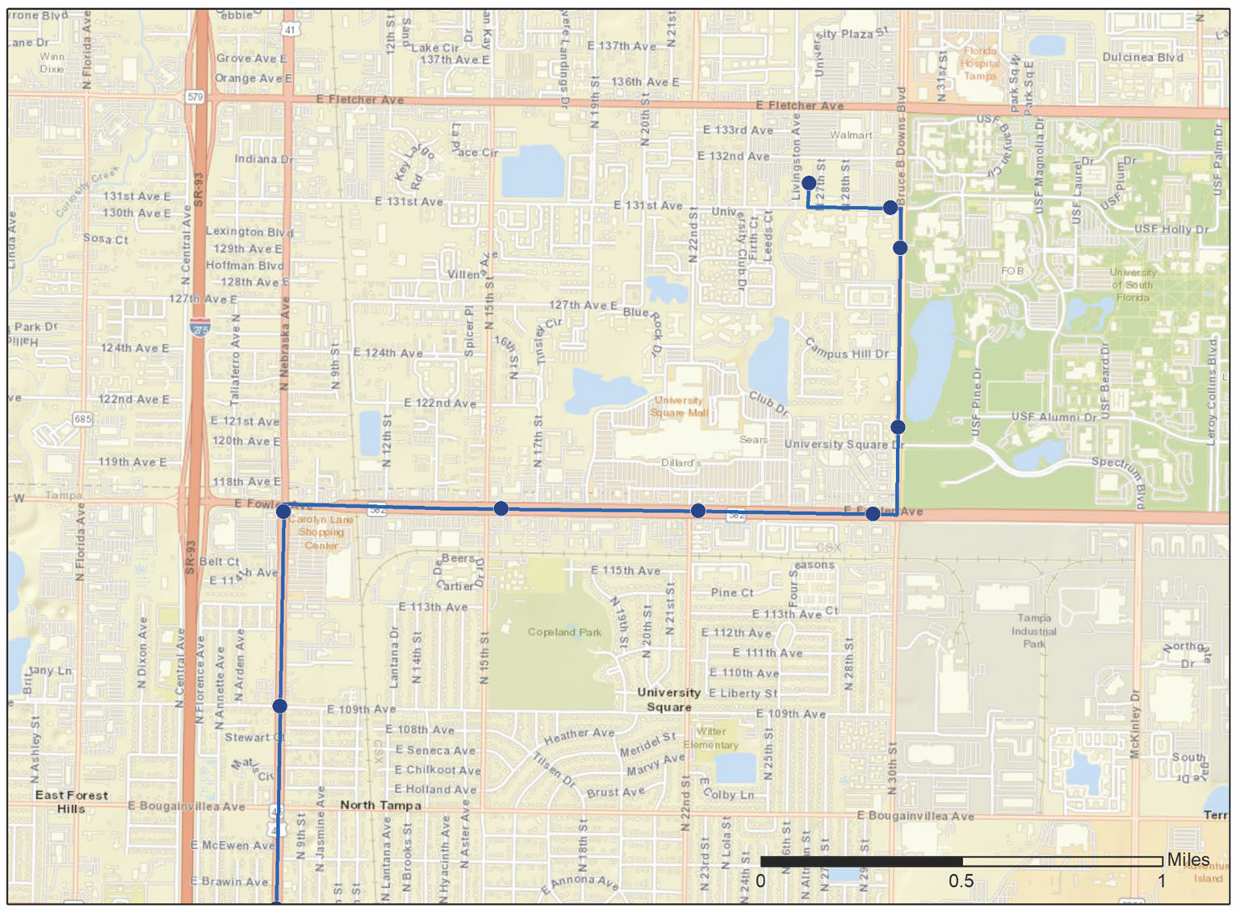
Tampa Arterial BRT: Fowler Ave
Latent transit demand along Fowler Avenue
Transit-oriented redevelopment going on in Uptown (e.g., University Mall)
High-need populations (low vehicle ownership, lower incomes, etc.)
Important connections to/from Seminole Heights, Tampa Heights, and Downtown Tampa
131st Ave
& VA Hospital
Sky Walk
& VA Hospital
UATC
10-to-15-minute bus service,
19 hours a day
USF Pine Dr
/University Square
Nebraska & Fowler
Fowler & BBDowns
109th Ave
* station area exact locations are subject to further analysis

Slide 4
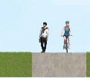
Tampa Arterial BRT: Streetscape
Preferred Alternative for Fowler Avenue: Bus-Only Lanes, Median-Running
Estimated Cost: $57.0 million (capital)
$3.1 to $4.9 million per year (operating)
Lower-Cost Alternative for Fowler Avenue: Business Access & Transit (BAT) Lanes, Curbside
B A T
Estimated Cost: $14.9 million (capital)
$3.2 to $5.1 million per year (operating)
B A T
-$42.1m (74% less than Preferred Alt.)
+7 mins. one-way (17% more time)
“Preferred” and “Lower-Cost” Alternatives were the outcomes of the Tampa Arterial BRT Study; FDOT’s ongoing PD&E study along Fowler Avenue will take these and other alternatives a step further
costs are for the entire corridor, not just Fowler Avenue; estimated by the Tampa Arterial BRT Study, updated Jan 2022
graphics adapted from Technical Memorandum #2 from the Tampa Arterial BRT Study (Oct 2020)

Slide 5
Tampa Arterial BRT: Next Steps
We Are Here
2
019 |  | 2020 |  |  |  | 2021 |  |  |  | 2022
2023
Q3 Q4 Q1 Q2 Q3
HART’s Arterial BRT Study Phase 1
Q4 Q1 Q2 Q3 Q4 Q1
HART’s Arterial BRT Study Phase 2A
Q2 Q3 Q4 Q1 Q2
Next Steps
(Phase 2B)
ONGOING
Recommended Alignment
Lower-Cost Alternative
Design Completion
Permitting
Public Engagement
Funding
(Federal/FDOT/TPO)
HART Board Approval
HART Board Approval
Construction
We Are Here

Slide 6
Fowler Avenue Vision Study
UACDC Partners Coalition
January 19, 2023
Jay Collins, AICP Alvaro Gabaldon

Slide 7
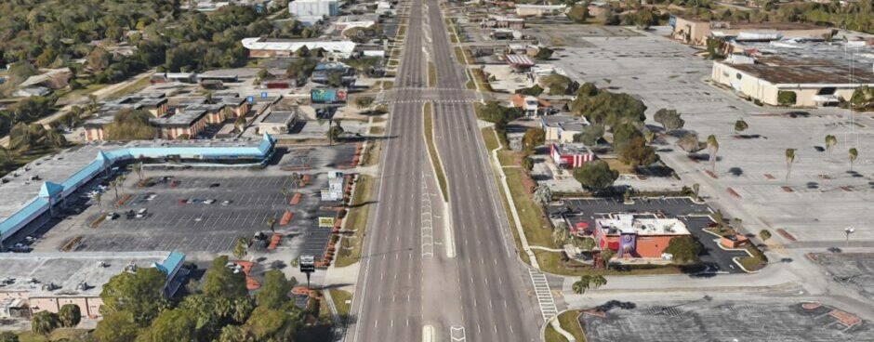
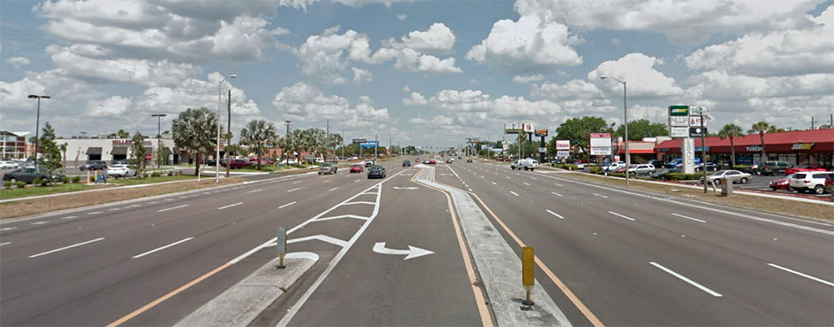
Background
Fowler Ave is at the intersection of Hillsborough County and City of Tampa boundaries
Provides unique land use challenges
Synergy with other studies and partners:
FDOT PD&E
HART Arterial BRT
USF
Innovation District/ University Mall

Slide 8
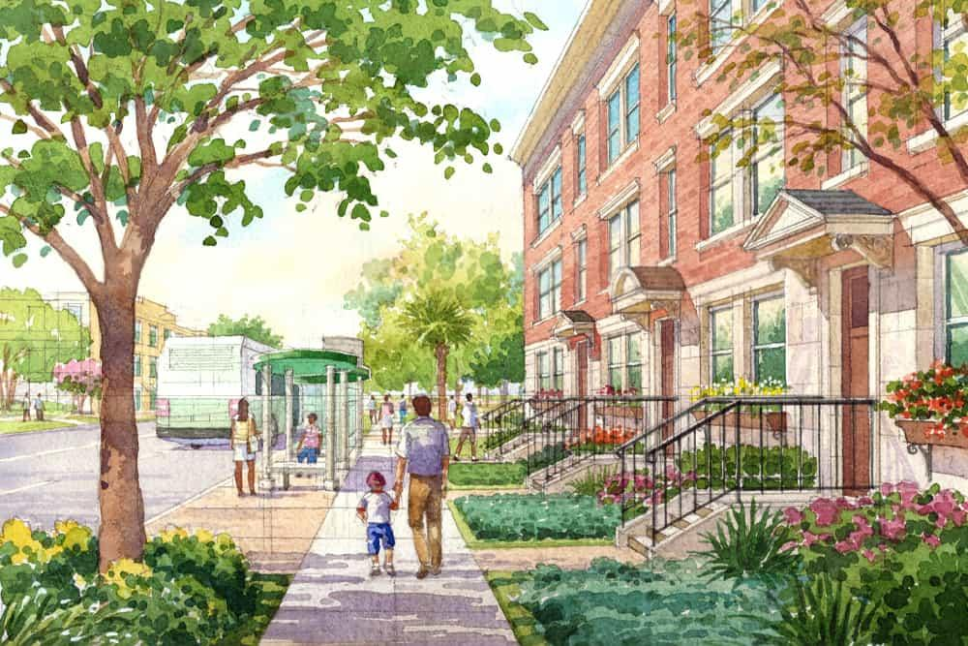
What is a Vision Plan?
Enables a community to define its future in public process
Explores the existing conditions of a community and identifies opportunities for improvement
Informs the comprehensive plan and represents the community in decision making

Slide 9
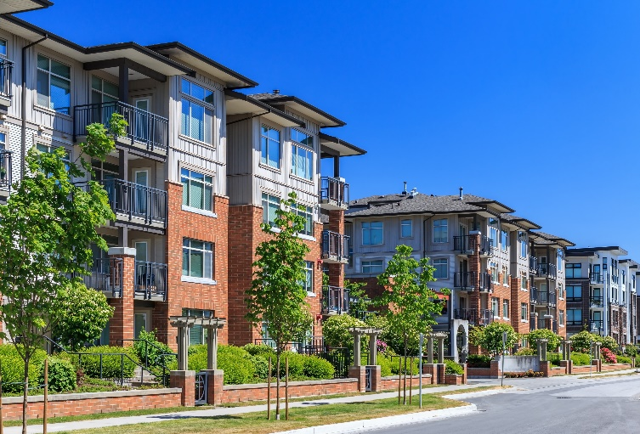
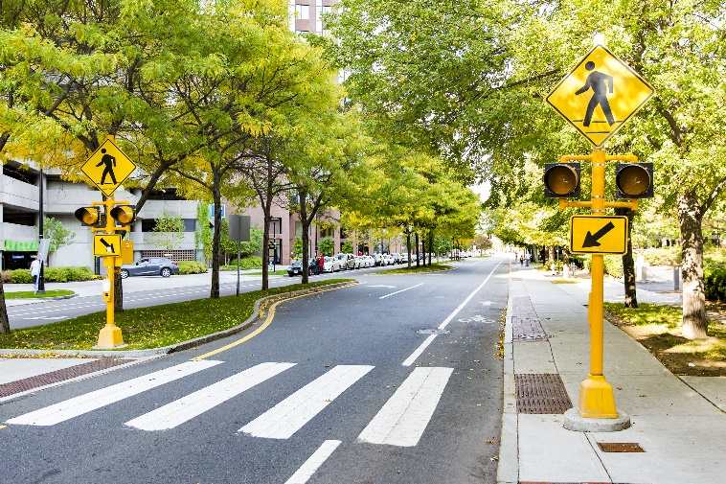
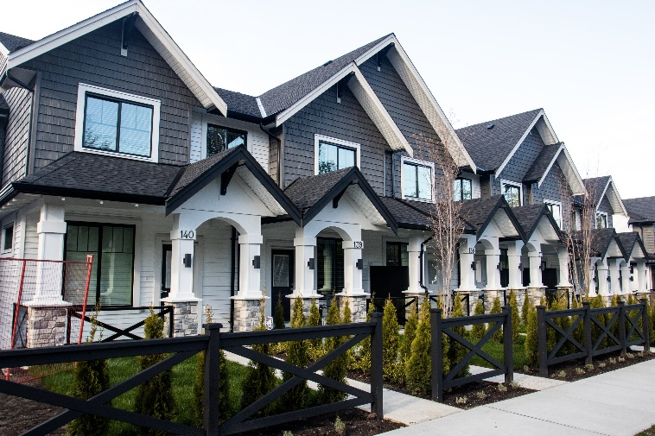
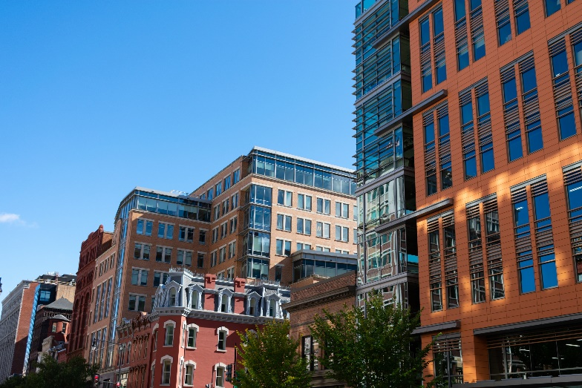
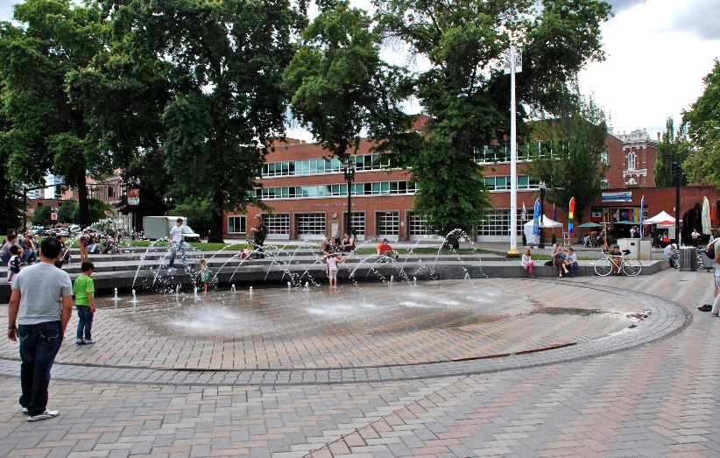
Potential Opportunities for Fowler Avenue
Land Use
Transportation
Housing
Economic Development
Public Spaces
Inspirational / Example Images

Slide 10
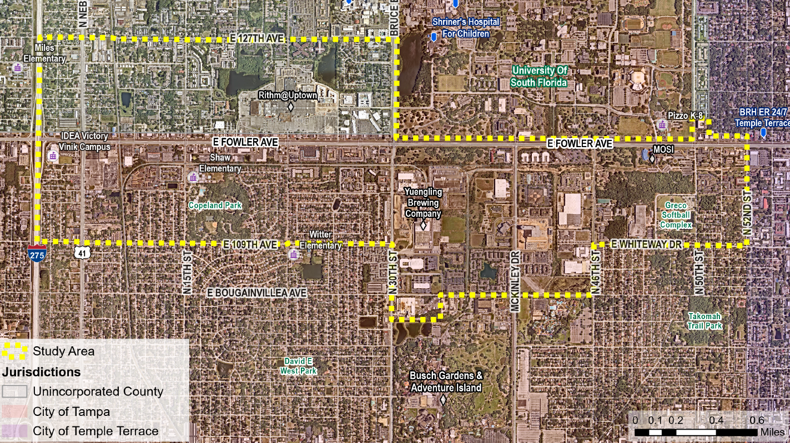
Study Area
Notes:
LRC
FDOT:
Incentivizing sidewalk building in residential redevelopment
Sidewalk widths in proximity to schools
How has single family development been created with sidewalks being mandated for new development
Sidewalk stompers (does Lisa have community contact/ leaders in Fowler study area)
HART:
50ft easement owned by TECO on the southside of Fowler (near all the fast food restaurants) 15th to 30th
City of Temple Terrace interested in using that easement,
Ocean Pkwy in Brooklyn good example of urban arterial
Tampa Raise Grant Match
Frontage road concept – BRT study did not include a frontage road alternative (link between FDOT study and HART BRT study)
Planning Commission:
Think of it as a neighborhood or community plan, for example sidewalks would be talked about as mobility in this plan (not the width, not the design these are implementation tools, the code is the regulating plan that would include these details, this deliverable is at the policy level that enables this implementations)
Begin to have understanding and conversation with neighborhood with how the right of way will impact the future and how the community can influence the right of way
Uniform idea of development along fowler avenue
Large institutional uses along Fowler
Vision plan has a redevelopment plan – what will be the policies that will be going in to the Comp plans of Hillsborough County and the City of Tampa and strategies for implementation
Why isn’t the university in it? Statistically an outlier
How are we asking people how they would like to participate at open house?
Did you incorporate PMT
Shaw Elementary off of fowler – Safe Route to School Recommendations incorporated into Fowler Report and vice versa
BPAC
-

Slide 11
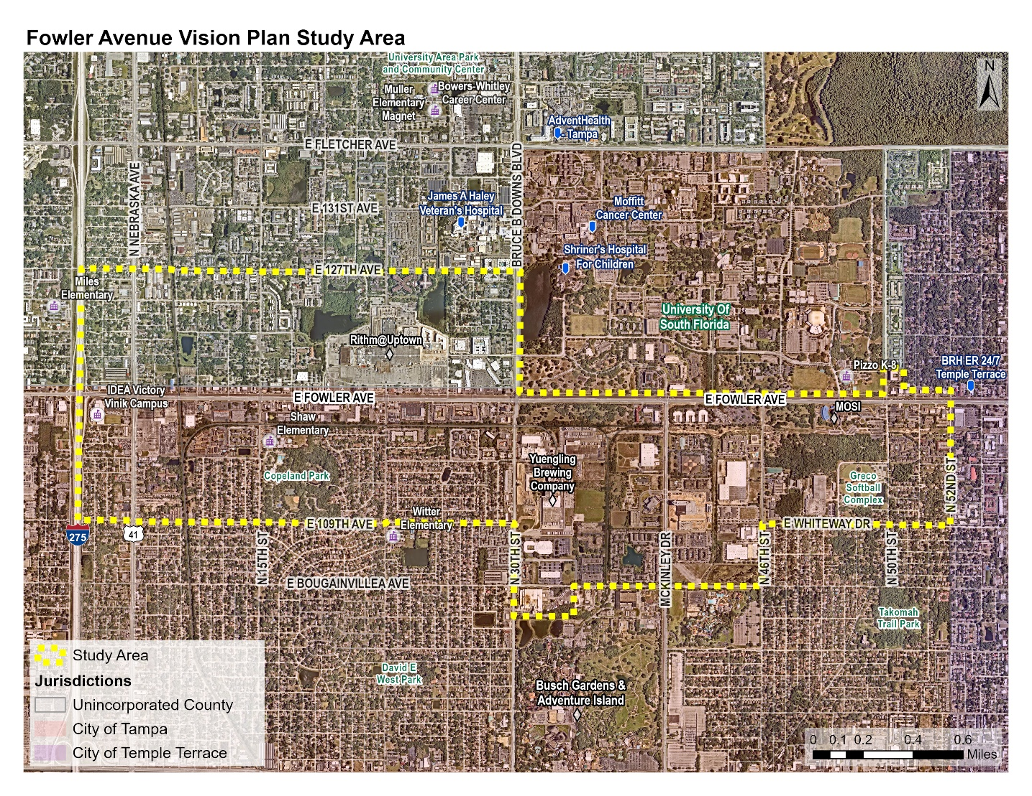
Demographics
Population: 15,120
Approx. 1% of County population
Number of Households: 6,080
Average Household Size: 2.44
25% of households do not have a vehicle
Total Employment: 9,950
About 1.5% of total County employees
Notes:
Dense Employment and Dense Residential
County Average: 1 job for every 5 residents
County population: 1.5 million
County employees: 660,800
This data is from ESRI business analyst

Slide 12
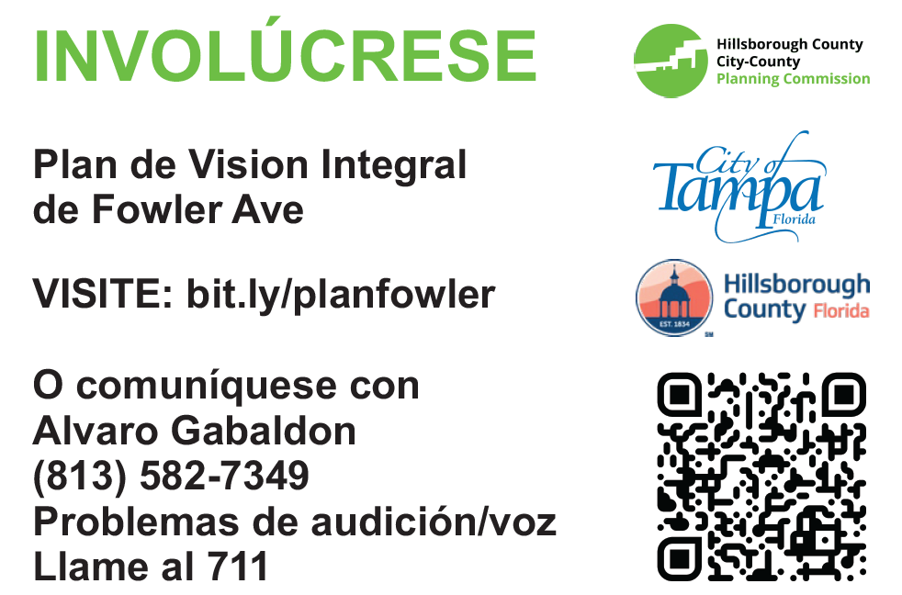
Public Engagement

Slide 13
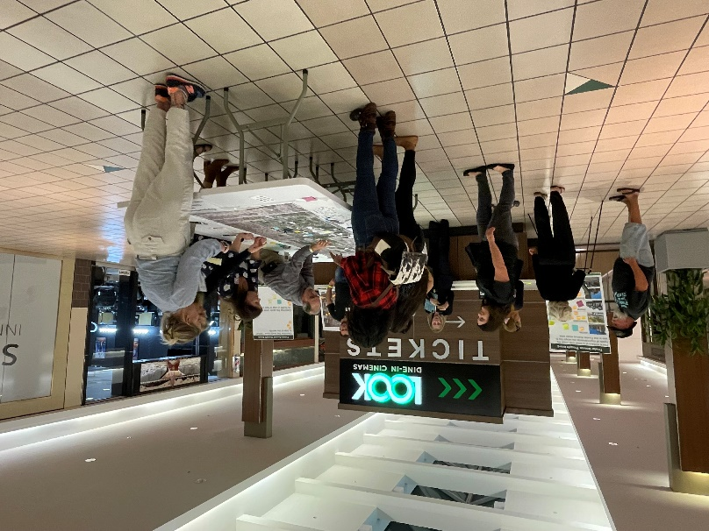
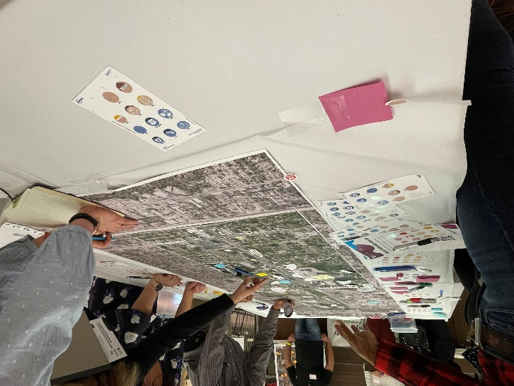
Fowler Avenue Engagement Next Steps
Spring Engagement Activities
Mobile Engagement Lab: February - May 2023
Promote online survey and continue eliciting feedback on the vision for Fowler Avenue and individual character areas
Includes Walk and Talks and other activities to meet people in the community
Stakeholder Focus Group Meetings: February - May 2023
Targeted engagement with businesses, community partners, and neighborhood associations/groups
Opportunity to identify community leaders for the Ambassador program
Community Workshop #2: July/August 2023
Focus on recommendations to support implementation of the Vision Plan
Notes:
Slide Added 1.6.2023

Slide 14
Overall Schedule
Fowler Avenue Vision Study - Project Schedule
Task | 2022/2023 |  |  | 2023/2024
 | Summer | Fall | Winter | Spring | Summer | Fall | Winter
Project Phase | Community Values
 |  |  | Corridor Vision
 |  |  |  |  | Redevelopment Plan
Public Engagement and Outreach Activities
Community Workshop #1
Community Workshop #2
Online Survey
Project Website
Mobile Events
Stakeholder Focus Group Meetings
Presentations to Agencies and Boards
Notes:
Combine/ Create a table with FDOT and HART to show timeline
1.5 year project

Slide 15
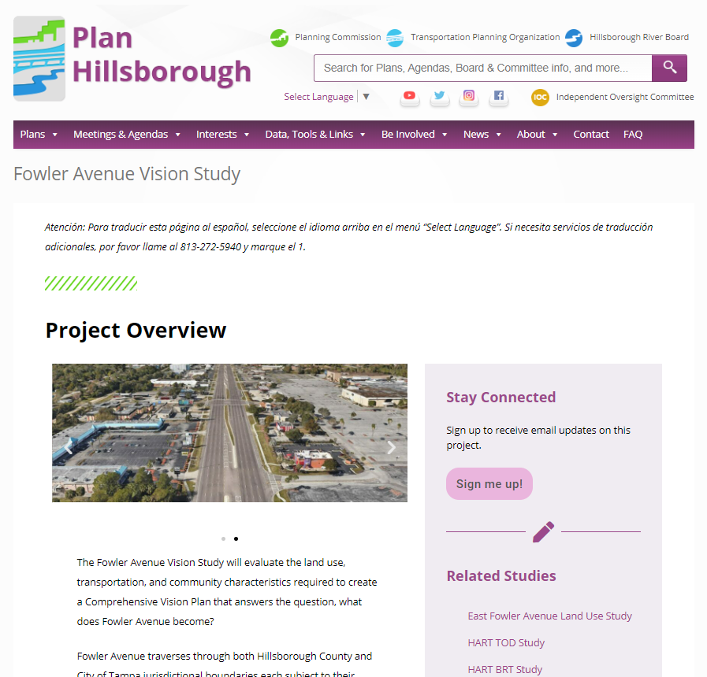
Fowler Ave Vision Study Project Page
Sign up for email updates
Review presentations and other background information
Bookmark upcoming meeting dates
https://planhillsborough.org/fowler-avenue-vision-study/

Slide 16
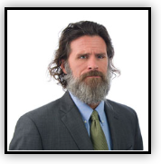
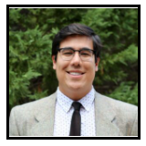
Contact Us
Jay Collins, AICP
Special Area Studies Manager
(813) 582-7335
CollinsJ@plancom.org
Alvaro Gabaldon
Planner II
(813) 582-7349
GabaldonA@plancom.org

Slide 17
Fowler Avenue Vision Study
UACDC Partners Coalition
January 19, 2023
Jay Collins, AICP Alvaro Gabaldon
Notes:
LRC Q’s
How many community meetings are we doing?
Community meetings are hard to get to, people use the bus to get around
Outreach to business and employers of the area?
WellBuilt bike shop may be of help for outreach

